Slide 1
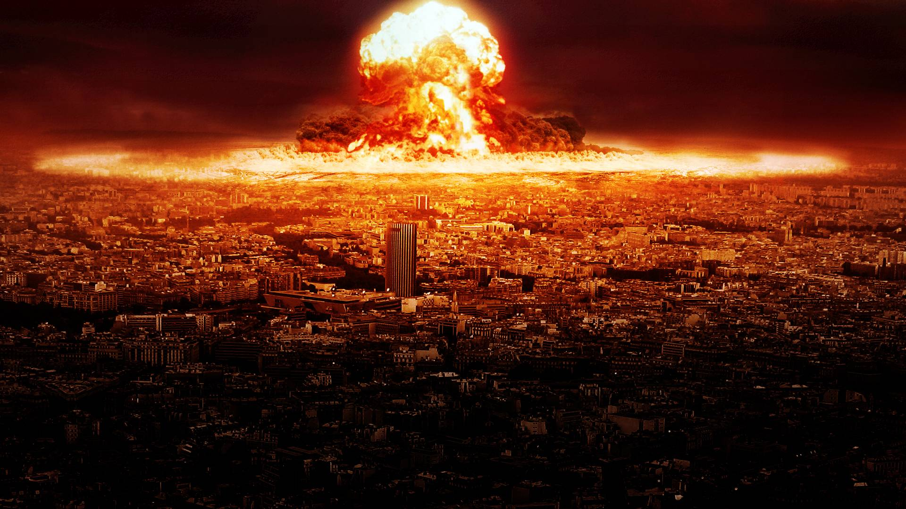
Nuclear weapons and arms control

Slide 2
What is a nuclear bomb?
A bomb that releases nuclear energy either by fission (atomic bombs) or fusion (hydrogen bombs)
Explosive power measure in tons of TNT – e.g. Hiroshima = 20 kilotons: biggest ever 50 megatonnes but 10 megatonnes is average (US).

Slide 3
The main players
The US – first atomic bomb – 1945
Russia 1949

Slide 4
How it works - fission
The Equation
E=MC²

Slide 5
How it works - fusion

Slide 6
The differences between atom bombs and hydrogen bombs
Nuclear fission is a process in which a neutron collides with an atom’s nucleus, splitting the atom into two smaller atoms and releasing a significant amount of energy. Every collision also releases more neutrons, which in a critical mass of fissile material will sustain a chain reaction of fission. By manipulating the size and speed of the chain reaction, nuclear fission can be exploited for power generation or alternatively, for weapons of mass destruction.
Fusion occurs when the nuclei of two atoms combine to form a single heavier atom. At extremely high temperatures, the nuclei of hydrogen isotopes deuterium and tritium can readily fuse, releasing enormous amounts of energy in the process. Weapons that take advantage of this process are known as fusion bombs, thermonuclear bombs or hydrogen bombs

Slide 7
How to make a bomb
Get some 20,000 tons of uranium.
Refine to 50 tons of metal which is a mix of 99% U238 and 1% U235. Heavier 238 atoms will not split, U235 will.
Heat uranium with fluorine and filter through cascades to make the uranium at least 80-90% enriched uranium (U235). By spinning at very high speeds—electrically driven to 70,000 revolutions per minute, in perfect balance, on superb bearings, in a vacuum, linked by pipes to thousands of other units doing the same—this is what the centrifuge achieves.
You need 50kg to make a critical mass that will start a runaway explosion.
Or use plutonium (you only need 10kgs so it is lighter) Average nuclear power plant produces enough to be refined in one year.
Keep apart in halves until detonation and force together with conventional explosive. There you go!

Slide 8
Now and then

Slide 9
Weapons storage

Slide 10
Types of nuclear weapons
Atomic or Hydrogen – fission v fusion. Kilotons v megatonnes
Strategic – Attacks cities, transport, energy and economic infrastructure.
Tactical – battlefield weapons, bunker busters. To be used when combatants are close together – a mini nuke. Pakistan
Suitcase – Small yield 10 kt. 20-40kgs. No suggestion that they actually exist but often seen in the movies.
Neutron – small blast area and minimises blast damage but spreads radiation. Can spread radiation through armour and several feet of earth.
Dirty – non nuclear but spreads radiation. No major damage directly but very hard to clean up afterwards.
EMP – destroys communications. Essentially, such a weapon would render the target’s entire electronic infrastructure useless. Small blast or no blast at all.

Slide 11
The early days
Eisenhower allowed battlefield Generals to decide if they are to be used if HQ is not contactable.
Russia has the same “Perimeter defence”
Kennedy insists on coded switches on all devices (not operable till 1970s) two man system. Same as on submarines.
1990s 8 digit code required. USAF sets them all to 00000000.
Delivered by aircraft before there were ICBMs – first was a Russian missile in 1957.
Big bombs because they were inaccurate – CEP. Cities only targeted because of it – aircraft used for the rest for hardened military facilities.

Slide 12
Who has them and how many– the nuclear club

Slide 13
Delivery systems
Bombers (can be recalled) but very few of them now. Average age 33 years. Most B52s
Submarines (cannot be recalled).
Artillery (discretionary)
Cruise missiles (can be recalled)
ICBMs (Cannot be recalled)

Slide 14
Warning times of an attack
US President has 12 minutes to launch on attack.
ICBM – 20 minutes
Duck and cover exercises in schools
Doomsday 747 ( 4 of them) ready at 5 minutes notice – can stay aloft for days.
Mount Weather bunker Washington DC
Youngest nukes in US 23 years old. Chemically unstable, radioactive material degrades – how many would work since there is no nuclear testing anymore?
$1 trillion to upgrade weapons (US)

Slide 15
Mount Weather

Slide 16
Melbourne and a 20 mt device

Slide 17
And here – a 5mt device

Slide 18
Fall out shelters

Slide 19
The notion of deterrence
The MAD doctrine: no one would be crazy enough to use them theory. Bipolar world view. Based on few owners of nukes.
One is enough – North Korea. Chinese support for NK because of what it might do with nuclear weapons. Multipolar world.
What if Saddam Hussein really had WMDs?
Ukraine regrets giving up its nuclear weapons back to Russia.
Half US force on hair trigger alert. A relic of the Cold War – USAF no longer always airborne but subs and silos on hair trigger still.
China's nukes are not attached to missiles. A lesson for the rest of us?

Slide 20
Unintended consequences
Many of the nuclear-weapon systems on both sides are aging and obsolete. The personnel who operate those systems often suffer from poor morale and poor training. None of their senior officers has firsthand experience making decisions during an actual nuclear crisis. And today’s command-and-control systems must contend with threats that barely existed during the Cold War: malware, spyware, worms, bugs, viruses, corrupted firmware, logic bombs, Trojan horses, and all the other modern tools of cyber warfare.
The greatest danger is posed not by any technological innovation but by a dilemma that has haunted nuclear strategy since the first detonation of an atomic bomb: How do you prevent a nuclear attack while preserving the ability to launch one?

Slide 21
What are they targetting?
All on a menu list in the “Football” along with authentication codes.
Russia: Weapons of mass destruction (510 targets, or “aim points”), 190 leadership aim points and 250 war-supporting-industry aim points. Moscow alone would encompass 100 aim points.
China: WMD (130 aim points), 60 leadership aim points and 250 war-supporting-industry aim points.
North Korea, Iran, Syria: Each country would be covered by many dozens of warheads targeted at North Korea (50 WMD, 10 leadership and 12 war-supporting-industry aim points); Iran (40 WMD, 14 leadership and six war-supporting-industry aim points); and Syria (20 WMD, 13 leadership and 10 war-supporting-industry aim points).

Slide 22
Defcon levels – defence readines condition
Never
Cuban Missile Crisis
Yom Kippur
9/11

Slide 23
Proliferation and non proliferation
One goes nuclear they all go nuclear?
North Korea – South Korea and then Japan?
Iran – Saudi Arabia etc
Current treaties – like the NPT nuclear Non-Proliferation Treaty, which slows the spread of weapons by reassuring countries that their neighbours are not developing nukes.
No “first use” policy. China and India have adopted it but the US has not yet. Need to set a “norm”?
Giving up? South Africa gave up its 6 nukes in 1993. Why? Uzbekistan removed fissile material long ago, Ukraine returned its nukes to Russia eventually but North Korea and Iran are not so accommodating.

Slide 24
Proliferation by theft
In 2004 a Pakistani-run network was exposed run by Dr Khan who had provided information and nuclear-weapons components to Iran and North Korea, and had begun negotiations with a fourth country, perhaps Syria or Saudi Arabia.
intellectual "borrowing" had to varying degrees contributed to the acquisition of nuclear weapons by the Soviet Union, China, Israel, France, India, and white South Africa—and also to nuclear-weapons projects that were ultimately (and perhaps temporarily) abandoned in Argentina, Brazil, South Korea, and Taiwan.
And the use of spies after the war - Klaus Fuchs who worked on the Manhattan project. Ethel and Julius Rosenberg.

Slide 25
The numbers

Slide 26
How safe are countries’ nuclear materials?

Slide 27
Progress

Slide 28
Acronyms in US/USSR/Russia co-operation on nuclear weapons
SALT 1 and 2. . SALT 1 limited the number of warheads.
SALT 2 was an anti ABM treaty
START 1 and 2. This treaty was designed to reduce the number of warheads.
NPT – Non proliferation Treaty – see next frame.
Comprehensive Test Ban Treaty 1996. Tests are now simulated.
New Start Treaty 2011 effective 2018 limits set 1550 war heads.
18 visits to check per year as well as satellite and remote monitoring.

Slide 29
The NPT

Slide 30
Near misses
The Korean War – 1951
Off shore Island Crisis – 1958
Goldsboro crash - 1961
Cuban blockade – 1962
6 Day War - 1967
Yom Kippur – 1973
NORAD Training exercise - 1979
During the Cold War, false alarms were also triggered by the moon rising over Norway, the launch of a weather rocket from Norway, a solar storm, sunlight reflecting off high-altitude clouds, and a faulty A.T. & T. telephone switch in Black Forest, Colorado

Slide 31
Hair trigger missile status.
Obama, while running for President in 2008, promised to take Minuteman missiles off alert, warning that policies like launch-on-warning “increase the risk of catastrophic accidents or miscalculation.” The Missiles are still there ready to go.
the Air Force has successfully fought against adding a command-destruct mechanism, fearing that an adversary might somehow gain control of it

Slide 32
Hair trigger alert
The United States still keeps its 450 silo-based nuclear weapons, and hundreds of submarine-based weapons, on hair-trigger alert.
The Russians do the same.
Removing hair trigger status would still leave largely invulnerable SLBMS available to retaliate.
All US missile silos have a safety switch that is used to prevent a launch of the missile when, for example, maintenance crews are in the silo.
The United States could remove its land-based missiles from hair trigger alert by turning this switch to the safe position in each silo.

Slide 33
How to start a war
A US President has the codes for launching attack with him at all times. – the biscuit
Carried in a suitcase that is called the football
Carter, Reagan and Clinton all lost their “biscuits” or authorisation codes.
The President can authorise a strike without consulting Congress.
Trump and nuclear weapons – would he use them as a first strike or against terrorists?
And outside of the US?
1 – India and Pakistan conflict
2 – North Korea if backed into a corner.

Slide 34
What would Trump do?
No checks and balances on a President particularly Trump - "My primary consultant is myself,“. “Russia has outsmarted us on START”.
Limited warning 30 minutes ICBM – 12 minutes from west of Bermuda a favourite spot for Russian SSBNs. Putin has 2 – 4 minutes to decide.
How would he perform under duress? Missiles are coming in at 7kms/second. Jimmy Carter and the 1979 false training tape alarm.
Take the President out of the loop?
Nixon taken out of the loop during Watergate because of depression and heavy drinking?
Obama – reduce nukes – Trump build more and modernise $1.2 trillion US. Remove land based missiles altogether out of the Triad?

Slide 35
Trump 2
US less reliant on nuclear strike as the military revolution in non nuclear, precision guided devices has improved enormously.
Trump has repeatedly said he is afraid of nuclear weapons and would not use them first.
South Korea and Taiwan talked out of nuclear programmes by the US who promised a nuclear umbrella. Will Trump’s isolationism change that?
He has said that he is not worried if South Korea, Japan and Saudi Arabia have nukes .
Tends to see things in black and white – impulsive. Could he have good advisors around him? Or........

Slide 36
Trump’s pledge

Slide 37
The new arms race
Smaller weapons but less destructive – is that positive?
Removing land based missiles in silos in the US and tacticals in Europe would save $100 billion over the next two decades. Use Sub and bombers instead. Silos – morale and drug problems.
Stops needed for launch on warning. Subs and bombers less vulnerable to cyber attack and give us time to evaluate the real threat.
A new arms race in conventional weapons – maintaining a technological lead over China and Russia. Armed drones with recognition software. Can distinguish between a rifleman and a photographer. Autonomous vehicles, robot ships that hunt subs, missiles that can decide what to attack now being budgeted for.
Terminators 10 years away – will they be built?

Slide 38
And the third world
Some countries want nuclear weapons to prop up a tottering state. Pakistan insists its weapons are safe, but the outside world fears that they may fall into the hands of Islamist terrorists, or even religious zealots within its own armed forces.
Pakistan creating mini nukes to stop an overwhelming Indian attack?
When history catches up with North Korea’s Kim dynasty, as sooner or later it must, nobody knows what will happen to its nukes

Slide 39
And of there is this....

Slide 40
Missile tests

Slide 41
North Korea’s missiles

Slide 42
Other concerns
All nuclear armed countries are upgrading their arsenals.
Russian defence budget has grown over 50% since 2007 and most of it is spent on nukes
North Korea ten so far and adding one a year.
Arms race in the Middle East. If Iran develops one so will the Saudis and the perhaps Egypt. Israel already has that capability – a 4 way stand off?
Countries most affected (US/Russia) are not talking. Best to get to know your adversary in less stressful circumstances.
Putin – nationalistic, violent and intimidatory.

Slide 43
Why nuclear weapons should not be eliminated.
There has never been a war between nuclear armed states in over 70 years.
Nuclear weapons make the cost of war unacceptable
Super powers have scrupulously avoided combat –war by proxy only.
India/Pakistan fought three wars before they both got nuclear weapons. None since!
What about the unhinged? Mao and Krushchev probably were and even Ahmadinejad was reined in by the clerics.
1964 China gets the bomb two years before the Cultural Revolution – but that did not threaten their use. When the USSR broke up the weapons were first secured.
Rogue states unlikely to give weapons to terrorists for their own safety’s sake.

Slide 44
Not so dangerous?

Slide 45
The case for nuclear weapons remaining
Even if Pakistan imploded the Taliban would have trouble – these weapons have complicate firing sequences, locks and can be easily disarmed. They also require constant maintenance for neutron triggers – polonium.
Expensive and controversial which is why South Africa, Ukraine, Belarus and Kazakhstan gave up theirs. Brazil, Libya and Argentina did not go ahead.
A scary bargain – you accept that something bad could happen in exchange for a conventional war.
Weapons create a level playing field and is the ultimate defence.
A lot of effort has gone into securing loose nukes.
Iran deal a good one. Slows down production limits in exchange for lifting trade bans.
More trouble than they are worth.

Slide 46
The good news
today, Russia has only a hundred and fifty land based missiles, which are rarely moved from their bases and more readily detected by satellite. Russia’s ten ballistic-missile submarines now spend most of their time in port, where they are sitting ducks.
China keeps the warheads separate from delivery systems.
Russian early warning satellites now severely degraded.
The nuclear arsenal will be modernised in the US making it less vulnerable to cyber attacks.
Deterrence still works. The costs of a war that might involve their use is unacceptably high.

Slide 47
Nuclear power generation

Slide 48
Nuclear Power plants.
As of May 2016, 30 countries worldwide are operating 444 nuclear reactors for electricity generation and 63 new nuclear plants are under construction in 15 countries.
Nuclear power plants provided 10.9 percent of the world's electricity production in 2012.

Slide 49
Nuclear power for and against
For
It is safe.
It is cheap.
It is non polluting.
Nuclear fusion – cheap energy from non radioactive materials
Thorium reactors (abundant material available, cheap and with reduced waste)
Against
It is can be made into nuclear weapons.
Renewables are a better option
Unsafe – no effective way of storing radioactive waste
Expensive to start up and decommission
Takes a long time to set one up.

Slide 50
Reading

