Slide 1
Russia under Putin
USSR/Russian relations with the West

Slide 2
Russia - it’s big!
Siberia takes up 77% of its landmass but less than 20% of its population.
Record Low - -68C
Divided by Ural Mountains.
11 time zones.
Same latitude as Canada.

Slide 3
How Russia became Russia

Slide 4
How did Russia become Russia?
862 – Russia a collection of some cities. Rurik crosses the Baltic as part of the Viking expansion and sets up in Novgorod. Mercenaries
882 - his successor Oleg captures Kiev. Kiev becomes a major trading centre for 300 years. Reaching out for the prize of Constantinople.
989 - Vladimir first reaches southern Russia – establishes state religion as Greek Orthodox.
1237 – Mongols destroy Kievan Rus. The rest pay tribute.
1240 - Swedes invade followed by Teutonic knights in 1242. Both def by Nevsky.
1252 – Berke Khan in Russia converts to Islam while Mongke Khan destroys the Caliphate in Bagdad in 1258.
1480 - Ivan the Great the ruler of Moscow defeats the Mongols at the Ugra river. (Tatars) and his son Ivan the IV (the terrible) unifies Russia. The first Tsar. Mongols pushed back and Siberia opened up to Russian expansion. Cossacks.
Fyodor, Dimitri, the Poles and Boris Godunov. The time of troubles.
1613– 16 year old Michael Romanov made Tsar. The Romanov Dynasty lasts till 1917. Great Romanovs – Peter the Great and Catherine the Great.
1812 – Napoleon Invades.
1917 - Soviet era starts. Germany inserts a virus?
1941 – Germany invades.
1945 – 1948 Territorial gains in Europe
1991 – Soviet era ends.

Slide 5
Russian expansion

Slide 6
After World War 2

Slide 7
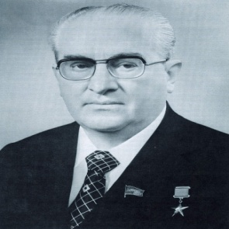
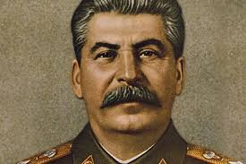
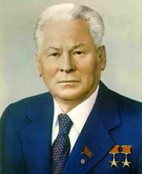
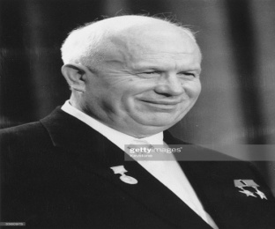
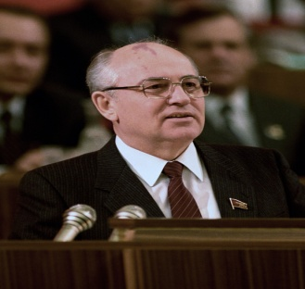
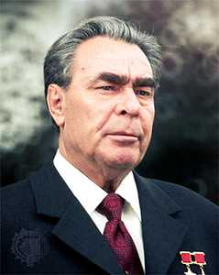
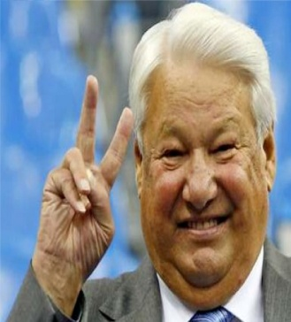
A little historical background
Lenin 1917 - 1928
Stalin 1928 - 1953
Krushchev 1953 – 1964
Brezhnev 1964 – 1982
Andropov 1982 – 1984
Chernenko 1984 – 1985
Gorbachev 1985 – 1991
Yeltsin 1991 – 1999
Putin 1999 – 2008
Medvedev 2008 – 2012
Putin 2012 - ?

Slide 8
Remember this about Russian leaders
hairy ones follow bald ones

Slide 9
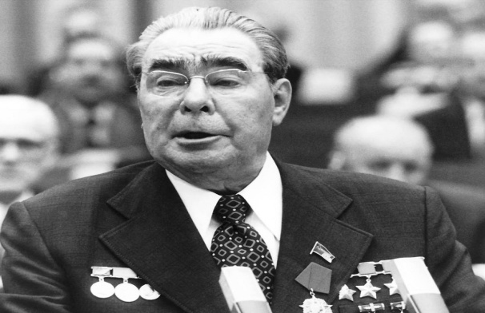
Brezhnev – (1964-82 )
Removed Krushchev while he was on holidays
Relations deteriorate with China
Border clashes in 1969 with China
Supported North Vietnam
Detente with the West
1970s achieved nuclear parity with the US
Helsinki agreement 1975 recognises European boundaries
Extended USSR influence in the Middle East and Africa
Detente ends in 1979 with USSR invasion of Afghanistan
Olympic boycott of Moscow games

Slide 10
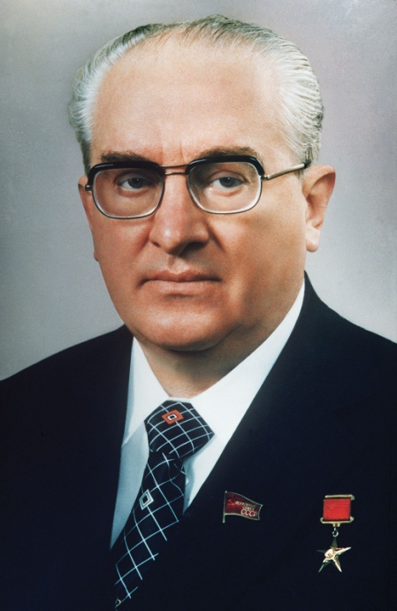
Andropov – 1982 - 1984
Died at 84 – kidney failure
Made attempts to improve the economy
Anti alcohol measures.
Weakened relations with the US
Missile deployment in Europe,
Shooting down of KAL 007 1983

Slide 11
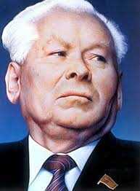
Chernenko 1984 - 1985
Often absent – caretaker, interim leader
Very ill.
Relations with US continued to worsen
Russian boycott of LA Olympic Games
Invested money into consumer goods
Died cirrhosis of the liver and emphysema

Slide 12
Gorbachev 1985 - 1991
Glasnost and Perestroika.
INF treaty 1987.
Met Reagan in Iceland.
Withdrew troops from Afghanistan
Loosens grip on Eastern Europe. Pro democracy activists win in Eastern Europe 1989.
Communist party stripped of power.
November 1989 – Berlin Wall comes down.
Nobel Peace Prize 1990.
Coup while in Crimea on holidays. Coup led by hard liners. Boris attacks parliament and saves him.
Forced to resign 1991.

Slide 13
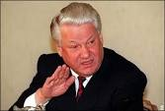
Yeltsin 1991-1999
First President and first elected leader.
Gained 57% of the popular vote.
1991 – Ukraine votes for independence.
USSR breaks up into CIS (1991)
Privatisation of state run services results in inflation, unemployment in state enterprises and heavier taxation.
1993 State Deputies move to impeach Yeltsin – 62 votes short . Yeltsin disbands chamber of deputies
1994 – invasion of Chechnya. Withdrew in 1996
1996 – re- elected
1998 Russia defaults on debt repayments, rouble collapses
1999 Dec 31 – resigns in favour of Putin
2007 – dies of heart attack aged 76

Slide 14
Boris Dancing

Slide 15
Problems facing Russia after the break up of the USSR
During the Cold War 25% of GDP went to defence in the Cold War – hard to retool and reinvent
Most cities had only one large enterprise. Decrease in production leads to massive unemployment
No functioning system of social security ( factories did that)
The human side – communism created jobs and hence inefficiencies – hard to re-adjust to a free market economy
Begging becomes common in the 1990s – barter replaces pay in some quarters as workers wait for pay.

Slide 16
Popular reaction to the fall of the USSR
Reagan given the credit. Russians humiliated
Solzhenitsyn and Afghan veterans return to a foreign country.
Loved the prospect of freedom but ended up with capitalism – something foreign to Russia. Every man a capitalist?
Living by Darwin’s laws – Russians not ready?
Hyperinflation – and unemployment – savings lost – Gaidar.
Russian capitalism at the same stage of early US capitalism.
Older Russians told their lives were a dreadful waste. Thrown on the scrapheap and yet many still committed to Communism.
Older generation don’t think the young could defend Russia.
Nostalgia for a Stalin despite his record. Whitewashing of history?
Sets the ground for a new Stalin - Putin

Slide 17
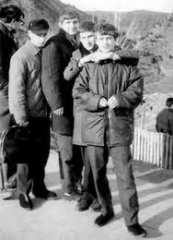
Young Putin – a quick summary
Born 1952 in St Petersburg
Joined KGB in 1975.
1980s - a KGB Lieutenant on duty in Germany.
Retired as KGB Colonel in 1991
Deputy mayor of Leningrad in 1994
1996 – moves to Moscow
1998 – Yeltsin appoints him head of Kremlin’s relations with regional governments.

Slide 18
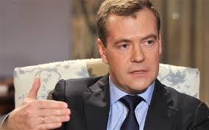
Medvedev (2008 – 2012)
Putin puppet – had popular appeal – another one from St Petersburg. Came out against corruption – fired Moscow mayor for corruption.
2008 – South Ossetia war. Came out against Georgia who supported Abkhazia against South Ossetia. Georgia forced to withdraw from both.
2008-9 economic recession. Government stimulus package –economy picks up again 2010
Putin reverted to position of Prime Minister.

Slide 19
A digression - Russian political structure
President 6 year term – has power over appointments.
No limit to Presidential terms in office but may not hold office for more than 2 consecutive terms. Hence Medvedev – Putin Swap and back again.
Prime Ministers is the stand in in case President reigns or dies – a VP
Russian Federal Assembly – Lower House (Duma) 450 members – no real power. Proportional voting – 7% minimum need to gain a seat – highest in Europe. Cuts out small parties and independents. 5 Year term – elections later this year.
Federation Council / upper House (Senate) – 170 senators terms not fixed but locally decided.

Slide 20
Russian political structure 2
Political parties
United Russia (49% of reps – lost ground in 2011 elections. (Putin’s party)
Communist Party – main opposition – 19%
Fake opposition party – Just Russia – 12%
Liberal Democratic Part (ultra nationalist party) – 12%
Yabloko party – western Oriented – 3.5%

Slide 21
Vladimir Vladimirovich Putin
Member of the St Petersburg mafia – close friend of the mayor
Stops the break up of the Russian Federation
Puts the Kremlin back at the centre of decision making
Stands up to the West to stabilise Russia?
Recovers lost prestige after the humiliation of the end of the Cold War.
1999 – orchestrated apartment bombings. FSB? Explosives – warning three days before – Putin swears revenge – popularity rises – 2nd Chechen war. Investigators killed off.
2000 – in trouble after the sinking of the Kursk. News conference fiasco.
2003 – wins Russian election with the United Russia party. Sponsored by state TV.

Slide 22
Putin
Renationalises state owned enterprises that Yeltsin sold off to the highest bidder. E.g. Yukos Oil.
Cuts all tax to 13% hoping that all will pay it
Removes Media barons and frightens off oligarchs after Kremlin meeting.
2004 – wins 2nd term as President (71%)
2004 – Beslan hostage crisis. Putin now puts provinces under central control.
Disposable income doubles in Russia from 1999 to 2006 thanks to rising oil prices. $140 a barrel
2006 IKEA leaves Russia because of corruption.
A Kleptocracy? 110 people control 35% of Russia’s economy. Sochi fiasco.

Slide 23
Putin (2012 - ?)
2011 election a fraud? Massive protests
Macho image – Russians still hanker for a Tsar or a Stalin?? Putin and the night wolves bikies and Poland.
2014 – annexation of Crimea. Russia gets its way but at the expense of sanctions.
2014 – July MH17 shot down by Russian advisors in the Ukraine? Bad cover ups!
2014 – Russian sub trapped in Swedish waters?
Air Force conducts aggressive intrusions to test NATO defences?
2014 – 7% growth drops to 0.6% growth as a result of Westerns sanctions and dropping oil prices.
Baltic states nervous – Sweden and Finland consider joining NATO.
Latvia, Lithuania, Estonia, Hungary, Romania and Poland already members.

Slide 24
Vlad and The Night Wolves

Slide 25
NATO map

Slide 26
Russia under Putin
Closer co-operation with Asia whose emerging economies need Russian oil and gas.
2014 – two gas deals with China – one worth $400bn
Europe spurns Russia so are they looking eastwards –a “pivot to Asia” same as the US – note naval exercise with the Chinese.
Crackdown on dissent at home. Bloggers must be registered, sites blacklisted – press controlled. 5 years jail for unauthorised protests. Ruthlessly stamped out spring flowering of 2011/12.
2011 – United Russia loses majority but Putin wins – 100,000 in the streets yelling “Russia without Putin”. “Putin thief”.
Nemtsov shot dead – main opposition leader. Opposition called a “fifth column”. Election monitors called “Foreign agents”
More Russians winding up poisoned over seas. Kursk protest injections.
Apartment bombing deaths and the man who knew beforehand.

Slide 27
Putin’s friends – the band of brothers
Karen Dawisha – 110 people control 35% of Russia's wealth
Nearly all have a Security background
Late 80s KGB (now FSB) moved Communist Party bank accounts to the West/foreign partnerships
Putin as a KGB man knew where the money was.
Massive corruption tolerated because of rising wages, sidetracked by the war in Ukraine and the Kremlin control of television.
Protests to resume if economy starts to falter?
Russian opposition leader Navalny convicted of embezzlement – targeted Putin allies as corrupt. Now cannot run for President in 2018. Did well as candidate running for Moscow mayor.

Slide 28
The sanctions - it gets personal
http://www.bbc.com/news/world-europe-26672800

Slide 29
Steam rolling cheese

Slide 30
The Russian economy
Russia is fragile. The economy is failing. The rise in oil prices after 2000, when Putin first became president, provided $1.1 trillion of windfall export revenues for him to spend as he wished.
But oil prices are three-quarters down from their peak. Russian belts have tightened further because of sanctions imposed after Mr Putin attacked Ukraine.
Living standards have fallen for the past two years and are falling still. The average salary in January 2014 was $850 a month; a year later it was $450.

Slide 31
At home
Conservative morality – anti gay propaganda
Using world war 2 experiences as a rallying point.
Banning food imports from the west leads to inflation, delights Russian farmers and is bypassed through Belarus
Western embargo after the Crimean war includes access to finance, exporting of high tech equipment and dual use manufacturing from the west.
Back to the old days? More Russian than at any time in the last 25 years? Censorship. Repression etc. Revival of cults of Lenin and Stalin?

Slide 32
Problems
Now spends more on defence than the US.
Western sanctions bite.
Falling oil prices ( no thanks to OPEC and the Saudis)
Oil amounts to half their exports ad funds 40% of the national budget
Allied to unpopular causes – Bashar Al Assad in Syria
Money flees abroad with the oligarchs – londongrad?
The battle between centralism and regionalism in Russian politics.
Population falls from 150 million in 1990 to 142 million in 2008. Life expectancy for men now 64. Vodka?
Russians are increasingly gaining a taste for democracy – a work in progress? Or are they not interested?

Slide 33
Nuclear weapons stats

Slide 34
And more problems
Russia is suing the Ukraine over debt.
Europe trying to lessen dependence on Russian oil and gas ( not working 63% of natural gas imported from Russia) pipeline runs through the Ukraine– US as a new supplier?
Poland calls for NATO troops to its borders.
Serbia and Armenia moving gingerly towards the EU.
Russia feels disrespected.
Long term closeness with the Chinese only a remote possibility
US quadruples military spending in Europe.
Russia cuts out the US in the Middle East after closer ties in Syrian peace deal with Iran and Turkey.

Slide 35
Russia and the West
Russia feels aggrieved that the US violated agreements not to include eastern European nations into NATO? America boasts it won the Cold War.
Russia wants that buffer zone back.
Needs to co-operate with European economies. Back off from Assad and greater co-operation with anti ISIS forces.
Running out of friends? Needs better ones than Syria, Iran, Venezuela, Nicaragua, Bolivia and North Korea.
Easier to manage better relations now than in 1962.
Trump and Vlad – a bromance? Trump to lessen ties with NATO – an opportunity for Russia?

Slide 36
From the Russian point of view
The country has no natural defences. It is open to invaders. Still living with fears of the Mongols? _ Moscow got its independence because Mongols underestimated it – paid its dues always on time.
It has been invaded by Swedes, Poles Lithuanians, Mongol hordes, Napoleon and the Germans
It is vulnerable – Germans came within sight of Moscow in 1942
20 million died in WW2 and Russia carried the brunt of the fighting.
Chinese regard Soviet Far East as “stolen territory”
Crimea only given to the Ukraine in 1954. Never part of Ukraine
Russia entitled to its own sphere of influence as the US has?
The whole world is against Russia – the Olympics.
Nationalistic grandstanding consolidates Putin in power.
No alternative to Putin.

Slide 37
Russian paranoia
Hard to defeat poisoned public opinion in Russia
EU and NATO are after Russian lands – commonly believed
Conspiracy fuelled media. Believe what you see.
Existential fear, deep resentment, manifest insecurity and profound mistrust dominates Russia's thinking about the West and especially the United States.
Most Russians today see the world as consisting mainly of intransigent enemies of Russia engaged, at best, in a zero-sum game, or, at worst, in a hidden war against their motherland.
How to make Russians believe that this is not so?

Slide 38
The Russian mentality – and its influence on foreign policy
An imitation democracy – rules/institutions are there but often swept away by bargaining, force, trade offs rather than compromise. Russian Navy in our waters for Putin visit after “shirt front” and MH17.
Western values on its borders.
Aggressive rhetoric used to mobilise society
Russians a willing partner? Apathy, inertia and passivity (82% poll).
Democracy important in Moscow and St Petersburg – concerns of the elite.
60% still live in small towns and villages- traditionalist. Rarely travel abroad – main source of information is state TV

Slide 39
The Russian mood
90% do not belong to any organisation – apathy?
77% believe Russia has enemies abroad.
60% see criticism of Russia as aiming to weaken Russia
Identify democracy with the chaos of the 1990s and blame the West for it. A need for security?
Ruling elite the siloviki background in security services – a closed society whose main is to restore Russia’s prestige and to become wealthy in the process.
Use WW2 as a means to legitimise current regime. What happened in Baltic States and Poland does not matter.

Slide 40
The Russian Mood – patterns and stereotypes
Russia has its own destiny different from other countries
Small countries are vassal states – it depends on whose
Wars are waged for geopolitical reasons not idealistic ones.
A tendency to think that fear creates respect
Foreign policy is a matter of deals. The truth “tradeable”? (Katyn and the Poles). MH17?
A tendency to see post soviet countries as traitors not as “prisoners”
The West wants control of Russian resources.
Ukraine most like Russia – if revolution/democracy works there so can it then in Russia.

Slide 41
Russia and its enemies
Cold War V2.0 as Russia moves missiles close to Baltic states and the US moves troops to Poland
The frozen war in Ukraine and the bombing of Aleppo are recent provocations – no “rules of the road” anymore as there were during the Cold War? Could Syria be a trap for them?
Putin is trying to challenge western diplomatic alliances – notably with Turkey, Egypt, China and Libya.
Russian Cyber warfare stepped up?
Europe divided between sanctions and detente.
Trump and Putin – a bromance? End of sanctions? What if Trump does not follow through? Republicans not happy with his pro Russian stance. Russian parliament jubilant! If US is no longer the enemy what will Putin blame? If both leave Syria what will happen to Syria?
Russia blamed Clinton for Georgia’s rose revolution and the orange revolution in the Ukraine in 2004.
Russians livid that the agreement that ex communist states would not be poached by NATO was broken.

Slide 42
Russians in Central Asia

Slide 43
Russians abroad
Moscow furious that Latvia and Estonia do not give Russians automatic citizenship.
Russians living in Central Asia (who are most certainly discriminated against) do not get a mention as Moscow make Central Asian states an ally.
In Georgia Russia used citizens living aboard as a pretext for war.
Using business to further state ends – e.g.. Gazprom demands immediate payment from the Ukraine and shuts off gas – not done to Western countries.
In Syria not for nation building so no quagmire – scatters Syrian refugees amongst his foes in the EU. Worried what the fall of Assad would do for Russia’s future?

Slide 44
Russia reaching out
Naval exercises with China
Talks with Turkey
Single actor advantage vs. The EU
Air base in Iran – its own legitimate sphere of influence?
Missile ships in the Mediterranean.
Anti terrorism – common ground with the West?
Brexit and Trump a bonus for Russia? Less confrontational? Defence a real drain on the Russian economy.
Trump win a real bonus – but will it last?
Ukraine and Crimea likely to stay as they are. Minsk agreement (2015 ceasefire).
Russia always more West than East as time will tell.

Slide 45
Putin and Trump
Clearly the Russians interfered in a close election but why is the response so muted?
Democrats don't want to sound like sore losers and Republicans don't care as long as their candidate won.
Drove a wedge between US and the Europeans.
Drove a wedge between Trump and the intelligence community.
Divided Republicans in Congress over Russia? Trump too close to Putin?
Adulation of Putin part of a macho culture – a yearning for a dictator?
a freer hand for Russia worldwide?
Trump has threatened to jail his political opponent, to sue women who accuse him of sexual assault, to limit reporters’ access to him and his events, and to change libel laws to make it easier to punish news organizations that report facts about him that he doesn’t like.

Slide 46
Reading list - Stalin’s Russia and a superb oral history

Slide 47
Best book on Putin?

Slide 48
And another one – download as PDF

Slide 49
And the 300 year reign of the Romanovs

