Slide 1
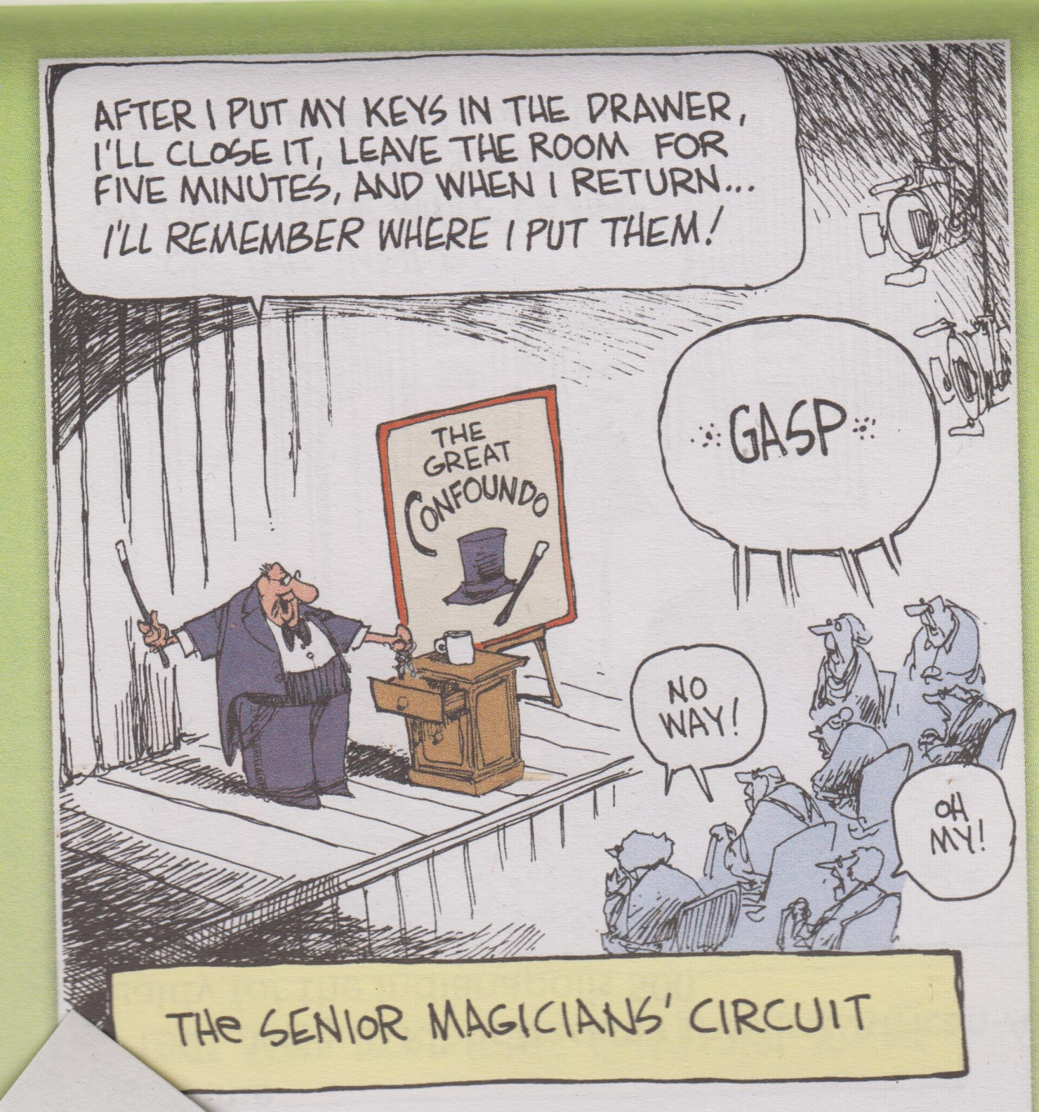
The senior magician

Slide 2
This week in International relations
Iran nuclear deal. What will the EU do? Will it hasten the day when international trade is conducted in Yuan rather than dollars? Iran to fold if sanctions reintroduced. Did not work with the Cubans. EU to protect businesses trading with Iran. But Maersk pulls out carrying Iran Oil. EU split over allowing Macedonia and Albania to join the EU.
SCS – China installs anti ship and ground to air missiles. H6 bombers also arrive. Aimed at the region not the US?
Australia and the US the only two to vote down an inquiry into deaths in Gaza.
Brexit – stay in the Customs Union – what is it? It means free trade with no tariffs on goods sold within the EU. Great for car makers. Goods coming into the Customs Union all attract the same tariff. No room to negotiate individually. Will it destroy Britain's “take back control”?
Trump gave Kim two options: reach an agreement to denuclearise and remain in power or suffer the fate of Libyan leader Gaddafi. Then Trump said that Kim would stay in power if he denuclearises and the NK economy would be rebuilt. North’s chief nuclear negotiator declared that the country would never trade away its nuclear weapons capability in exchange for economic aid. Trump now worried about proceeding with the meeting.

Slide 3
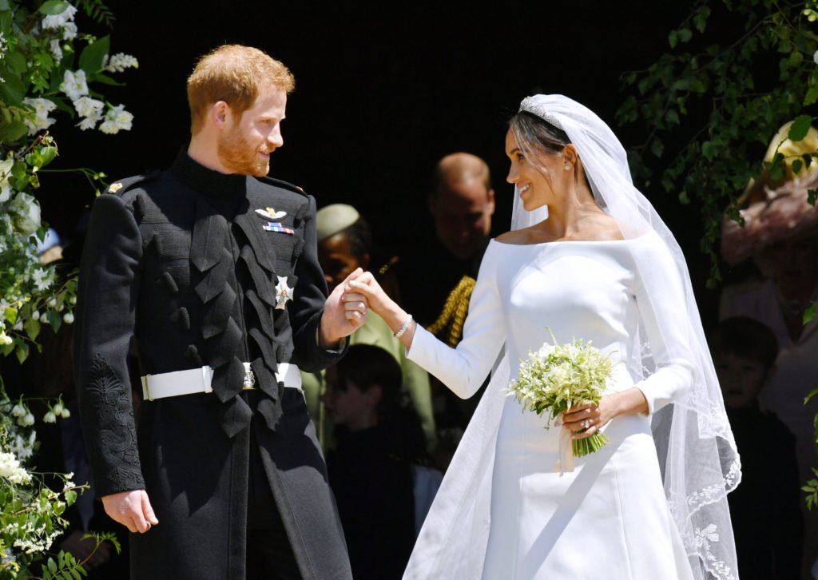
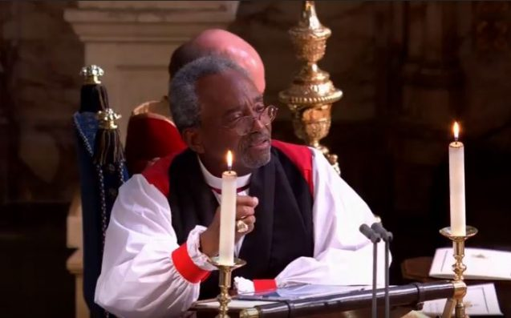
And that other event

Slide 4
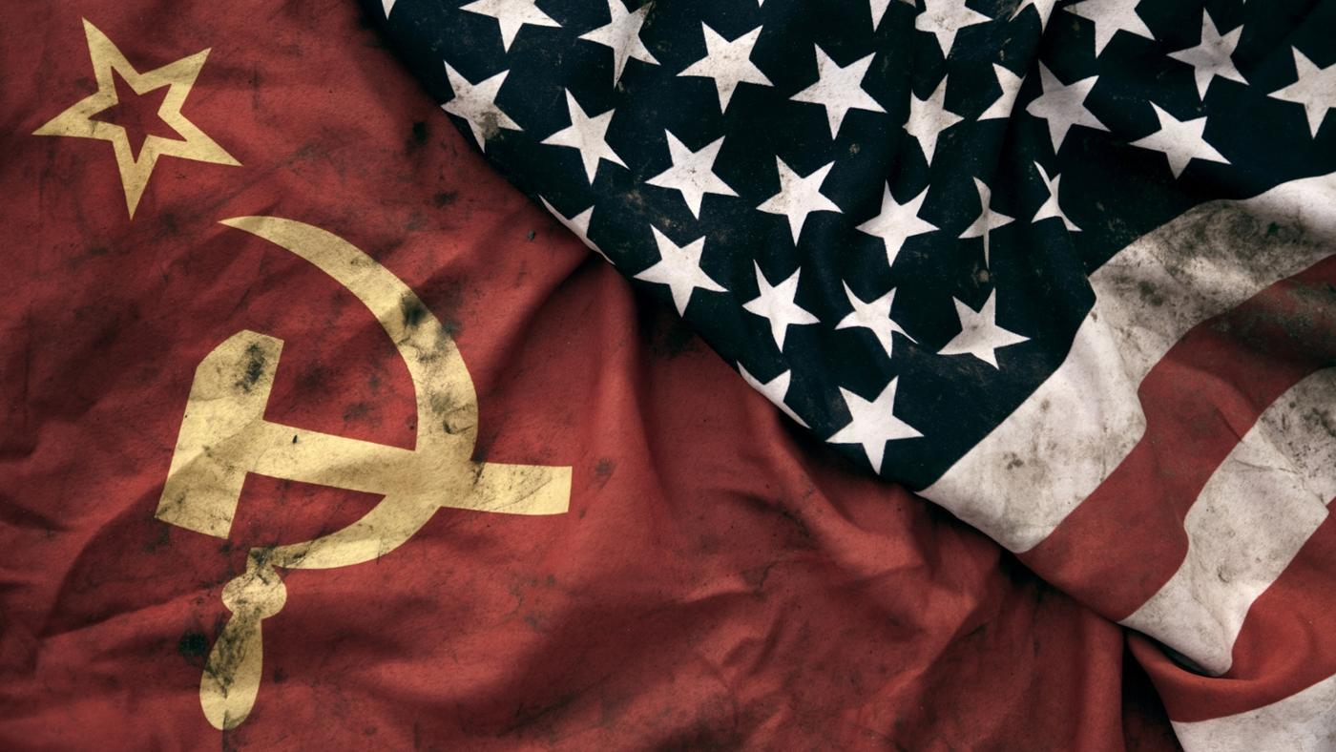
The Cold War
U3A Wodonga 2018

Slide 5
The Scale of the Cold War
A global conflict. Almost everyone drawn in. US in Vietnam, Cambodia, Laos and Korea. Turks, Algerians and Chinese.
Cuban in Angola, Saudis fight Russians in Afghanistan.
Proxy wars in Latin America and Africa.
Weapons sold around the World.
The Space race – Sputnik and the race to the Moon.
Ethnic and nationalist conflicts take on new depths. India and Pakistan, China and Taiwan, Ethiopia and Somalia.
Not global as in troop movements but rather global in terms of social and economic effects of the conflict.
Cold War takes up 10% of GNP in the US. Ruins the USSR.
Highways constructed primarily for the military – pipelines near roads in Europe.
The Internet – communications redundancy in case of a nuclear exchange.
Dominated thinking and culture.

Slide 6
The relationship was strained to begin with
The West supported the whites against the reds in the Russian civil War in the 1920s.
The Bolsheviks withdrew from the conflict with Germany with a separate peace treaty.
Promoted incompatible ideologies world wide – The US pushed Liberal democracy. The USSR put the state above the individual.
The US – the world has right to self determination and a democratic government.
The Soviets have a state planned and controlled economy while the US has a market based economy.
Central planning in the USSR led to farm collectivisation. Peasant revolt who destroyed livestock rather than hand them over to the collective farm. Kulaks
Vast famine – 5 to 6 million died. USSR associated with a lack of freedom, nationalisation of private property and curtailment of civil liberties.
1930s – secret police, show trials, labour camps, gulags.

Slide 7
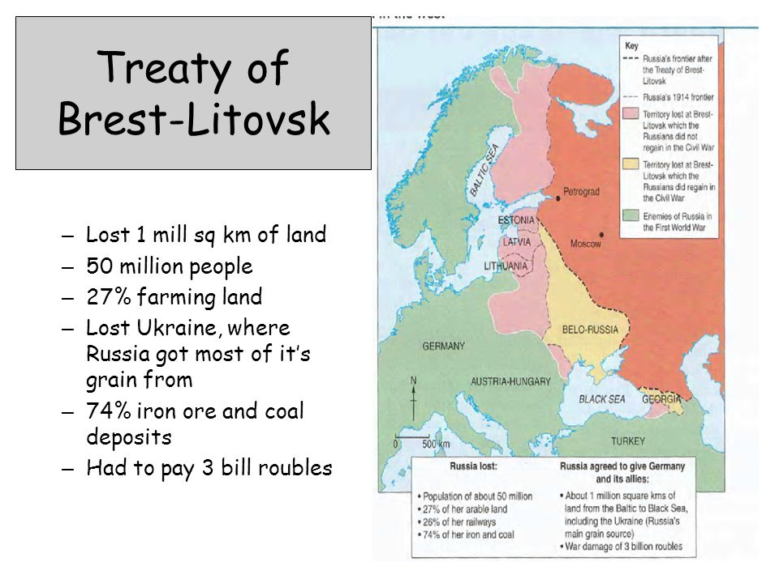
The Treaty of Brest - Litovsk

Slide 8
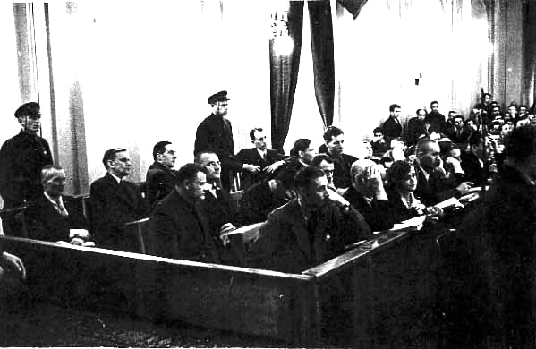
Show trials – the Metrovic trial

Slide 9
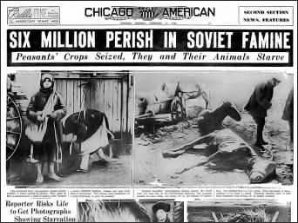
Famine in the Ukraine

Slide 10
The 1930s and 40s
Stalin starts purges but the US is occupied with the Great depression.
Stalin rigid and repressive. Signs no aggression pact with Hitler in 1939 which allowed Hitler to attack the Wet. USSR attacks Finland and Poland.
June 1941 – Hitler attacks Russia.
Pearl Harbour – December 7th 1941.
1942 – Stalin asks for a Second Front to take pressure off Stalingrad. D Day does not arrive until June of 1944. Russians believed that the West was hoping that the Germans would destroy them.
Germany 30 divisions in the West and 250 divisions in the East.
20 million dead in the USSR. The West admired Uncle Joe and the sacrifices the Russians made.
End of the War cordial relations but it is a new world. UK is out of the picture. WW2 brought superpower status to the US and the USSR but France, Britain and Germany devastated.
1946 – Churchill “Iron Curtain” speech.

Slide 11
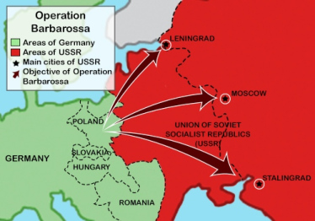
Operation Barbarossa – the invasion of the USSR

Slide 12
Post War
Europe divided up post war at the Yalta conference. Stalin gets part of Finland and East Poland. Roosevelt pre-occupied with setting up the UN. Churchill pre-occupied with Stalin's’ land grab in Eastern Europe, the Balkans and the Black Sea.
USSR increased its population by 24 million. Local communist come to power – a buffer zone for the USSR? Or Tsarist imperialism.
US wants to bring the troops home however Truman wanted a tougher stance.
Post War reconstruction of Germany – millions displaced, infrastructure in ruins and hunger. Communists had a ready appeal as most were leaders in the resistance.
Communist governments in Poland, Hungary, Albania, Yugoslavia and Czechoslovakia. France and Italy ha large communist parties.
US had nukes but the USSR did not.

Slide 13
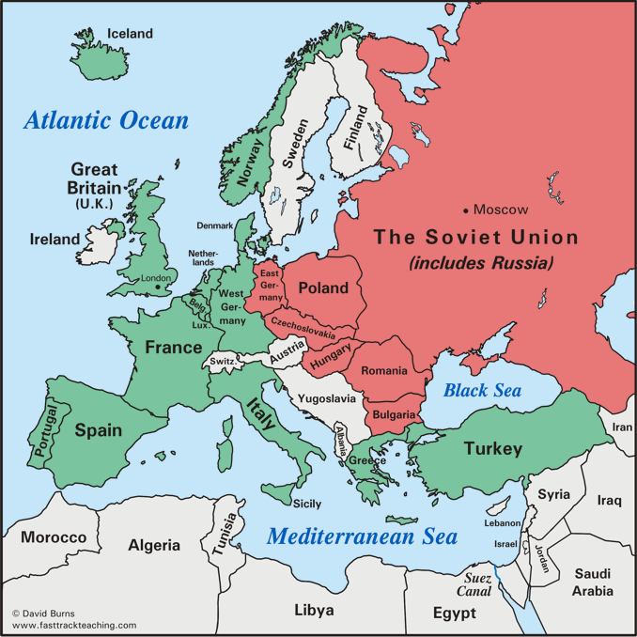
Europe 1945

Slide 14
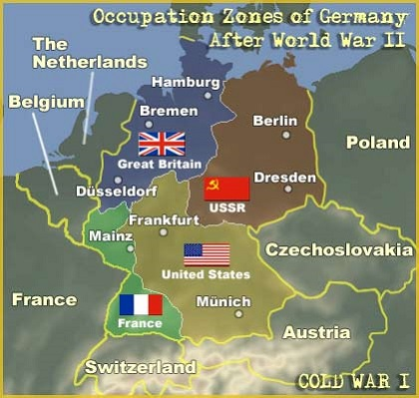
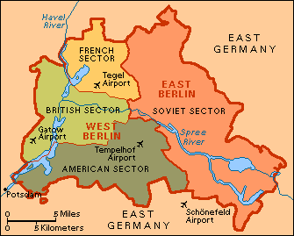
The Division of Germany and Berlin

Slide 15
The occupation of Germany
This was a major source of conflict. 4 occupation zones. US and UK join theirs.
Russia removes vast quantities from the East as War reparation.
Marshall Plan set up to allow Europe to recover and to resist Communist expansion. Was offered to Soviet clients states but offer as declined. $US22 billion over 11 years.
Berlin 170 km inside the Soviet Zone. In 1948 the USSR blockades the city. Lasted 1 year – The Berlin airlift commences with 1400 flights a day until the Soviets give up. Partly because B29s as nuke carriers arrived there.
1948 – Yugoslavia expelled from the Cominform. Yugoslavia neutral during the Cold War. Yugoslavia not invaded but others not so lucky. Gomulka in Poland – jailed. Rajk in Hungary – shot. Petkov in Bulgaria (hanged) and Xoxe in Albania (hanged).
1949 – NATO formed. Collective security guaranteed by the US with US bases now on European soil.
1955 – The Soviet equivalent – The Warsaw Pact established.

Slide 16
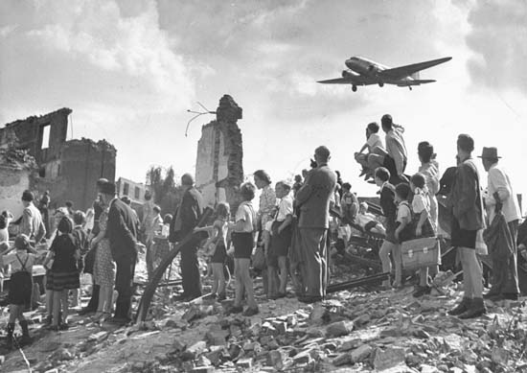
The Berlin Airlift - 1948

Slide 17
Why did Germany recover so quickly after 1945?
Highly educated, savings-minded workforce whose population losses were instantly replenished by the influx of millions of refugees from former eastern Germany, Poland, and Czechoslovakia.
Wartime destruction meant wonder years for the construction industry. Entire cities were destroyed and had to be rebuilt.
Just fighting the war under conditions of scarcity and bombing engendered a high level of state-industrial cooperation and focus on efficiency and optimization. Do more with less. For example, Germany managed to produce more war materiel in 1944 than in 1940.
Germany shrank by 25% in 1945 compared to its 1937 territory. Most of the lost territory, such as East Prussia and Pomerania, was historically relatively poor and agricultural. Other relatively poor regions were sequestered away into East Germany. So the richest and most industrial parts of West Germany could grow without having to subsidize the East.
Ludwig Erhard, the minister given much credit for the "Economic Miracle," astutely kept exchange rates artificially low in order to promote exports.
The Marshall Plan certainly helped by infusing capital. East Germany experienced a net loss of capital and industrial plant as "reparations"

Slide 18
Anti Communism in the US in the 1950s
1949 - The Soviets detonate their first atomic bomb. And China turns communist under Mao Tse Tung. Who helped? The Cold War spreads to Asia.
Spy ring investigations in the US and the UK.
In the US Senator Joe McCarthy heads the Un-American Activities Committee. Home grown communists to be rooted out particularly from the State Department (who lost China?) and Hollywood. Hysteria follows and many careers ruined (Charlie Chaplin and Lucille Ball etc. Ronald Reagan and Walt Disney informers. Hollywood blacklist.
1950 – the Korean War. Afterwards the US starts re-arming on a large scale.
1948 – 1960 The Malayan Emergency.
1948 – 1954 – The Huk rebellion in the Philippines.
1954 – French defeated in Vietnam at Dien Bien Phu. SEATO formed.
Unsuccessful rebellions in Burma and Indonesia. The domino theory and the need to contain communism.

Slide 19
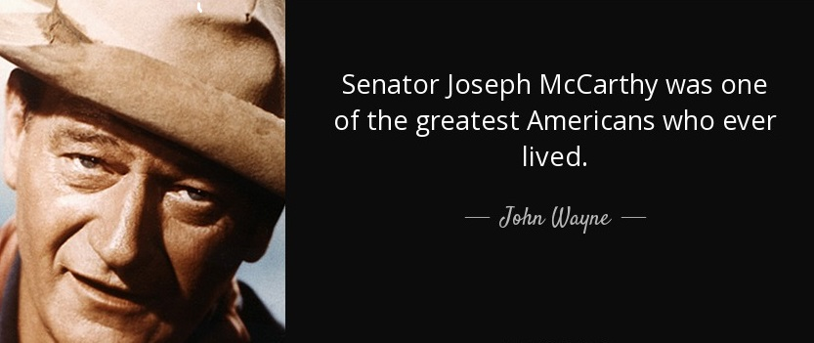
And admirers

Slide 20
The Cold war comes to Asia
1950 – Friendship Treaty between the USSR and China but disagreements over methods surface. US sees it not as differences between the two but in Cold War terms. Stalin says concentrate on the cities – Mao focuses on the villages and the peasants.
Stalin – conventional warfare – Mao guerrilla warfare. Former proves disastrous.
Mao win in 1949 and Nationalists escape to Taiwan and further south.
1950 – UK recognises China but the US does not and sets about containment of China.
1951 – May – China occupies Tibet.
The US starts its support of France in Indo China.
China gives moral support to liberation movements in South East Asia particularly in Burma, Vietnam, Malay and Indonesia.
The domino theory

Slide 21
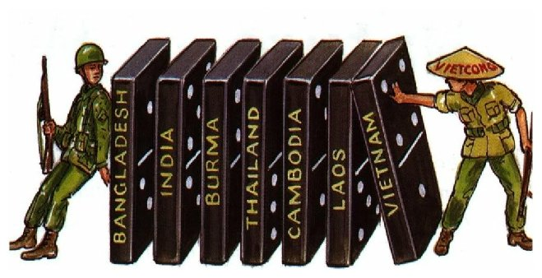
The domino theory

Slide 22
The death of Stalin and a change of direction
Stalin dies in 1953. Krushchev takes over.
A new approach “peaceful co-existence”.
1956 – 20th Party Congress – Krushchev says “Stalin made mistakes” uproar and Chinese very angry as they were not forewarned.
1956 – rejection of Stalinism in Hungary. The limits of peaceful co-existence. In June 1956, the demonstration of steelworkers in Poznan was roughly put down by the government. However, in October 1956, the reverberation of these events in Poznan inspired a period of change and moderate liberalisation, known as the "October thaw". The Polish experience encouraged many Hungarians to hope for similar concessions for Hungary.
“Russians go home” – statues toppled. Russian tanks enter Hungary withdraw and then come back after Hungary withdraws from the Warsaw Pact.
No help from the West – both side respect each other’s “sphere of influence”.
2000 dead, 200,000 flee abroad and Nagy executed in 1958. The Iron Curtain?
1961 – The Berlin Wall erected.

Slide 23
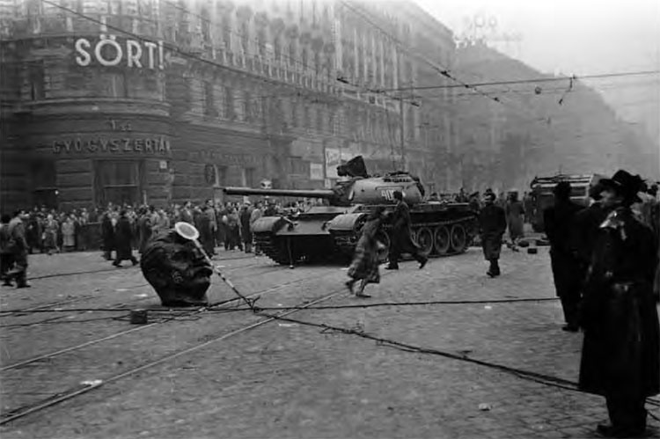
Russian tanks in Budapest

Slide 24
The Suez Canal Crisis - 1956
The Suez Canal provided Britain with a shorter sea route to its empire and, as the 20th century dawned and oil grew in importance, it provided a short sea route to the oilfields of the Persian Gulf.
July 1956 the Egyptian president, Nasser, nationalized the Suez Canal. The canal had been controlled by French and British interests.
The Suez Crisis was provoked by an American and British decision not to finance Egypt’s construction of the Aswan High Dam, as they had promised, in response to Egypt’s growing ties with communist Czechoslovakia and the Soviet Union. Nb – cotton growing
Nasser had three goals: end British occupation; build up Egyptian forces for an attack on Israel; to improve Egypt’s economy by constructing a high dam at Aswan to irrigate the Nile valley.
France, Britain and the Israelis. Israeli forever now defined as western power. The reaction of the US and USSR, The Hungarian uprising,. Soviets gain a toehold in the Middle East via Egypt. The role of Eden and the start of the end for the British Empire.

Slide 25
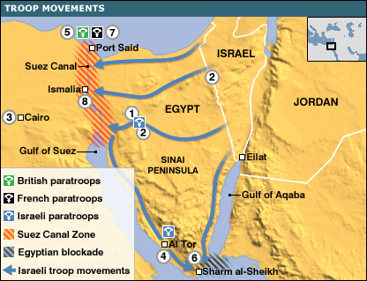
The Suez Crisis

Slide 26
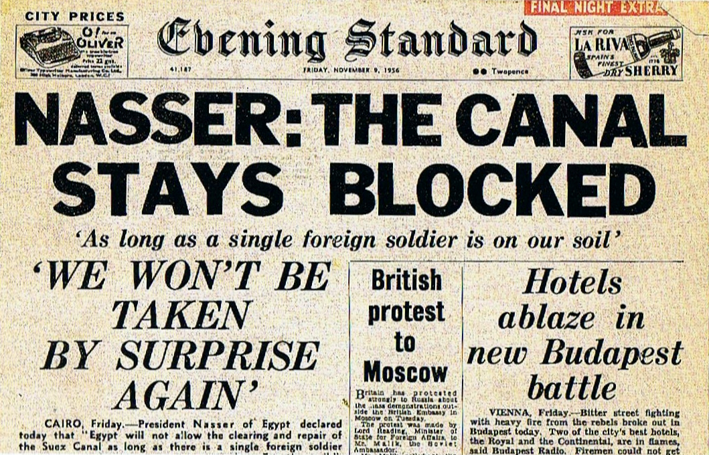
The headlines

Slide 27
Meanwhile - the Offshore Islands Crisis - 1958
Once part of the mainland’s Fujian province, Quemoy and the other islands in the group were occupied by the Nationalist Chinese when they were driven from the mainland to Taiwan in 1949.
Thereafter, Quemoy—which at its closest point is only about 1.5 miles (2.4 km) off the Fujian coast—was subject to periodic artillery exchanges with communist forces on the mainland.
One such incident, in 1958, (which also included Matsu Island to the north) provoked an international diplomatic crisis, when the communists heavily bombarded both islands and demanded that the Nationalists there surrender.
The standoff was diffused only after the United States interposed the 7th Fleet between the mainland and Taiwan.
Was it a possible nuclear incident waiting to happen? Nixon and Kennedy both widened the issue by pledging to protect Taiwan from invasion by the mainland at all costs.

Slide 28
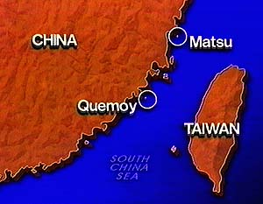
Quemoy and Matsu

Slide 29
The Cuban Missile Crisis - 1962
Having promised in May 1960 to defend Cuba with Soviet arms, the Soviet premier Nikita Krushchev assumed that the United States would take no steps to prevent the installation of Soviet medium- and intermediate-range ballistic missiles in Cuba.
Such missiles could hit much of the eastern United States within a few minutes if launched from Cuba.
Shipments arrive discovered by U2 spy planes. Kennedy begins a naval blockade – quarantining Cuba. Preferred to air attacks on missile sites or an invasion of Cuba itself.
During the following days, Soviet ships bound for Cuba altered course away from the quarantined zone. As the two superpowers hovered close to the brink of nuclear war, messages were exchanged between Kennedy and Khrushchev amidst extreme tension on both sides. On October 28 Khrushchev capitulated.
Kennedy in exchange secretly promises never to invade Cuba and to withdraw IRBMS from Turkey. It mean the end of Krushchev in 1964.

Slide 30
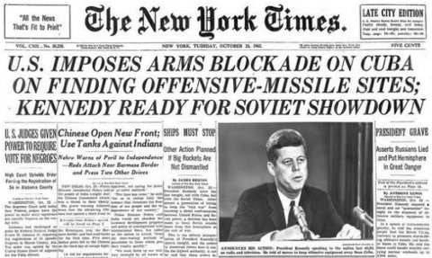

Slide 31
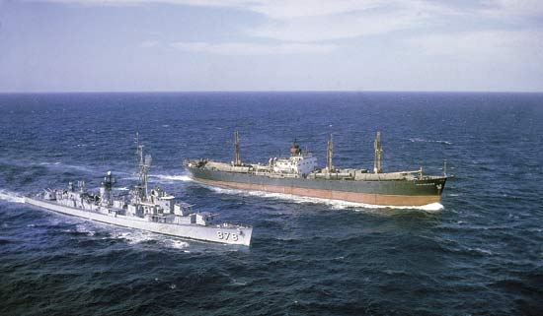
The naval blockade of Cuba

Slide 32
The Sino – Soviet split
Asian nations such as North Korea, Vietnam and Cambodia began to turn to communism, they also lacked an urban proletariat, so followed a Maoist path rather than the classical Marxist-Leninist doctrine — to the Soviets' annoyance.
Mao saw himself as the leader of the Communist world as he was senior to Krushchev. Competition for Communist world leadership.
Conflict over Destalinisation, The Great Leap forward of 1958, nuclear weapons technology and detente with the West.
1959 Tibetan uprising – Russia supports the Tibetans. Insults and abuse flow.
Differences over the Cuban Missile Crisis – Soviets back India in the Sino – Indian War of 1962.
1968 - border dispute in Xinjiang nearly leads to War. Soviets consider a strike against nuclear testing are of lop Nor in China.
Differences over Afghanistan – China and the US support the mujahedeen.
Gorbachev changes and the fall of the USSR – “we told you so...”
Now co-operating over oil and gas? What do the Russians think of OBOR?

Slide 33
The nuclear build up
USSR gets the atomic bomb in 1949 and the H bomb in 1953. China gains its first atomic bomb in 1964 and a H bomb in 1967.
The nuclear arms race – Few missiles were then ICBMs – hence the Cuban Missile Crisis and US missiles in Turkey. First ICBMs - 1958 in the USSR, 1959 in the US and 1975 in China.
B52s “fail safe” and Russian ICBMs.
The triad – B52s, ICBMS in silos, SLBMs.
The MAD doctrine and the keeping of the peace – proxy wars.
By 1986, it was estimated that throughout the world there were 40,000 nuclear warheads – the equivalent of one million Hiroshima bombs.
Cuban missile Crisis and “brinkmanship”.
1963 – Hotline installed.
1966 – air travel between Moscow and New York begun.
1969 – Nixon Doctrine. SALT 1
1972 – normalising relations with China – Nixon visit.

Slide 34
The Cultural Revolution in China (1966 – 76) BBC
The Cultural Revolution was a campaign launched by Mao to rid the Party of his rivals, but which ended up destroying much of China's social fabric. At its start, Mao and his supporters mobilised thousands of young, radical "Red Guards" who were ordered to destroy the "four olds" in Chinese culture – old customs, habits, culture and thinking. Colleges were shut so students could concentrate on "revolution", and as the fervour of the movement spread, they began to attack almost anything and anybody that stood for authority.
Schools and temples were destroyed, their teachers and parents vilified and, in thousands of cases, beaten to death or driven to suicide.
While this was going on, Mao and his supporters – including his former film-star wife Jiang Qing – purged the Party of thousands of officials, including Mao's expected successor Liu Shaoqi, and the man who went on to become paramount leader, Deng Xiaoping.
The Cultural Revolution officially lasted until 1976. Although the fervour of the first two years was not maintained, some areas of the country became almost ungovernable. In the cities, only the army prevented a complete breakdown of law and order.
Following Mao's death in 1976, his wife and three other radicals were officially blamed for launching and orchestrating the Cultural Revolution.

Slide 35
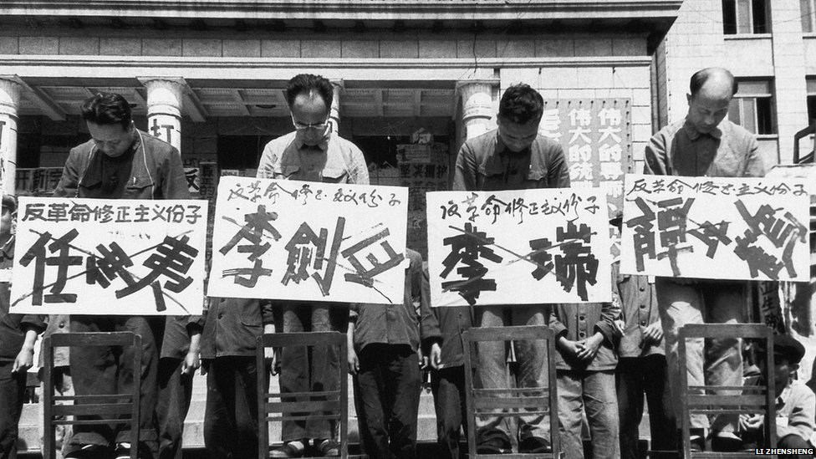
The cultural revolution in China

Slide 36
The US in Vietnam
France returns to Vietnam in 1946.
US shoulders 80% of the financial burden for the French.
1954 – Dien Bien Phu. French defeat.
1954 – Geneva talks – elections promised within two years. Elections postponed because Ho Chi minh would have won and reunification never achieved.
1959 – 1961 – Civil War resumes. Viet Cong and NVA attack the south.
1963 – The US sends 10,000 advisors.
1965 – Bombing campaign of the North begins.
1968 – Tet offensive – Hue and US embassy in Saigon. 800,000 US troops in Vietnam.
1973 – US withdraws
1975 – Saigon falls.

Slide 37
Czechoslovakia 1968
1968 - Alexander Dubcek elected and the “Prague Spring” begins. Free elections and new political parties to be set up. “Socialism with a human face”
The policy of détente encouraged the uprising. Romania had also broken free of Russian control, and was improving relations with the West.
Resentment at Russian control of the economy which was performing badly
August 1968 - Brezhnev reads out a letter from some Czechoslovakian Communists asking for help.
The Brezhnev Doctrine - the USSR would not allow any Eastern European country to reject Communism.
On 20 August 1968, 500,000 Warsaw Pact troops invaded Czechoslovakia. Dubcek and three other leaders were arrested and sent to Moscow. Died 1992.
Romania and Yugoslavia horrified by turn of events
Czechs appeal to the West for help but mindful of Hungary in 1956 do not resit other than peacefully.

Slide 38
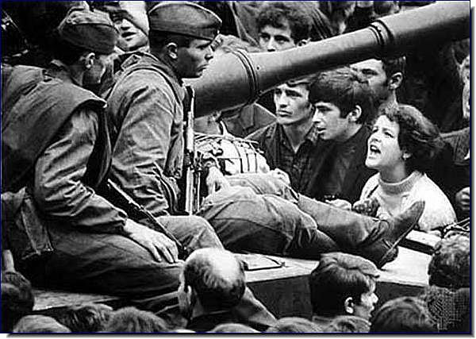

Slide 39
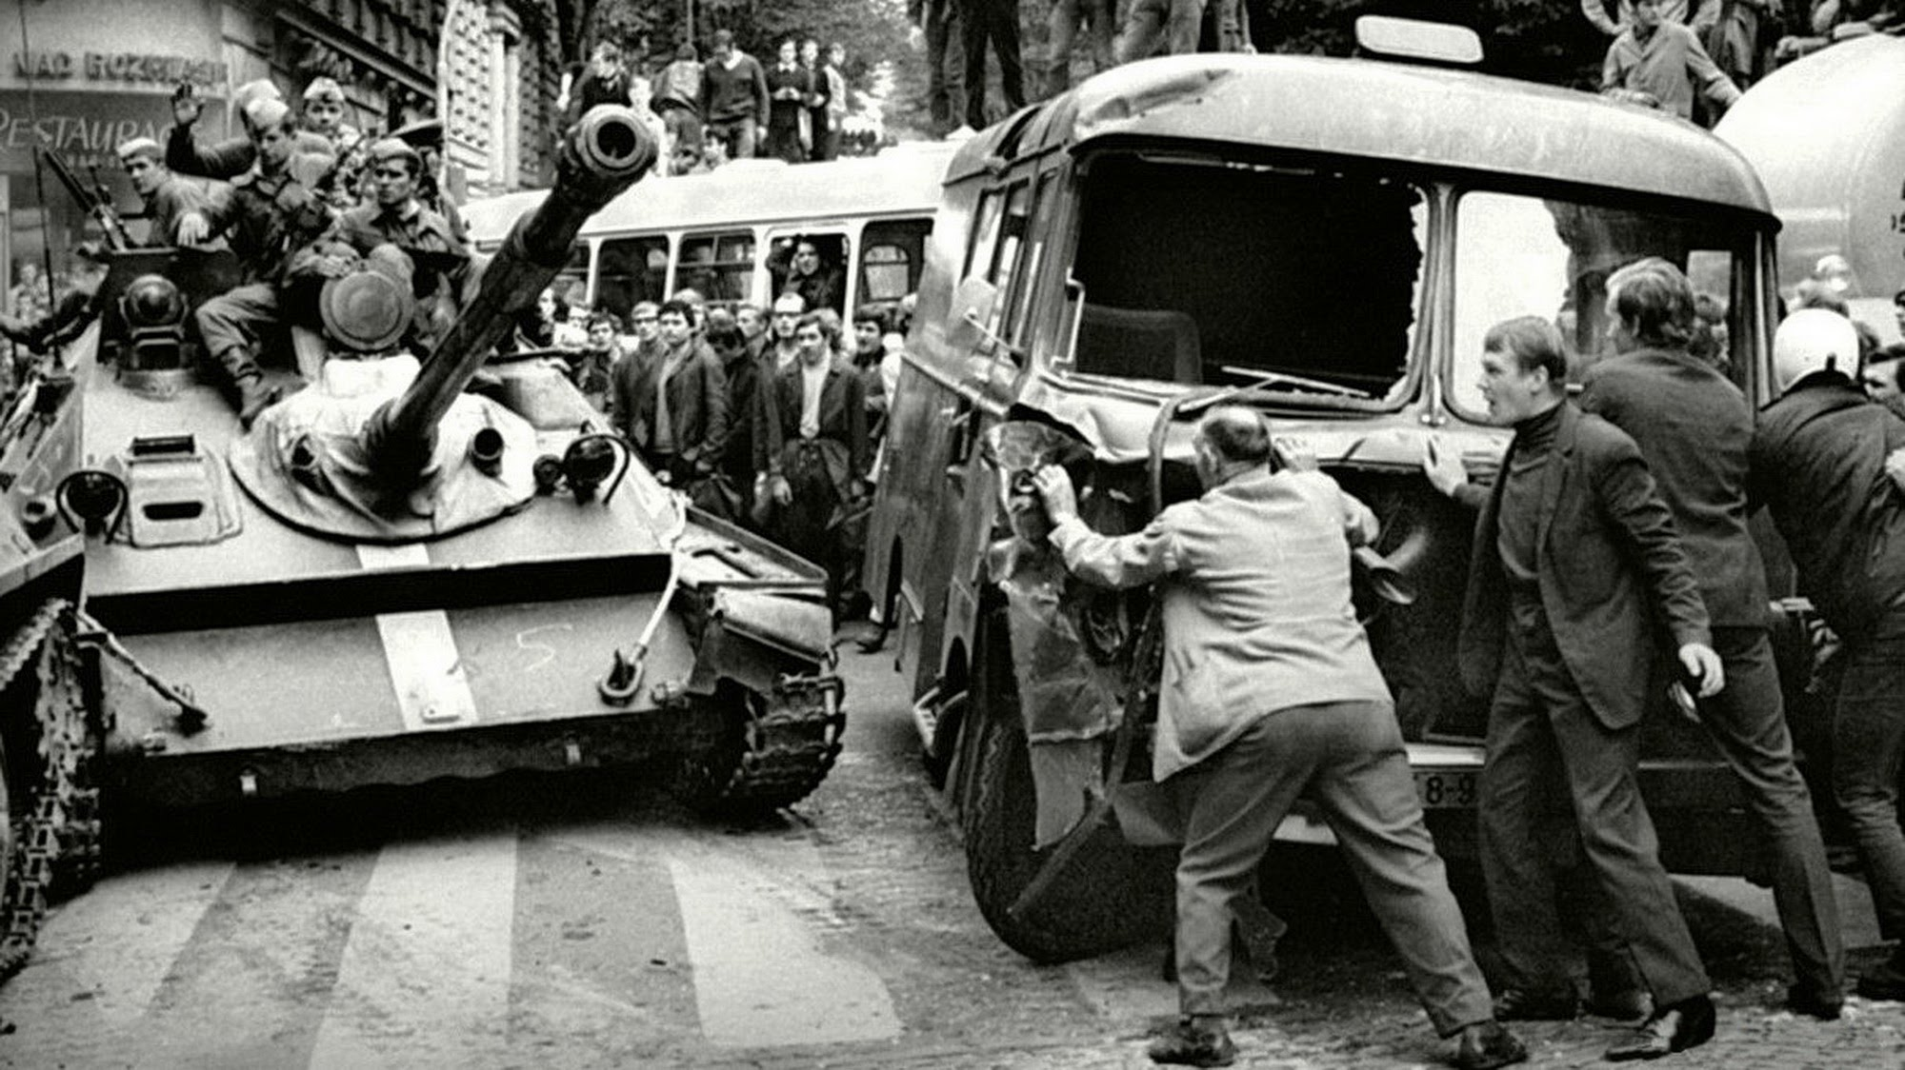

Slide 40
Detente in the 1970s
Ostpolitik – tidying up border anomalies left over from WW2.
Europe distances it self from the great powers. Concerned over nuclear weapons and fears of being the meat in the sandwich.
West German foreign policy begun in the late 1960s. Initiated by Willy Brandt as foreign minister and then chancellor, the policy was one of detente with Soviet-bloc countries, recognizing the East German government and expanding commercial relations with other Soviet-bloc countries.
Helmut Schmidt continued these policies. Recognition and acceptance of current borders and renouncing the use of force.
1972 – Nixon visits Russia after he visited China – SALT 1 in exchange for grain for the USSR.
Fits and starts – human rights in Russia an issue for Carter.
Detente ended with the election of Reagan in 1981. “The Evil Empire” speech.

Slide 41
The New Cold War – the 1980s
For Nixon and Carter human rights in the USSR were an issue – particularly the treatment of Jews.
1979 – detente set back with the Soviet invasion of Afghanistan.
1980 - The US boycott of the Moscow Olympics.
1983 - Reagan announces SDI or “Star Wars” and put INF into Europe – mass protests in Europe
1984 – Soviets boycott the LA Olympics.
Reagan supports “freedom fighters” in Afghanistan but also Africa and Central America.
SALT 11 never ratified in the US as Reagan saying it made the US vulnerable.
.1985 – Reagan blindsided by rise to power of Gorbachev. Focus on the Russian economy – perestroika and glasnost. Gorbachev a cult figure and a hero in Europe and the US ( even in China?).
Gorbachev reduces army by 10% and withdraws tanks and troops from Europe.

Slide 42
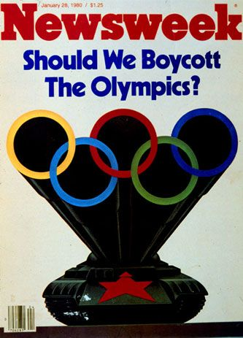
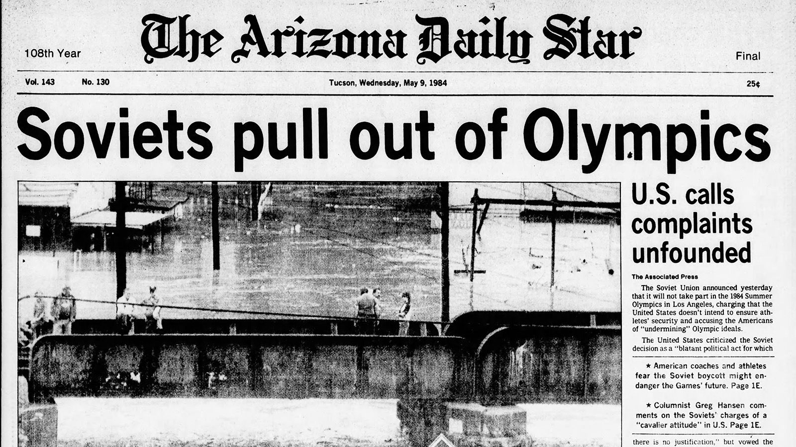
The Olympic tit for tat

Slide 43
The New Cold War in the 1980s and the end
1986 – the Iceland summit between Reagan and Gorbachev.
The Reykjavík summit almost resulted in a sweeping nuclear arms-control agreement in which the nuclear weapons of both sides would be dismantled. Nothing finalised but it did start the massive reduction in nuclear weapons and marked the start of the end of the Cold War.
Troops in Eastern Europe down from 50,000 to 5,000. Precipitated the fall of many Eastern European dictatorships.
1989 – USSR withdraws from Afghanistan.
1989 – Solidarity gains power in Poland. Ceausescu removed in Romania.
1989 – Ten An Mien massacre – were they inspired by Gorby?
1990 – Berlin Wall comes down. USSR Communist Party spooked an launches a coup in 1991 – too late.
US now the only super power? It now has a free hand in Iraq War of 1991.
1995 – US normalises relations with North Vietnam (Vietnam now)

Slide 44
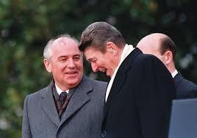
Gorbachev and Reagan

Slide 45
The Cold War ends in Europe
Poland – 40 years of socialism and there is still no toilet paper”.
Everyone lives as hunter – gatherers. One third of each day in queues.
$1300 to join a waiting list for TVS.
Hungary – summer sees the start of the East German tourists looking for restaurants,, bars and food in the shops. Hungary tells Gorbachev he cannot ford to maintain the fence between East and West. Gorbachev says he wont pay for it.
Open air concert – “Austrians” invade. Maps issued so people don’t “stray”. German consular officials in the bushes. A mass exodus from Honecker’s workers Paradise.
Honecker –a resistance fighter in Ww2 – 6 years in concentration camps then did the same to his own people. Isolated form own people –staged factory visits, curtained Volvos - weekends at dachas.
Romania – “if we only a little more food it would be just like wartime. Ceausescu 71 in 1989 – shot. Germans apprehensive about jobs – wished conditions would improve in the East so people would stay there. Young and ambitious leave. Elderly left in a denuded country.

Slide 46
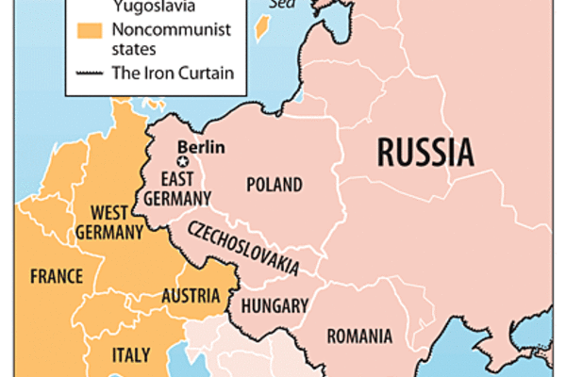
The picnic on the border of Hungary and Austria

Slide 47
The Cold War revived under Putin
.Putin plays the anti west card t shore up support at home and to expand Russia’s influence abroad.
He criticised the West’s support of the anti-Moscow “colour revolutions,” in Georgia, Kyrgyzstan, and Ukraine, which deposed corrupt, Soviet-era leaders, to its endorsement of the uprisings of the Arab Spring. Five years ago, he blamed Hillary Clinton for the anti-Kremlin protests in Moscow’s Bolotnaya Square.
The 2016 Presidential campaign in the United States was of keen interest to Putin. He loathed Obama, who had applied economic sanctions against Putin’s cronies after the annexation of Crimea and the invasion of eastern Ukraine. Clinton, he believed was worse.
Podesta’s “change your Gmail password” fiasco.
Use of social media to spread pro Trump messages.
1989 - Putin was burning documents in Dresden – asked fro help. “Moscow was silent”. The decline of the USSR as a world force and the need to regain respect.
Notes:
Putin in 1989 as the wall fell was burning ocuments in Dresdane. Asked for help – “Moscow was silent”

Slide 48
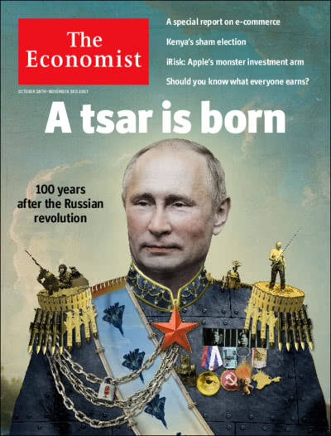
Putin – a new Tsar?

Slide 49
Russian resentment
The West no longer feared Soviet power; Eastern and Central Europe were beyond Moscow’s control; and the fifteen republics of the Soviet Union were all going their own way. An empire shaped by Catherine the Great and Joseph Stalin was dissolving.
The fall of the imperial state meant the loss of two million square miles of territory, a parcel larger than India. Tens of millions of ethnic Russians now found themselves “abroad.”
Western Triumphalism.
NATO expands into former soviet territory. Battling pro Russian Serbian forces in Bosnia.
Every aspect of the country’s political life, including the media, was brought under Putin’s control as he sought to stabilise Post Yeltsin Russia.
Initially friendly the US invasion of Iraq the turning point for Putin – Russia had no role and it annoyed him.
In 2012 Putin re- elected on the platform of nationalism, xenophobia, and social conservatism. At odds with liberal Obama administration.
Death of Gaddafi – he was safe as a pariah and vulnerable when he opened up. A lesson for Putin.

Slide 50
Cold War 2 and Putin
Putin also regarded the anti-Kremlin, pro-democracy demonstrations in Moscow, which started in 2011, as a rehearsal for an uprising that had to be thwarted.
Some thirty journalists have been murdered in Russia in the past decade and a half; human-rights groups that receive funding from abroad are registered in Moscow as “foreign agents.” Dissent is marginalised – Navalny
even in the Internet era, more than eighty per cent of Russians get their news from television which Putin runs as state enterprise.
Involvement in Syria to establish Russia as a player on the world stage.
Bullying the Baltic States.
Trump totally uncritical of Putin and has business interests there. Not committed to NATO. “America first”
Merkel warns Trump of New cold war but trump is not interested. White House staff now see Russia as main threat not terrorism.
Not as dangerous as the first Cold War or is it? More connected now and there fore more collision points are possible.

Slide 51
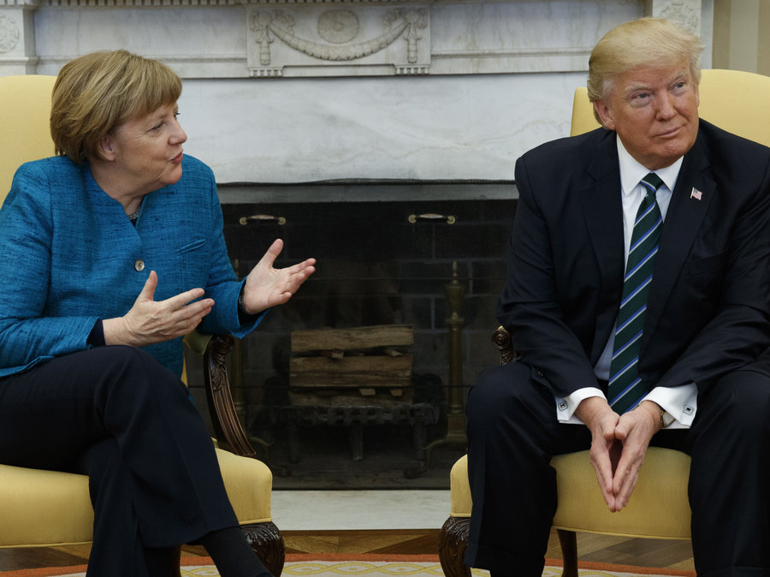
Awkward

Slide 52
And under the radar
Active measures were used by both sides throughout the Cold War.
In the nineteen-sixties, Soviet intelligence officers spread a rumour that the U.S. government was involved in the assassination of Martin Luther King, Jr.
In the eighties, they spread the rumour that American intelligence had “created” the aids virus, at Fort Detrick, Maryland. They regularly lent support to leftist parties and insurgencies.
The C.I.A., for its part, worked to overthrow regimes in Iran, Cuba, Haiti, Brazil, Chile, and Panama. It used cash payments, propaganda, and sometimes violent measures to sway elections away from leftist parties in Italy, Guatemala, Indonesia, South Vietnam, and Nicaragua.
In the 1990s US supported Yeltsin with technical support on the ground to help him win the election in the USSR
In 2016 – The USSR is suspected of having been involved in the Anti Clinton, pro Trump campaign.
Cyber warfare – cheap USBs in Kabul for US servicemen to use. US and Stuxnet.

Slide 53
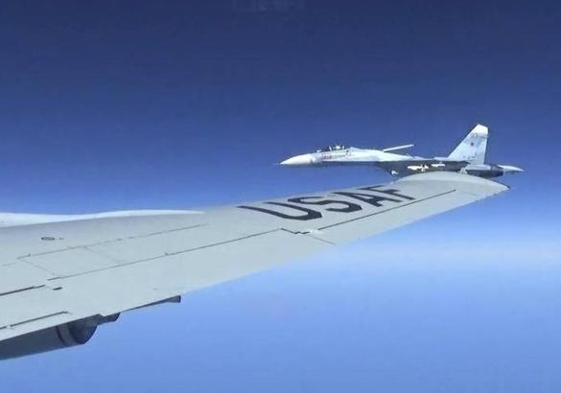
A new Cold War?
Active measures were used by both sides throughout the Cold War. In the nineteen-sixties, Soviet intelligence officers spread a rumour that the U.S. government was involved in the assassination of Martin Luther King, Jr. In the eighties, they spread the rumour that American intelligence had “created” the aids virus, at Fort Detrick, Maryland.
They regularly lent support to leftist parties and insurgencies. The C.I.A., for its part, worked to overthrow regimes in Iran, Cuba, Haiti, Brazil, Chile, and Panama.
It used cash payments, propaganda, and sometimes violent measures to sway elections away from leftist parties in Italy, Guatemala, Indonesia, South Vietnam, and Nicaragua.
Cold War 2?

Slide 54
A new Cold War?
An end to an era of Western dominance?
Hybrid warfare – Military, economic, cyber and criminal warfare – who is the enemy? Asymmetric warfare.
The green troops in the Ukraine – sending a message to Belarus?
The Poisoning of Skripal and the deteriorating relations with the West.
The Petya virus – ransom ware.
The hacking of Podesta's phone
The Mueller indictment of 13 Russians and two companies
Where to from here on Russia for Trump?
Would Nato partners defend each other? Trump has not shown any willingness to do so.
Denying the US access to the Baltic states? The Baltic Sea? Make it too costly to intervene?
Can they keep competing with the US on a cost basis?
Putin’s new super weapons.

Slide 55
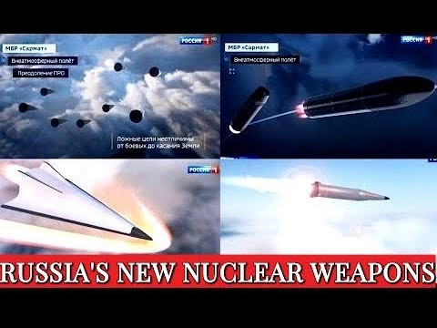
Putin’s new nuclear options?

Slide 56
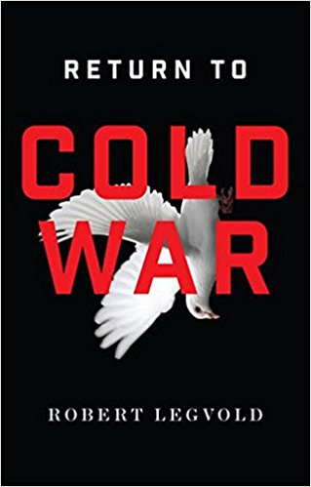
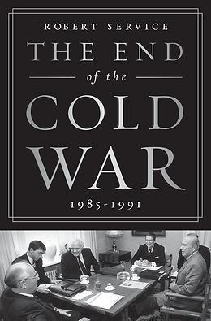
Reading guide

Slide 57
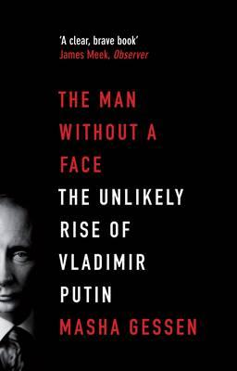
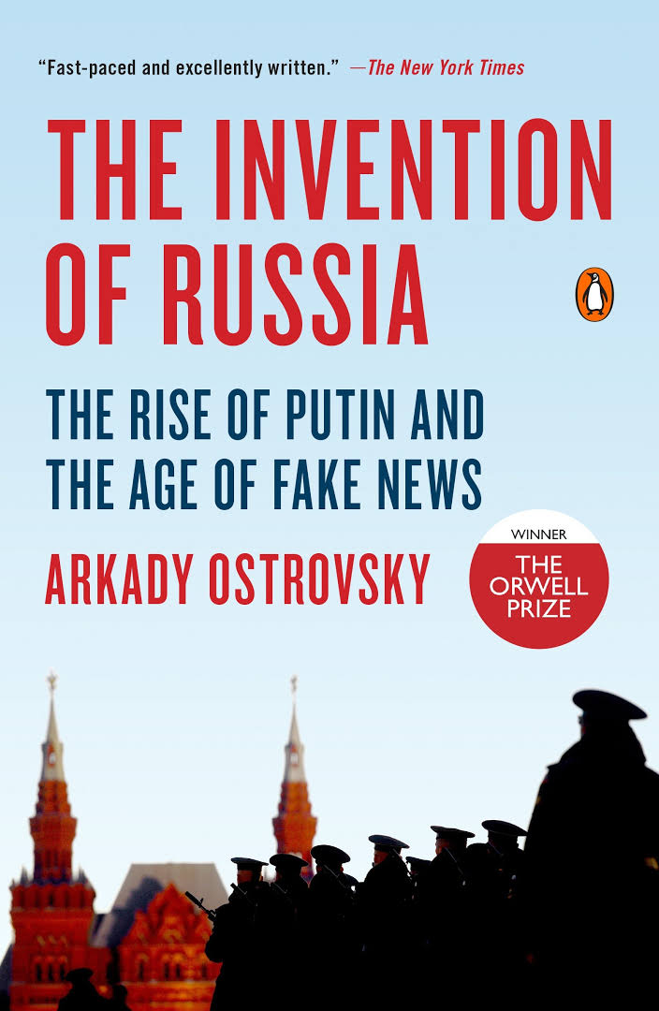
Best book on Putin?

Slide 58
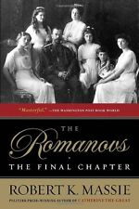

And the 300 year reign of the Romanovs

Slide 59
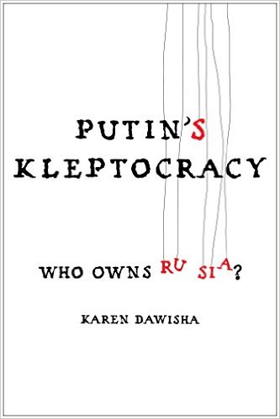
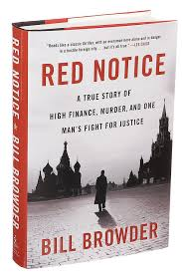
And another one – download as PDF

