Slide 1
The decline of War
Beechworth U3A, 2017
“The world is getting less violent; we're just more aware of the violence.”

Slide 2
The decline of war
Outside the Middle East, war is effectively disappearing. In Nigeria, Boko Haram is on the retreat from many of its home territories.
In the Central African Republic, a newly elected government has brought genuine hope for lasting peace.
In Ukraine, a shaky ceasefire is holding despite partial flare ups. We have short memories too.
We forget about the wars that ended recently in Lebanon, Rwanda, Chad, Peru, Iran, Sri Lanka and Angola and have forgotten earlier ones from a generation ago.
Fewer of us as a proportion of the world’s entire population have had to go war than any other generation since the Roman Empire.
As large scale war declines we can turn our attention to ethnic violence, drug wars, state collapse, extremism and persecution of minorities.

Slide 3
Have there been fewer deaths?
In 1950 there were 851,000 battle deaths.
In 2000 wars killed 310,000.
In 2013 there were some 30,000.
There have been fewer deaths this decade than in any decade since the end of World War 2.
Syria and Iraq may raise the numbers but nothing like to the levels seen during the Chinese Civil War, Korea, Vietnam, India/Pakistan/Bangladesh, Iran-Iraq, USSR-Afghanistan, and the many now-quieter regions of Africa..
Definitions – “war“ is anything involving over 100 battle deaths. Anything less is called a “conflict”.

Slide 4
In the past
Among ancient agricultural civilizations, warfare almost always meant complete genocide and enslavement of entire populations. Hunter-gatherers, from prehistory till modern times, lost on average between 4% to 30% – some archaeological sites suggest up to 60% – of their populations to warfare.
Long before WMD’s were conceived, the 8th century ‘An Lushan’ revolt in China wiped out two thirds of the Chinese population in just eight years – that is: one sixth of the world’s population at the time.
Most likely causes of unintended death were – wars, famine and the plague. Those factors no longer just seen as “god given”.
As well as a decreasing mortality rate from war, there is also a global downward trend in homicides. England, Canada, and most other industrialized countries have also seen their homicide rates fall in the past decade. Among the 88 countries with reliable data, 67 have seen a decline in the past 15 years.
In Europe your chance of being murdered is now one tenth of what is was 500 years ago and in some place one fiftieth.

Slide 5
The statistics

Slide 6
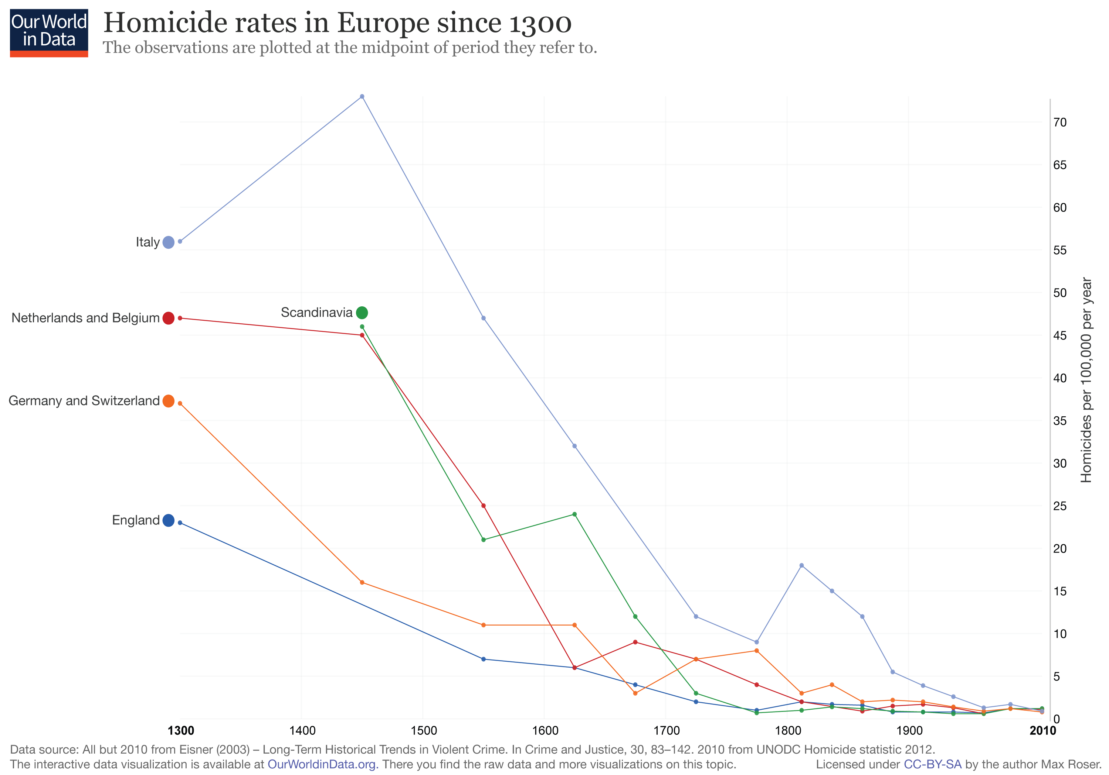
The decline of violence - Europe

Slide 7
A more peaceful time
Between 1945 and 2011 the global death rate had fallen from 22 per 100,000 people to 0.3. You are much more likely to kill yourself than be killed by a drug dealer, terrorist or soldier.
Travel is safer – no bushrangers. Slavery is a dim memory and husband cannot by law beat their wives. And it is all due to the rise of the State. In the Amazon basin where there is no state or police 1 quarter of men die due to conflict over women, property or prestige.
Empires not opt for peaceful retirement rather than the previously usual bloodbath. Even the Soviets just walked away from it all in 1991. In Roman time Diocletian the only retiree.
We have broken the law of the jungle. Can you imagine a war between Germany and France? But not just Western Europe – South America too has gone without a war since 1932.
War is less profitable and peace more so. Now you cannot invade to get what you want because you get it from everywhere. 1998 Rwanda invaded Kenya for the coltan reserves. No point in China invading anyone for the same reason. The rise of soft power – see China.

Slide 8
Possible reasons
Greater peacekeeping efforts by the UN. Some 100,000 of them.
Nuclear deterrence and the greater precision and lethality of conventional weapons. War at a a distance?
Capitalist countries have not gone to war against each other since WW2. Neither have “democratic” countries.
The Fall of Communism. The spread of democratic countries
Civil wars are far less destructive than wars between great powers, and even civil wars went into decline with the end of the cold war a quarter-century ago.
War does not pay. Korean War ended where it started, so did Israel’s 6 day War of 67, The Iran-Iraq war of the 19080s as did the first Gul War over Kuwait. Wealth used to come from conquest now it is from trade.
Major wars have died down but new ones have not taken their place. Peace means peace now not as in 1913 an absence of war.
One factor is our new global awareness shared through the internet and social media.

Slide 9
Tribal battles in PNG

Slide 10
War and primitive societies

Slide 11
Crime rates in the US

Slide 12
The decline in civil violence the US /worldwide.

Slide 13
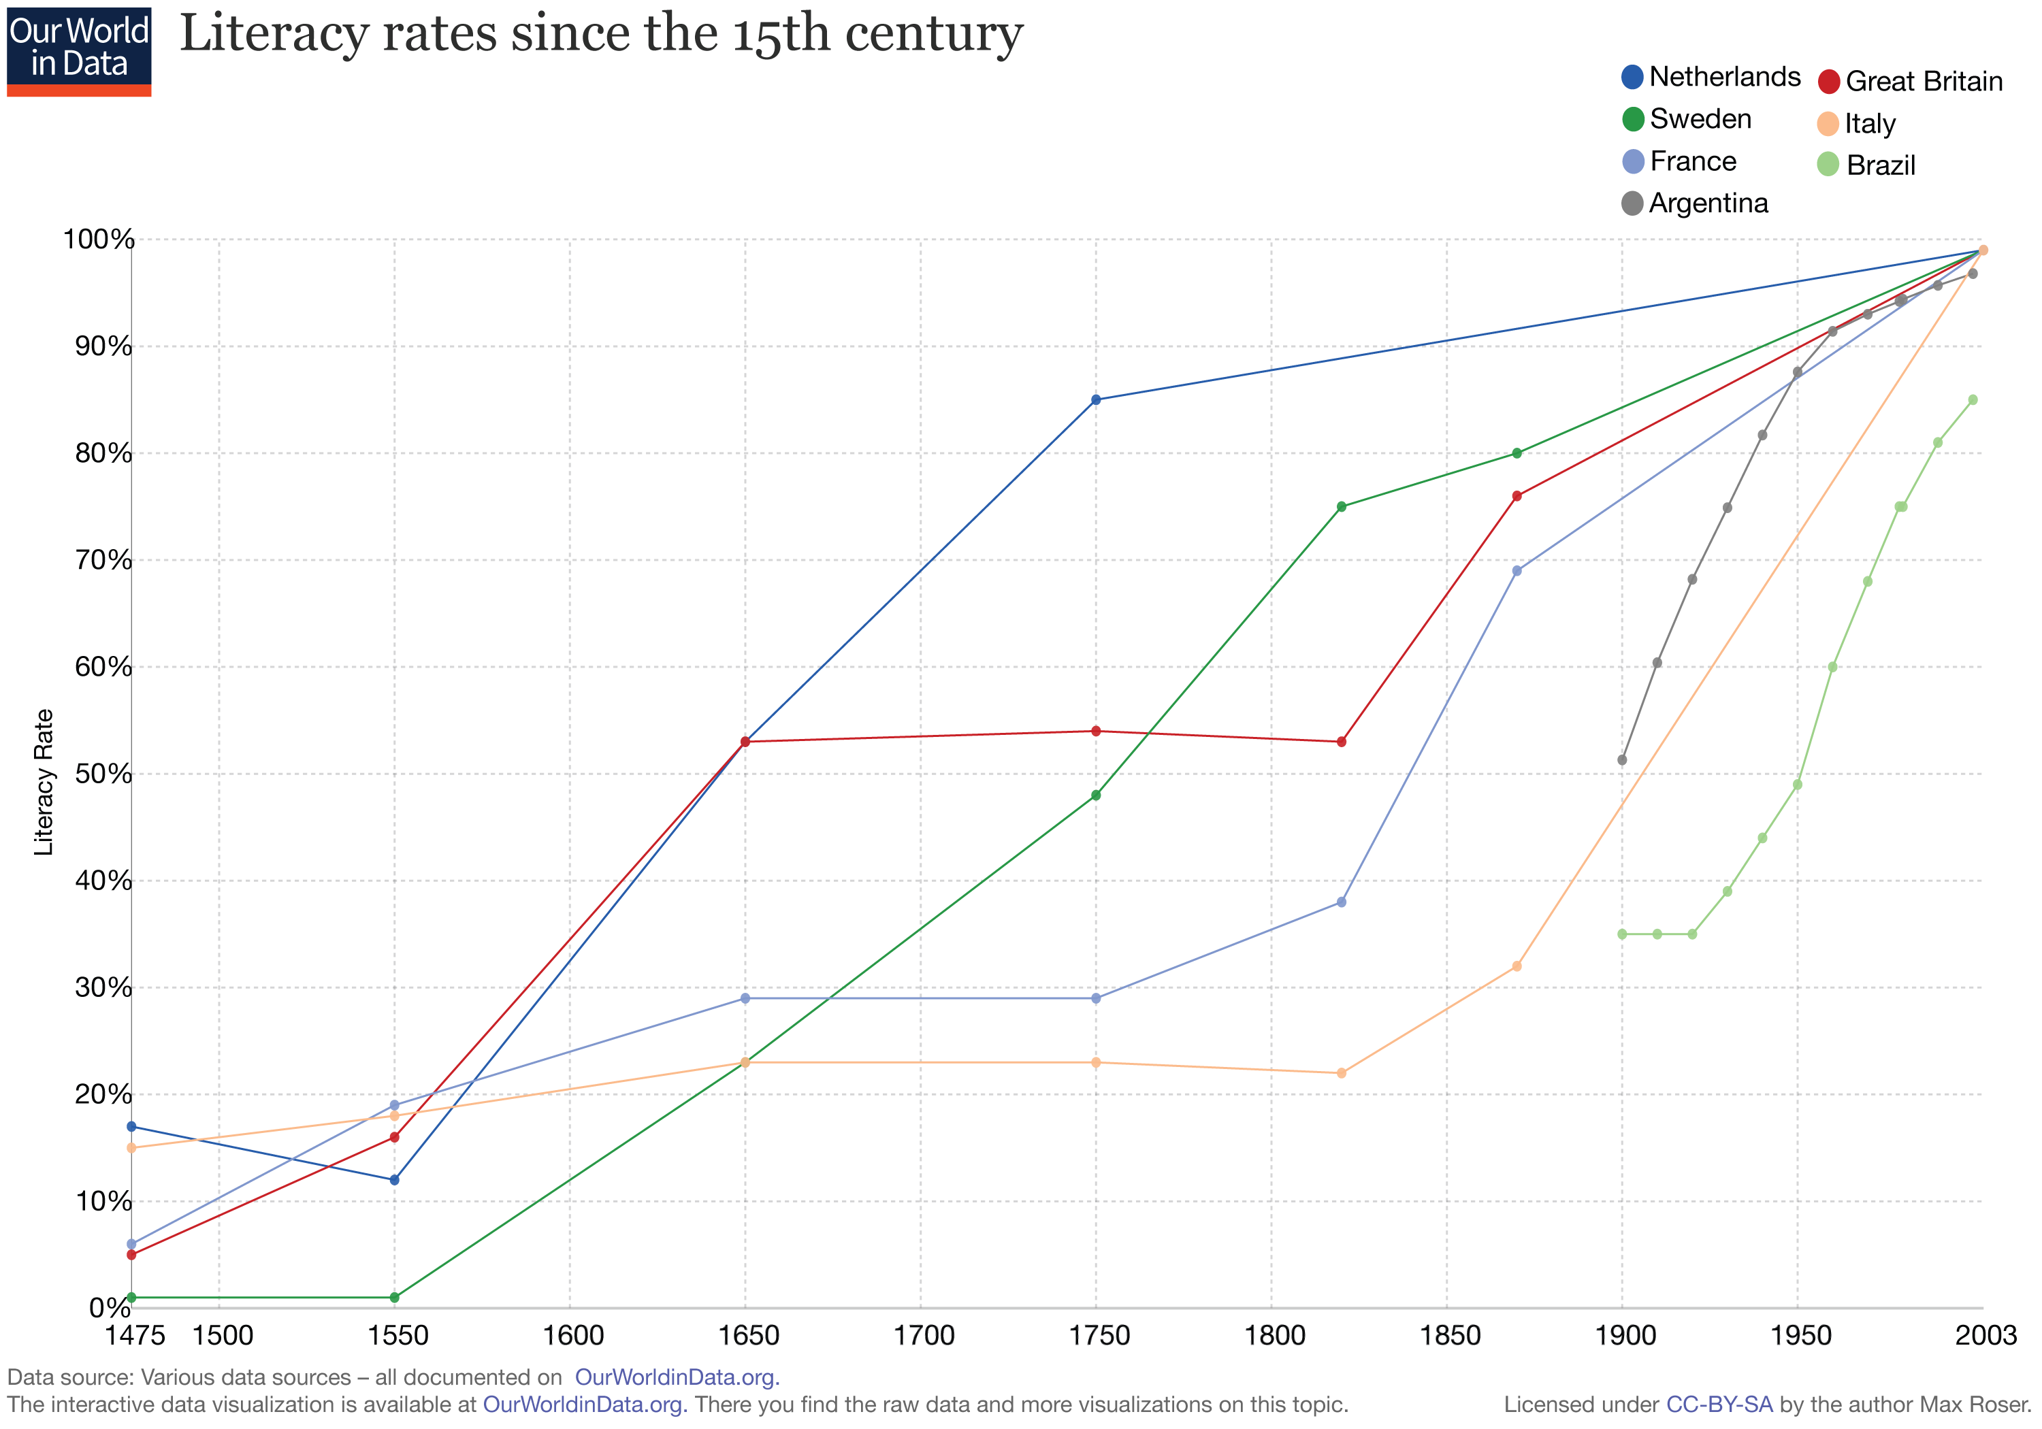

Slide 14
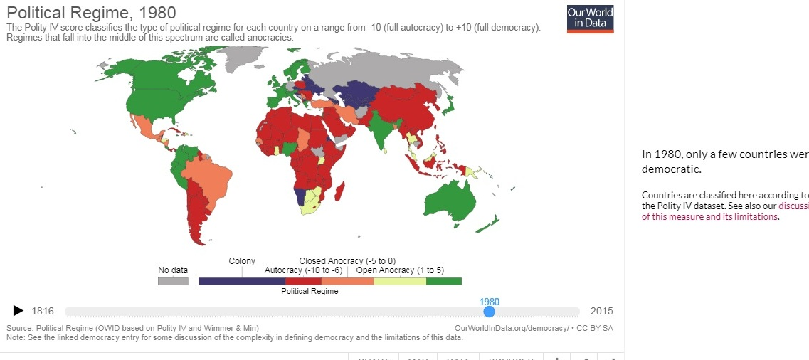
Democratic countries 1980

Slide 15
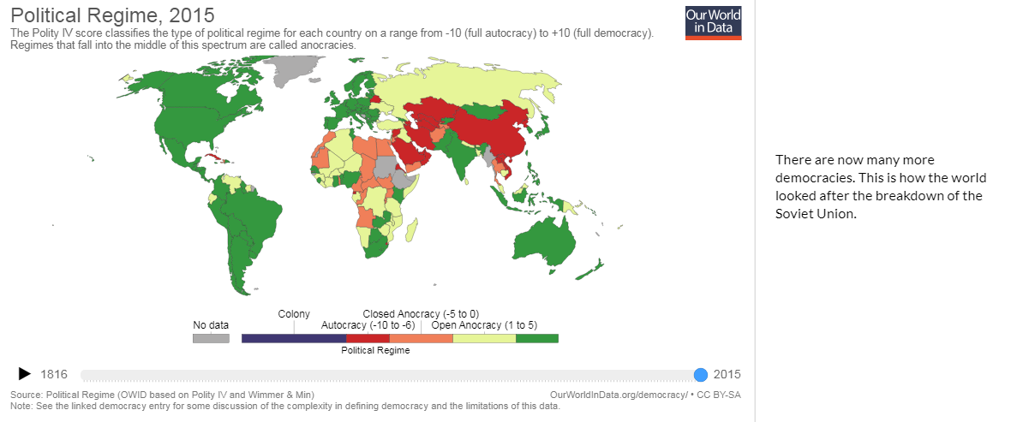
Democratic countries now

Slide 16
Military and civilian deaths in war.
Waterloo – open country south of Brussels.
The Crimean war - During the Crimean War (1854-1856), wealthy families, Lords and Ladies would sail out to the Crimea and live on elegant steamers during the summer. From there they would travel to a significantly safe high vantage point in order to watch the battles unfold.
World war 1 – support trenches away from the fighting, Zeppelins over London. Tours after the war for civilians.
The change in World War 2. Women at war – Land Army, WAAFS Women’s auxiliary air force. Ferry pilots, Intel, ATS (Transport) ARP – conscripted from 41 onwards to working in essential industries. 20 Million Russians dead.
Germany kept their wives at home – a mistake?
Modern wars mostly in civilian areas – e.g. Aleppo

Slide 17
The Crimean wars as a spectator sport

Slide 18
Civilian deaths in war
Deaths of non-combatants have been steadily rising. Around a million of the 10 million deaths due to the first world war were of non‑combatants
around half of the more than 50 million casualties of the Second World war and over 90% of the millions who have perished in the violence in the Congo for decades belong in that category.
However the Mongols killed 40 million. (nearly all civilians). An Lushan, Stalin, Mao, Pol Pot.
Civilians no longer tolerate outright public cruelty –executions, torture and slavery etc. The Humanitarian revolution. Mass murders more likely to finish up in front of court - Milosevic
The Long peace since 1945 – 72 years – previous long peace was from 1815 to 1914.
Greater attempt to avoid “collateral” damage with smart weapons, precision guided munitions , drones etc.

Slide 19
The stats by Pinker
You never see a reporter standing on the streets in Mozambique or Colombia saying there’s no war this year. But there were wars in past years, and we forget about them because they are not news.”
During World War II, the human population lost 300 of every 100,000 people each year. During the Korean War it was in the 20s, before dropping into the teens during the Vietnam era. In the 1980s and 1990s, it fell into the single digits. For most of the 21st century it’s been below one war death per 100,000 people per year.
The amount of damage that terrorists do in terms of the number of people they kill is a fraction of the number of people who die in ordinary day-to-day homicides.
The rate of violent crime in United States has fallen by more than half in just a decade. Yet it has ¼ of all the world’s prisoners.

Slide 20
The role of the media
“If it bleeds it leads”.
people who carry concealed or open firearms for protection have been found to systematically overestimate the numbers of others who are doing so. Police therefore more wary and possibly over react.
The media covers tweets more than it covers news.
Most Americans get their news from the filter less social media.
individual responsibility – now to “share” means to “act”. Fake passion?
From wars between states to wars within them, from crime and terrorism to climate change and cyber-mischief, we are beset by a seemingly endless array of threats and dangers. This is what creates anxiety disorders.
A danger abroad is tyranny at home. “You don’t ever want a crisis to go to waste” (Obama official)
The only real threat are nuclear weapons. For nearly every country in the world, nuclear weapons are more trouble than they are worth. Islamic State – knives and vans.

Slide 21
Nuclear weapons - the numbers

Slide 22
Have we had this before?
Yes, from 1815 ( the end of Napoleon and the Congress of Vienna) to 1914 the start of the First World War. A relative peace – wars were smaller and localised.
1848 – the wars of Independence, Germans, Italians, Hungarians, French, Romanians, Poles, Czechs, Croats and Serbs, the year was to be the ‘Springtime of Peoples’ . The end of serfdom, the beginning of nationalism and the conservatism put off liberalism for a while.
1854 – the Crimean War and 1871 the Franco Prussian War.
Britain’s imperial century – pax Britannica. France no longer a rival – Napoleon 111 except for the Russians whom they defeated in Crimea (1854-56) and helped prop up the Ottomans.
Germany under Wilhelm 1 as Emperor and Italy become nations in 1871.

Slide 23
So what can we learn from History? The causes of World War 1 and how it led to World War 2.
Both Britain and France prepared for it but neither expected it to actually happen.
“One day the great European War will come out of some damned foolish thing in the Balkans (1888).” Otto Von Bismarck.
The obvious causes –
militarism,
competition for colonies,
the arms race,
alliances.
The trigger - the assassination of the Archduke Ferdinand and his wife in Sarajevo

Slide 24
Militarism
Defined by - War talk, military leaders as heroes, rival nations portrayed as aggressive.
Prussia the basis of European militarism – armies reformed by Von Moltke the elder in 1850 –decisive in the defeat of France in 1871.
Domination of the military over the civilian. Kaiser Wilhelm 2 always in military uniform.
Leads to an arms race – naval arms race - dreadnoughts. A reaction to German naval build up. Germany feared Russian armaments build up.
Between 1870 and 1914, the military budget for Britain, France, Germany, Austria-Hungary, Russia and Italy more than quadrupled.
New technologies – rapid fire rifles, machine guns, heavy artillery, submarines, aircraft, motor transport, turbine driven naval ships etc

Slide 25
Kaiser Wilhelm 11

Slide 26
Alliances
The intertwining of alliances meant that if one was attacked the other signatories had to come to their aid.
Russia and Serbia
Germany and Austria-Hungary
France and Russia
Britain and France and Belgium
Japan and Britain
Austria-Hungary declared war on Serbia, Russia got involved to defend Serbia. Germany seeing Russia mobilizing, declared war on Russia. France was then drawn in against Germany and Austria-Hungary.
Germany attacked France through Belgium pulling Britain into war. Then Japan entered the war. Later, Italy and the United States would enter on the side of the allies.

Slide 27
Alliance entente

Slide 28
Imperialism
Before World War I, Africa and parts of Asia were points of contention among the European countries. This was especially true because of the raw materials these areas could provide. The increasing competition and desire for greater empires led to an increase in confrontation that helped push the world into World War I.
The scramble for Africa.
The growth of navies to protect trade routes.
Germany had seized control of modern-day Tanzania, Namibia and the Cameroon in Africa, German New Guinea, some Pacific islands and an important concession in Shandong (China).
The British Empire took in India, South Africa, Australia, New Zealand, Canada, Hong Kong, parts of north Africa, islands in the Pacific and Caribbean and concessions in China.

Slide 29
The scramble for Africa

Slide 30
Nationalism
Much of the origin of the war was based on the desire of the Slavic peoples in Bosnia and Herzegovina to no longer be part of Austria Hungary but instead be part of Serbia. In this way, nationalism led directly to the War. But in a more general way, the nationalism of the various countries throughout Europe contributed not only to the beginning but the extension of the war in Europe.
Weltpolitik or the desire for world power status was very popular in Germany. The French desire for revenge over Alsace and Lorraine was very strong. In Britain Imperialism and support for the Empire was very evident.
This nationalism meant that there was little resistance to war in these countries. Many welcomed what they thought would be a short, victorious war. For example the outbreak of war was greeted by cheering crowds in Berlin, Vienna and Paris.
As A P J Taylor wrote “the people of Europe leapt willingly into war.”

Slide 31
When war was declared

Slide 32
Guess who?

Slide 33
Why did World War one take so long?
Generals based their attacks on hugely unrealistic tactics. They dreamed of large, graceful prongs and manoeuvre. generals based their attacks on hugely unrealistic tactics. They dreamed of large, graceful prongs and manoeuvre.
Basically, they would bombard the enemy with artillery, then launch human wave attacks. They had forgotten that the troops facing them weren't men armed with muskets .
Men and rifles could be rapidly replaced thanks to industrialisation.
A war of attrition kept going by trench warfare and the massive output of industry.
Germany could not make a breakthrough on either Western or Eastern Fronts until after 1917 when Russia collapsed. The spring offensive of 1918 was the last throw of the dice for Germany.

Slide 34
The British high command – Haig etc

Slide 35
The end of the war and the Treaty of Versailles
The German Army was limited to only 100,000 men of all ranks.
No large artillery pieces, tanks or aircraft.
Limits on German Army Reserves.
No General Staff was allowed.
The German Navy was limited to six cruisers, two old battleships
Submarines were completely forbidden.
The Allies were to occupy the Rhineland for 15 years in an area called the “demilitarized zone.” Germany was to pay for the cost of the Allied troops.
Alsace-Lorraine was returned to France. Taken by Germany in 1871.
Parts of Germany that were occupied by Polish people were given to the new country of Poland..
All German overseas colonies were divided up and given to France, England and in the Pacific to Japan.

Slide 36
What did Versailles Treaty lead to?

Slide 37
Consequences of Versailles for Germany
War reparations – 6600 million pounds.
Loss of colonies meant loss of resources/income
Depleted labour force.
Germany prints money to repay monthly debt. Led to hyperinflation.
German government refused to sign it and resigned. Ludendorff did sign it.
“Stab in the back by politicians” claim as German troops were still stationed in France. Led to Hitler’s Nazis.
Tariffs on German goods killed trade and as the depression hit the US called in loans it had made to Germany.
Hitler use the Jews as the scapegoats for Germany’s economic collapse and promised to restore the economy. He did this with national infrastructure projects, if you did not accept the job given it was off to the camps – women and Jews taken out of unemployment figures. 1935 Conscription – also not counted. Unions banned – strikes outlawed.
Autobahns, VWs and subsidised holidays. Germany cancel payments in 1933 and starts to rearm in 1935.

Slide 38
So the 1930s and the lead up to WW2
The extremes of right and left faced off in the 1930s. Hitler’s Nazis fought with Communists whom he hated as much as he hated Jews.
On the face of it there are similarities - Britain’s vote to leave the EU parallels its panicked decision to quit the gold standard in September 1931 – the first major country to quit the global economic system..
The resort to tariffs and economic nationalism.
1936 – 1939 war by proxy – the Spanish Civil War.
The rise of the demagogues – Mussolini and Hitler. Easy solutions to complex problems.
“In temperament, he was “bombastic, inconsistent, shallow and vainglorious.” On political questions, “he made up his own reality as he went along.”

Slide 39
An outbreak of peace
The China approach – the use of soft power – OBOR and the decline of the SCS as an issue. US soft power – exporting culture.
In recent years, wars in Iran, Peru, Chad, Angola, Sri Lanka and Lebanon have ended.
A ceasefire is holding in the Ukraine.
Afghan government and the Taliban move closer together.
The end of Islamic State with the loss of Raqqa and Mosul.
In Colombia the government and the rebel FARC movement end a 50 year conflict.
The world is becoming a more peaceful place, however, it is simply that we are now catching on camera and video some acts of violence that then spread on social and alternative media.
Steven Pinker - “Look at all the places that aren’t blowing up,” he adds. “That is not going to be on the news. You never see a reporter standing on the streets in Mozambique or Colombia saying there’s no war this year”.

Slide 40
However there are some parallels
Other parallels: The growing belief that democracy is rigged. That charisma matters more than ideas. That strength defeats principles. The growth of populism this last year.
Also, that immigrants are plundering the economy. That the world’s agonies are someone else’s problem. That free trade is a game of winners and losers—in which we are the invariable losers. That the rest of the world plays us for suckers.
Trump says what they want to say but are afraid to express- Your troubles are due to the outsiders, the immigrants, the media elite, the Muslims, the intellectuals and their political correctness.. Violence, disregard for the truth, threats to free speech, macho cult of personality. Sloganeering!!!
Brought to power by “generalized rage” of “mainly working class, middle class, and poor white males. More right wing governments on the horizon in Europe?
Job insecurity and no growth in wages fuelled the politics of the 1930s.

Slide 41
Why it is the same as 1914
England, France, Spain, Germany, and other European states clashed violently for centuries, but war between these members of the European Union has become unimaginable. The danger is not in Europe but in the Middle East.
Note the parallels with 1914:
Two rival alliances – The Saudis and Iran.
Proxy wars in Syria and Yemen – like the Spanish Civil War in 1936.
Unpredictable third forces like Islamic State, The Kurds and Russia.
Saudi attempt to isolate Qatar similar to Austria-Hungary attempting to threaten Serbia.
A larger power trying to force a tiny power into cutting ties with terrorism.
The tiny power (Serbia/Qatar) looks to larger powers rivals (Turkey and Iran) to protect it.
A fog of rumour and misinformation ( by the Internet now and not the telegraph)
Except that the US military dwarfs all others and constrain local actors from things getting out of hand. However the superpowers can make matters worse by picking sides as Trump has done with the Saudis. Can the American Pax Americana function without a head?

Slide 42
The charismatic demagogue appealing to those felt let down by democracy

Slide 43
Why today is not the same as 1939
Fascism in Germany and Austria and revolutionary leftism in Spain thrived as a result of truly extreme economic deprivation. Gross domestic product in Germany fell by 30 per cent after the Great Crash in 1929, and unemployment reached 6m. In Spain the Civil War was preceded by widespread hunger in the south and artillery shelling of striking miners in the north.
England and Poland – two where populism has triumphed have moderate growth.
The US where most things come from has not suffered as say France did which lost more men in one day in WW1 than the US did in its worst year in Iraq.
Nowadays we use fiscal stimulus rather than letting things get out of control.
We are not in the 1930s. We are not being crushed between the monolithic alternatives of fascism and communism.
the memory of European war is no longer raw in people’s minds, and modern states (despite cuts and austerity) have social safety nets to prevent people falling into the abject poverty of the 1930s.

Slide 44
Why today is not the same as 1939
Political parties in Europe today do not have paramilitary wings.
However there are concerns about civilisational decline, in which whites are demographically overwhelmed by “inferior” peoples, minorities and immigrants.
Rising employment: Despite widespread anger at the establishment, we are not quite living in pitchfork times again.
Lack of ideology: Trump and some other leading populists today come across as opportunistic self-promoters rather than incorrigible ideologues.
International cooperation: Institutions of international co-operation and the rule of law at home are much stronger in the developed world than they were in Europe in the 1930s.
No unity of national purpose as there was in Nazi Germany. No one party rule.
What comes after the current batch of populists is a key risk to watch. After Trump and Brexit fail to deliver on promises.

Slide 45
The fragility index

Slide 46
The fragility index - trends

Slide 47
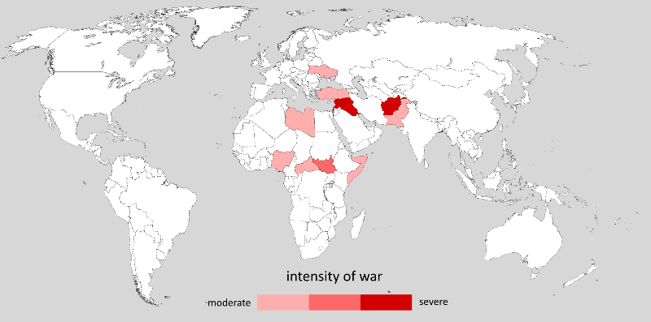
A war-like world – a media beat up?

Slide 48
The Stability index in a graph

Slide 49
The best and the worst
The five most violent countries are: Syria, Afghanistan, Iraq, South Sudan, and Yemen.
The combined Middle East and North Africa was the least peaceful region in the world.
Iceland remained the most peaceful country in the world, a spot it has occupied since 2008.
The other four most peaceful countries are New Zealand, Portugal, Austria, and Denmark.
The US is slipping down the scale.

Slide 50
Terrorism and peace
England, France, Spain, Germany, and other European states clashed violently for centuries, but war between these members of the European Union has become unimaginable.
London mayor says being prepared for terror attacks 'part and parcel' of living in a major city.
Terrorism will fizzle out. The “war on terror” glamorises it.
Terrorism is, in fact, far less dangerous than widely believed. Consider, for example, that a total of 19 Americans have been killed in four separate terrorist incidents carried out by Islamist extremists on American soil since 9/11
Three Waves
1 – those who joined Bin Laden in Afghanistan in the 1980s
2 – those who joined AQ in the 1990s now hiding out in Pakistan.
3 – those who congregate on the Internet. Vulnerable as soon as they start to organise. Young, criminal element – bored, anti social, poorly educated and egging each other on. More gang members than religious fanatics.
As the western powers leave the Middle East these will die out.

Slide 51
Putting today’s threats in perspective
Although the world will never be free from dangers, we should aspire to understand them clearly. Maintaining perspective isn’t easy when we are bombarded with images of fighting from Eastern Ukraine or Gaza. But, in many instances, we are today merely seeing what has always existed beyond our field of vision. Tragic, even horrifying, stories of human suffering do not portend that we are living in a more dangerous world. In most respects, we are living longer, better lives. Our chances of suffering a violent or premature death are very low, and still declining. And our prosperity and broader wellbeing are protected by a dynamic and resilient international economy, and by the spread of powerful ideas that have reduced poverty and disease.
A better understanding of what actually threatens us will help us tame our tendency to overreact.
Ref - https://www.cato.org/policy-report/septemberoctober-2014/most-dangerous-world-ever

Slide 52
Reading guide

Slide 53
Norman Angell – the Illusion of war
Published in 1910 - Angell argued that war between industrial countries was unlikely because it would be too costly.
Angell said that arms build-up, for example the naval race that was happening as he wrote the book in the early 1910s, was not going to secure peace. Instead, it would lead to increased insecurity and thus increase the likelihood of war between industrial countries was futile because conquest did not pay.
It is sometimes said that the outbreak of World War 1 disproved Angell's argument in The Great Illusion, but Angell had not maintained that a war was impossible, rather that it would be futile.
The British took it as meaning that war was unlikely. The Germans took it as war was inevitable and necessary.

