Slide 1
The defence of Australia
U3A Beechworth 2018
“In 1938, the bloke who built my house trained as a mounted officer. Two entire light-horse divisions graced the order of battle. Two years later, he was flying Spitfires. I hope our forces today can evolve as quickly as he did”.

Slide 2
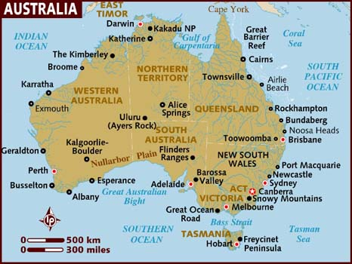
The problem – we cannot defend this?

Slide 3
The three pre-occupations for defence
A sense of threat.
A need for powerful friends.
Forward Defence.

Slide 4
The threat scenario
Out numbered in Asia by 200 to 1. 1951 – 7 million Australians
Away from the centres of world power.
A massive coastline – 42,0000 kms
The legacy of the Japanese threat in World War 2. The Brisbane line. The treatment of POWS by the Japanese
Erratic if not hostile governments in Asia post WW2.
The domino Theory – China Vietnam, Malaya, Singapore Indonesia Australia (the last domino). Communist insurgencies supported by China.
The rise of the PKI in Indonesia. The blank cheque for the F111s, Bloodhound missiles in Darwin.
The test in Vietnam.

Slide 5
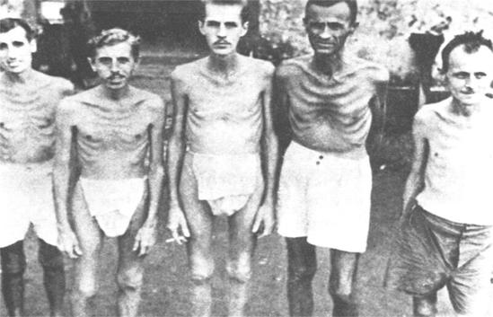
A reminder

Slide 6
The need for great and powerful friends
Traditionally British – it was considered “home”. We were culturally superior and “white”
British lifestyle and culture at home.
But there were doubts – Anglo – Japanese naval Treaty of 1902.
The Great White Fleet visit from the US in 1908 showed us options
A century of concern over the threat posed by the Japanese after their invasion of Korea in 1910 and then their spread throughout China in the 30s.
Over reliance on Singapore naval base.
Pearl Harbour” – “ I told you so”.
Troops released from Europe to head back to Australia.
PM Curtin’s speech after the fall of Singapore.
MacArthur arrives in Brisbane after the fall of the Philippines.
Australia as the secure rear in WW2. and the base of the island hopping campaign to defeat the Japanese.

Slide 7
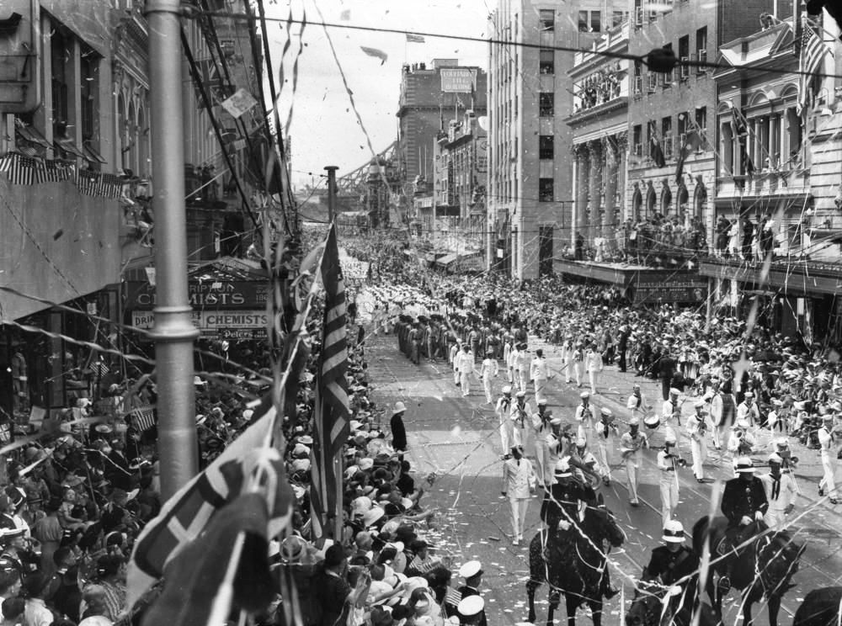
The American Fleet in Brisbane 1941

Slide 8
Forward defence
Colonial powers – Dutch in Indonesia, French in Indo China and the English in Malaya and Singapore created a secure northern perimeter.
Once they were gone that security was lost.
Active engagement in the Malayan Emergency 1948 – 1960
Confrontation with Indonesia – 1963 – 1966. The massacre of Communists in 1965. “The Year of Living Dangerously”.
In co-operation with the British during Malayan Emergency and The US in Vietnam but not with the Dutch in Indonesia.
Menzies turns the clock back over Indonesia.
Concerns over the commitment of the British to our defence and security. The Fall of Singapore and the “East of Suez” policy. (1968).
Vietnam 1964 – 1972.
Five Power Defence arrangement with Malaysia and Singapore

Slide 9
Our Wars
Sudan 1885
Boer War (1899-1902)
China (Boxer rebellion) 1902
First world war (1914-18)
Second World War (1939-45)
Occupation of Japan (1946-51)
Korean War (1950-53)
Malayan Emergency (1950 - 60)
Indonesian Confrontation (1963 – 66)
Vietnam War (1962- 75)
Iraq First Gulf War (1990 -91)
Afghanistan (2001 – Present)
Iraq second Gulf War (2003 – 2009)
Peace keeping (1947 – Present)
Plus 38 peacekeeping missions some going for years (e.g. Kosovo) and some dangerous (East Timor (1999)

Slide 10
Since then
In the 1970s things became a little easier.
China and Indonesia became less of a threat. Particularly Indonesia as the Communists were removed and right wing Army Generals assumed power.
The US maintains a strong presence in the Pacific after Vietnam
No strong regional powers to challenge us
Complacency sets in – Howard/Rudd - no threat till 2030 so slow to start on the subs.
However China’s growth since 2010 has been remarkable. The country we cannot mention.
Uncertainty about the nature of threats has affected purchasing and procurement.
A different world view from that of the US?
China once the threat – then communism in SEA, then Indonesia, then terrorism and now China once again?

Slide 11
Defence spending
2% of GDP or $33bn this cycle.
Australia’s defence spending is expected to increase by over 80 percent — from A$32.4 billion in fiscal year 2016-17 to A$58.7 billion in 2025-26 — over the next decade.
42% goes on wages.
18,000 employees in Russel Hill Canberra (in 1938 it was 57).
63,000 personnel in our Armed Forces
Big ticket items – 12 submarines ($50bn) by 2050. Ground based missile defence for the Army ($1.5bn). F35 – 72 x $98 million each.
A$200 billion over the next ten years under the Integrated Investment Program on new military hardware, with A$89 billion allocated for the Royal Australian Navy’s (RAN) shipbuilding program alone. Among other things, the RAN will acquire three Hobart-class Air Warfare Destroyers, nine new future frigates optimised for anti-submarine warfare, 12 new offshore patrol vessels, and 21 patrol boats.
Money and the need to keep up . Reagan and the USSR.

Slide 12
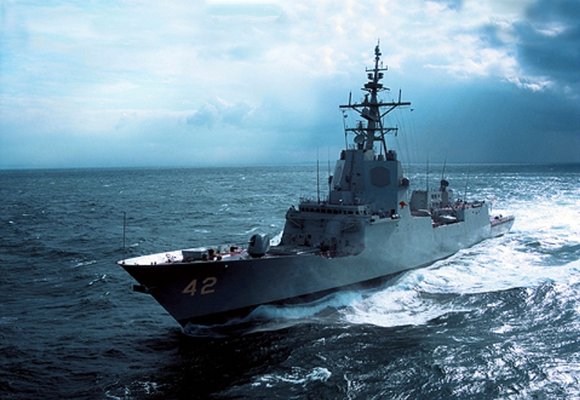
Hobart Class AW destroyers

Slide 13
Where we are at
Air Force
109 frontline fighters – 2 F35 plus F18 Super hornet and F18A and B.
8 C17 aircraft plus 12 Hercules J models
14 Maritime patrol aircraft
6 AWACS.
Navy
49 ships – 10 frigates and one destroyer. 6 Collins class submarines, 2 helicopter carriers. Divided between Sydney and Perth.
Army
20 Black hawks, 10 Chinooks, 59 main battle tanks. 31,000 troops – 2900 overseas.

Slide 14
2017 Defence white paper
A step back for Australia after expectations from Turnbull that Australia would become involved in any Korean conflict.
However without the alliance, Australia would have to triple or quadruple its defence spending, at a budgetary cost of an additional $70 billion to $100bn a year.
We support ANZUS but does the US – Howard invokes it after 9/11 but nothing coming the other way.
The future according to Gareth Evans is: for the foreseeable future is going to have to be founded on three core principles: More self-reliance. More Asia. Less United States. US isolationism could become a flood. There is no turning back.
Newly released White Paper on Defence – Great and powerful friends not so powerful anymore. Friction with China is “inevitable”. Australia must be sovereign and not reliant.
If the US does retreat, and China becomes more unpredictable, what else can we do? We can hedge building partnerships/free trade with Indonesia and India.

Slide 15
The critical issues
Defence White paper 2016. Up to 2% of GDP for defence by 2020 (i.e. $59Bn annually). $450bn over the next 10 years.
Big ticket items (F35s and Subs)
Sea lane defence – Defence has only 22 days reserve fuel, petrol stations 3 days)
91% of all our fuel imported via Singapore. Fuel refineries closing here (7 to 3)
Whom are we defending against? Threats determine nature of defence spending. Most Australians do not fear our neighbours.
More concerned about terrorism than anything else. The US has moved on from that – a new Cold War?
Purchases take a long time from concept to operations and deployment. Technology moves too fast for that – what is stealth today may not be stealth a year or two from now but the we are relying on ships, submarines and aircraft to maintain a technical lead for decades.

Slide 16
Problems and buying disasters
The ‘Sea sprite’ helicopter fiasco when we tried to make an ASW (Antisubmarine Warfare) helicopter from airframes that had been in the Arizona desert since the ‘60s.
The exercise was aborted after we spent $1.4 billion. They never entered service
Army buys 200 camera armed drone at a cost of $500,000 each.
Torpedos for the subs – documentation only in French and Italian. Sometimes no documentation from US products at all.
22 Tiger helicopters bought from Airbus at $1.5 bn deemed too unsafe to fly.
Land 400 project to buy armoured vehicles at $20bn total.
Navy problems with LHD (large Helicopter docks)
HMAS Manoora, HMAS Kanimbla and HMAS Tobruk large amphibious ships often in port for maintenance.

Slide 17
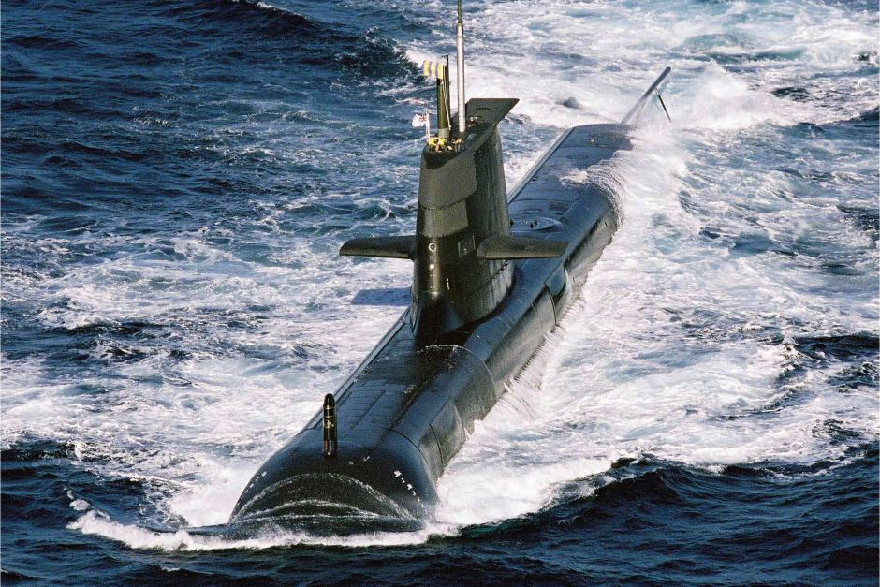
And those subs $50bn worth

Slide 18
The submarine question
Why 12? $50Bn to build 12 French made diesel subs to be delivered between 2020 and 2050. Japanese had been tipped to win. Rapidly out of date?
Would it have been cheaper to have them completely built in France? Adelaide a political decision – Note David Johnston’s criticism of the shipyards there.
2800 jobs in Adelaide but 4000 jobs in Cherbourg.
Why not off the shelf nuclear subs? Virginia Class. Nuclear version of DCNS sub possible in the future as the Australian public becomes more in favour of a home-grown nuclear industry.
6 Collins subs (only 3 operational at any one time) due to retire 2025 has crew of 60. Virginia class – 135. Could we staff it? Unlimited range and fuel but we have no nuclear industry. Would it make us too reliant on the US?
Conventional subs need to surface frequently to recharge their batteries, need to refuel every 70 days, and can only briefly maintain a top speed of about 20 knots. Nuclear-powered submarines, on the other hand, can stay submerged as long as the crew can endure, never have to ­refuel and can travel at nearly 40 knots.
Asymmetric weapon – subs are hard to detect and destroy.
All about sea denial not control.

Slide 19
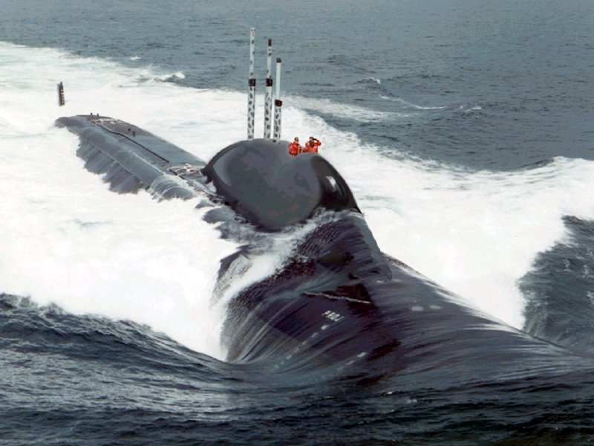
The submarines – the nuclear option
experts are warning that the rapid onset of technology in unmanned underwater vehicles will likely render Australia’s submarine fleet obsolete before the acquisition program is complete. Leasing proven platforms would buy Canberra time in a race to the future.
Mixed manning with US crews?
Virginia class comes with Harpoon and Tomahawk cruise missiles.

Slide 20
Why the F35?
The F35 will replace the F18s.
We probably need 200 front line fighters not 100.
We are getting 72 of them at a total cost of $24bn. Cost could come down.
A multi role “all in one” aircraft – but range too short –
bomb load too small and not an air superiority fighter.
Range a problem – F111C had a 6,000 km range. F35 – 1920 kms. Combat radius – 1090 kms Without refuelling.
F22s no longer made and the US would not export it anyway.
On the other hand stealth and early detection as well as integrated electronics with ground forces its strength. With its own secure server its shares the view of the whole battlefield. Total 360 vision.

Slide 21
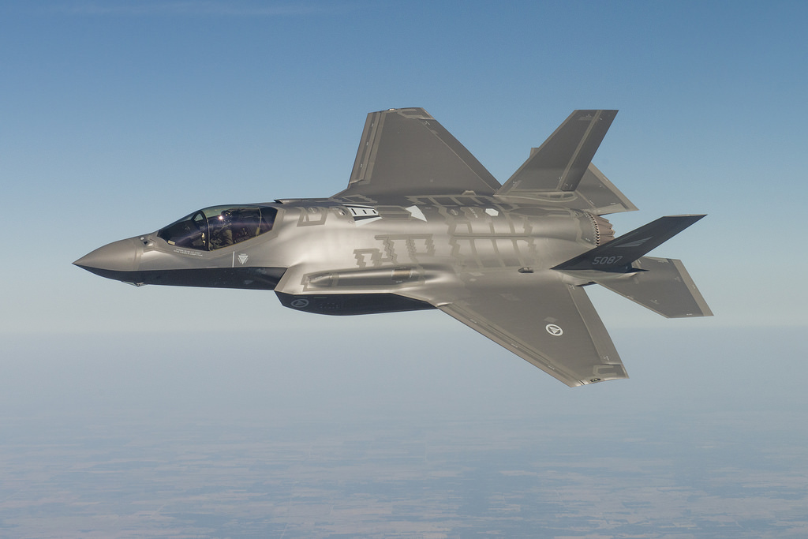
The F35 purchase

Slide 22
The Armed Forces future
It is 2030 and Australian soldiers are moving into a crowded megacity in which peace and order have collapsed amid fighting between rival ethnic factions.
Micro drones the size of birds or insects fly ahead, scoping for threats. The soldiers wear augmented-reality goggles that project easily digestible information – where their comrades are, where the enemy might be, any religious buildings they must avoid shooting at, the distance to their objective, whether a local man's face matches that of a known bomb-maker.
If it is a long patrol, the soldiers will wear exoskeleton suits that allow them to carry gear weighing many times what they could normally carry. They may also be followed by sled-like drones that bring extra ammunition and can help evacuate wounded soldiers. Wheeled drones with ground-penetrating radar search for improvised explosive devices.
We are spending billions of dollars to digitise the Army - turning the Army into an “internet of things”.

Slide 23
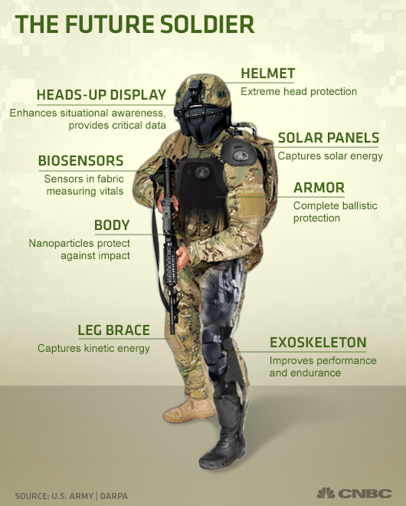
The Army

Slide 24
Where are the threats?
China?
An isolationist US?
Indonesia?
North Korea?
Cyber attacks?
Climate change?
Terrorism?
Not Russia or China says the government. (Jan 2018)

Slide 25
And what of the future?
Predictions are fraught with danger – e.g. 1870 – rail, artillery and sudden attack will win the day. It did until WW1.
1930s – aerial bombardment is the way to win – not realised till Hiroshima and Nagasaki.
1990s – US in Iraq – Stealth, surveillance, precision munitions – then 9/11 happened.
But we do now that by 2040 70% of the world will live in cities – therefore more urban warfare like Aleppo where hi tech has less of a bearing on the outcome.
We also know that Russia and China will not accept accept Western dominance forever. – hence annexing Crimea and destabilising The Ukraine. China and the SCS.
Grey zones - - hybrid warfare using, military, economic, intelligence and criminal means to achieve ends. Who is attacking you?
Russia’s little green men in Eastern Ukraine. Russia not trying to defeat Ukraine but to stop it moving West – a message for Belarus? Also avoids unpopular interventions abroad. Like Afghanistan
Trolls, facebook plants and the use of proxy militias, China and Hainan fishermen, Iran and Hezbollah.

Slide 26
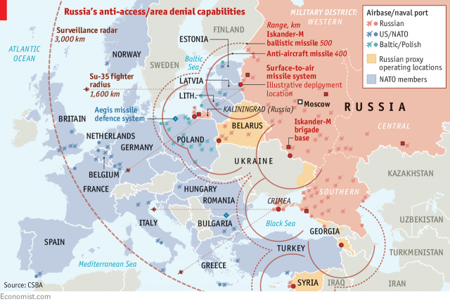
Russian area defence

Slide 27
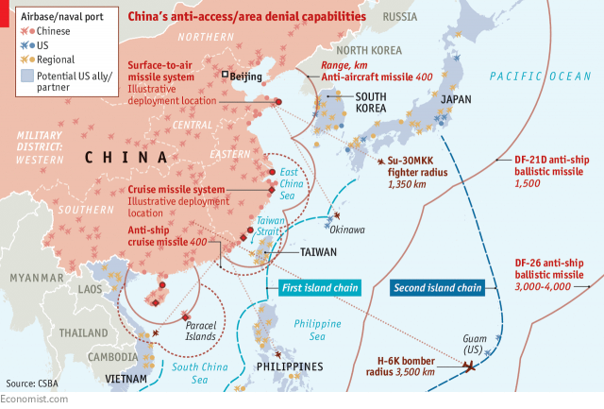
And the Chinese version – area denial – no more carriers in the Taiwan strait

Slide 28
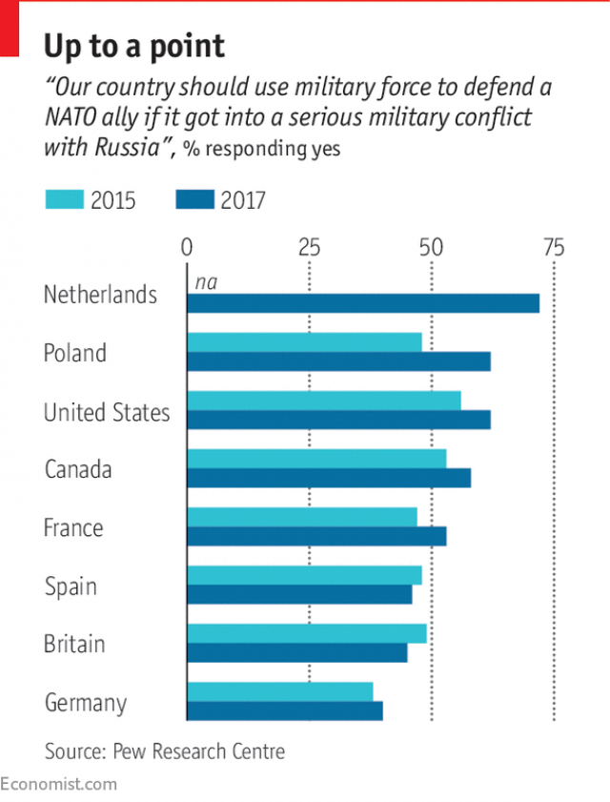
Russia and NATO and the US in Asia?

Slide 29
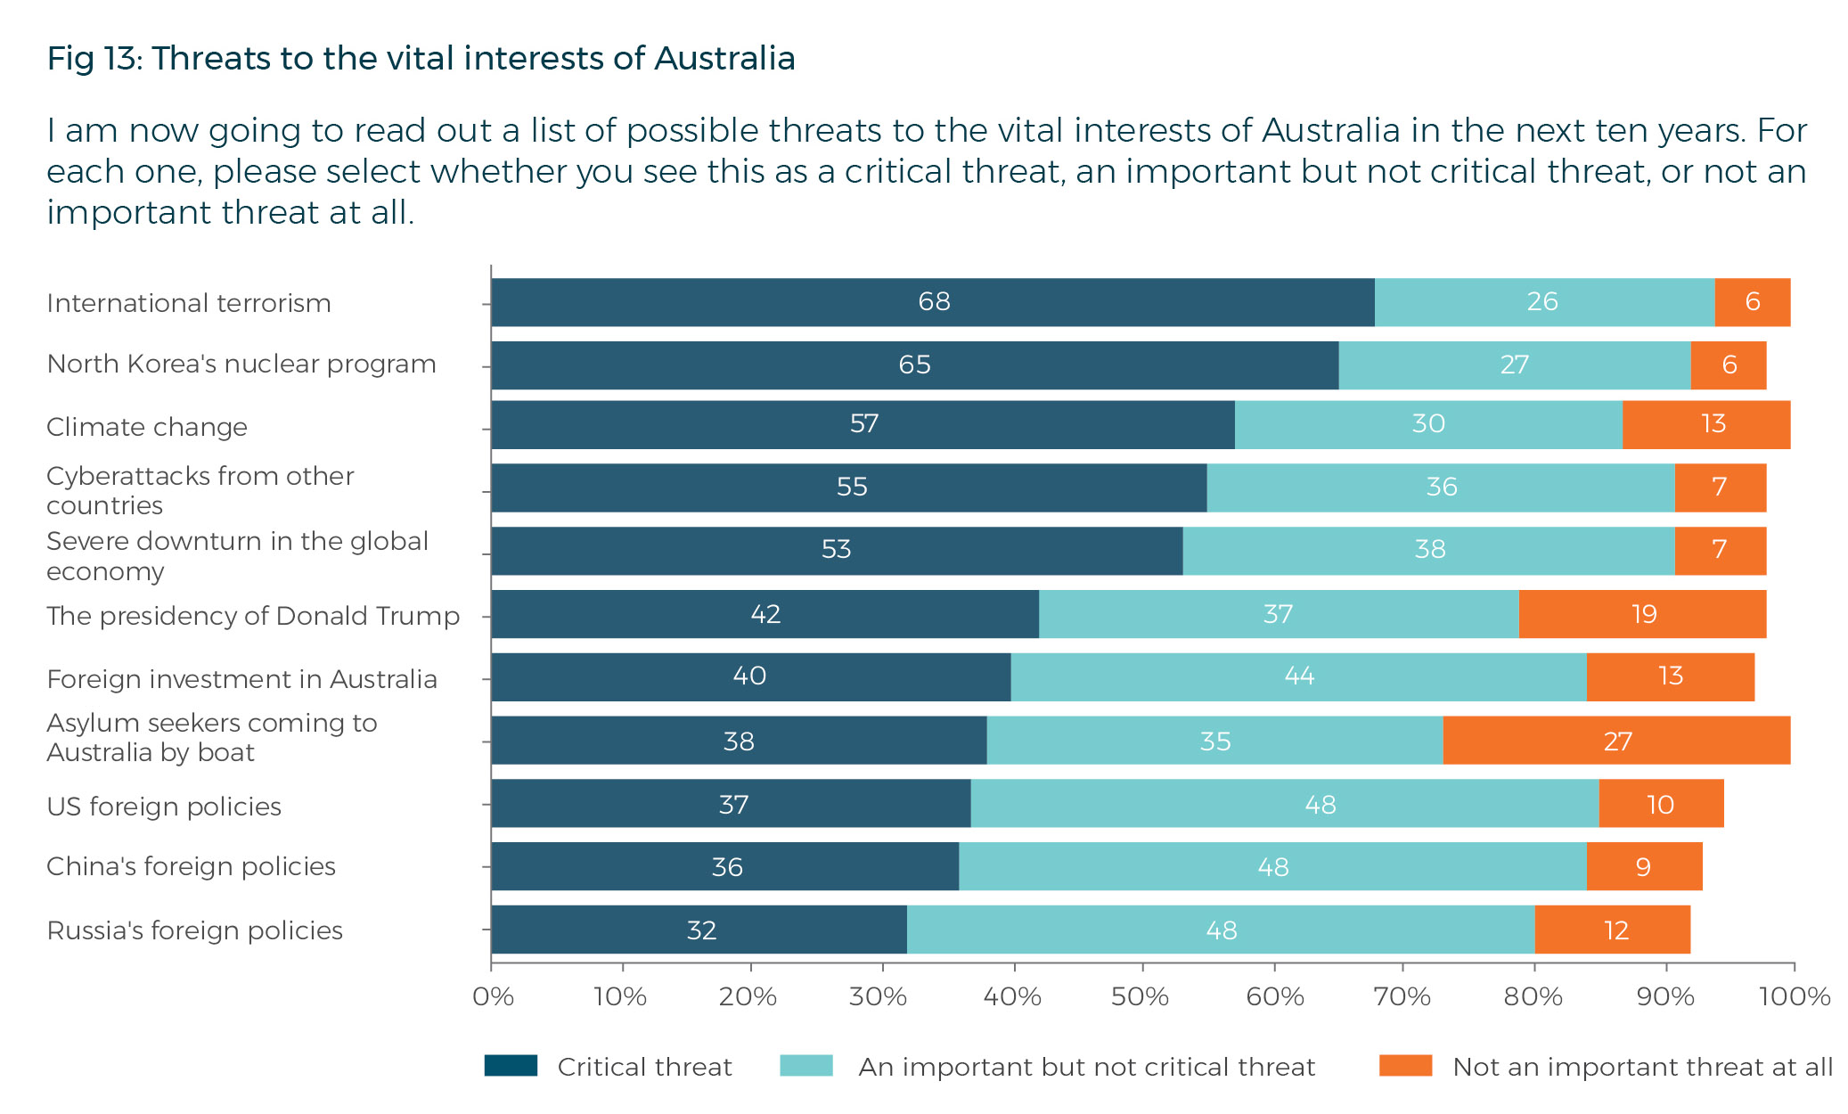
Threats to our vital interests

Slide 30
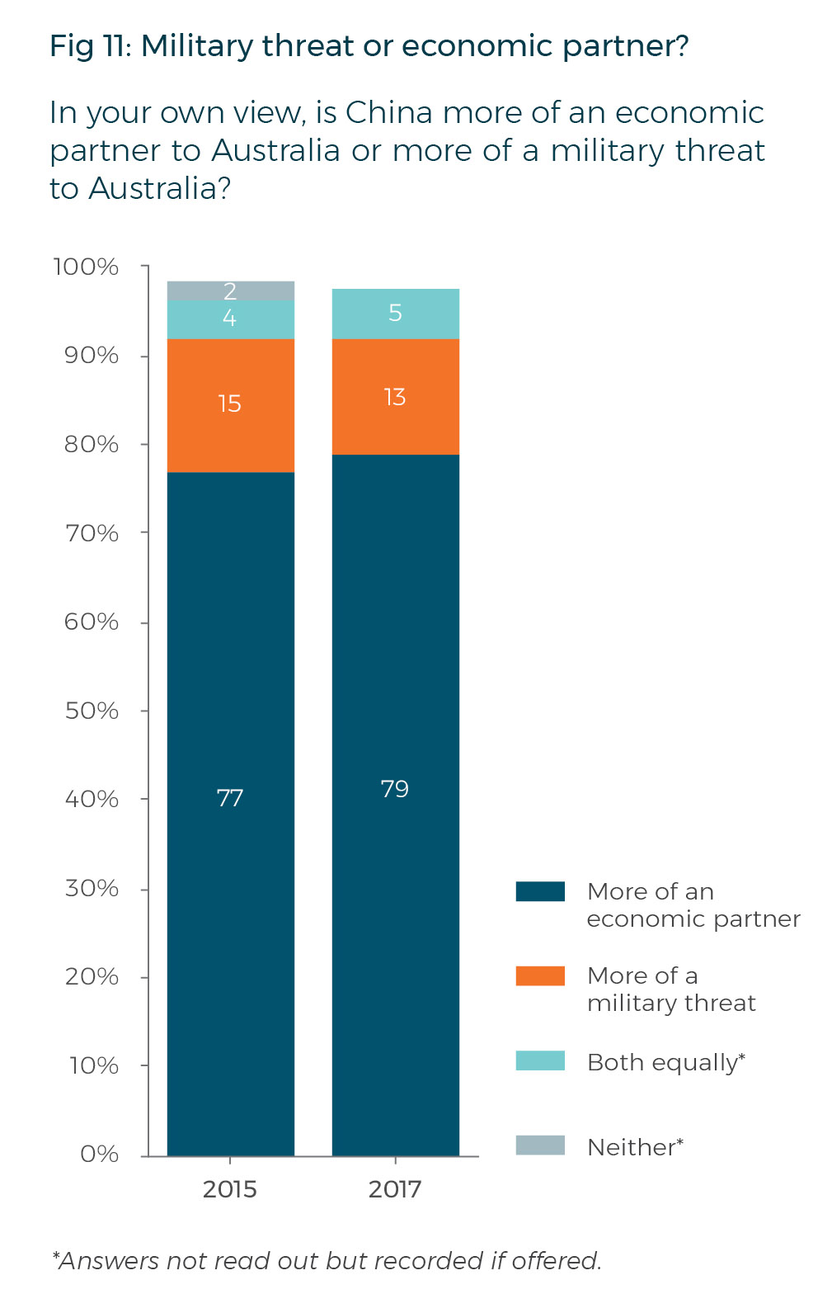
Threat or partner?

Slide 31
ANZUS – the cornerstone of the relationship with the US
Signed in 1951. Now AUSMIN – NZ left in 1984 but back in 2010?
US needed a Japanese Peace Treaty.
Anti Japanese pact – one of many the US signed.
No guarantees. Consultation. Also binds us to the US
No standing force like NATO.
A reward for our part in the Korean War?
What if there was conflict with Indonesia? 1999 East Timor and 1982 – the Falklands.
Yet US expected us to support them with troops over Taiwan.
Involvement in FONOPS in the South China Sea?
Nevertheless PM Turnbull invokes ANZUS over North Korea.

Slide 32
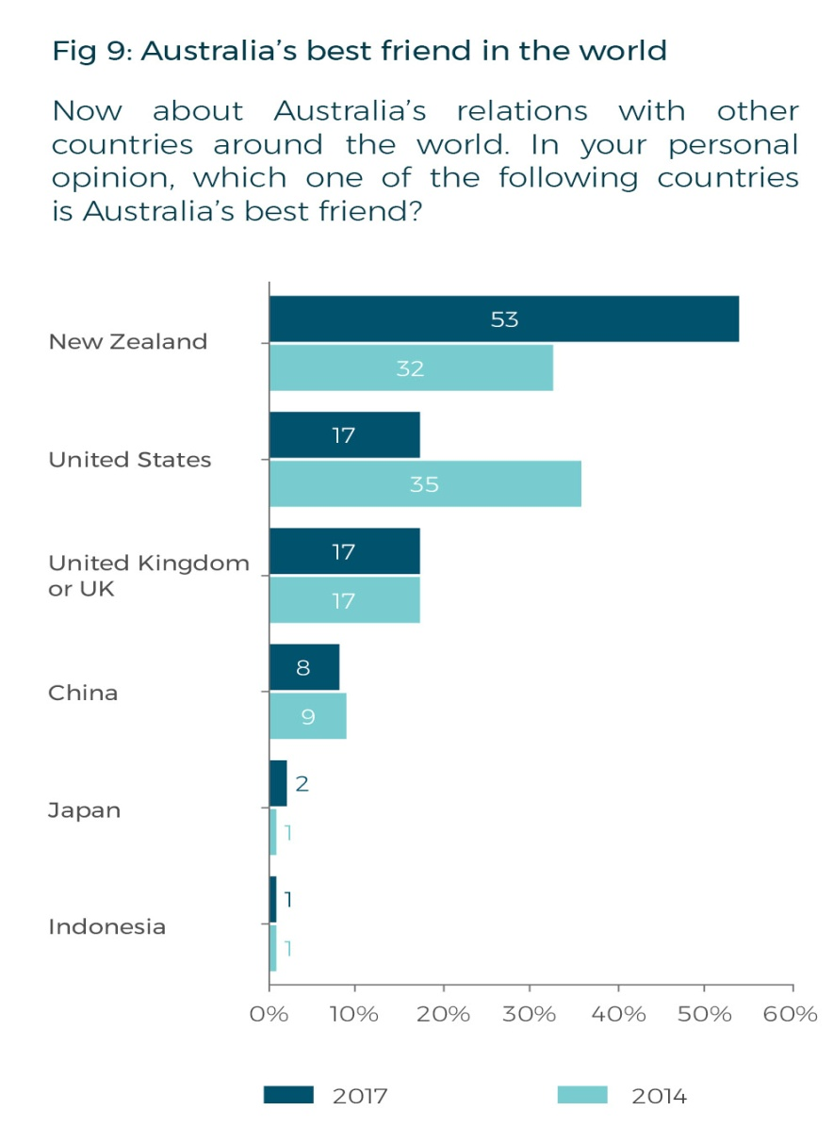
Our best friends

Slide 33
Our ties with the US
From China’s perspective the problem is not US bases in Australia but that we are an American base
Australia buys 10% of all US Arms exports – single biggest customer.
We are the 7th largest arms importer in the world.
$1 billion spent on US WGS satellite. Satellite system improves global reach of drones. Tied into the US way of doing things?
Space radar move to NW Cape (2010)
2014 Force Posture agreement (25 years) ties us even more closely in.
Went to Afghanistan purely because of the US?

Slide 34
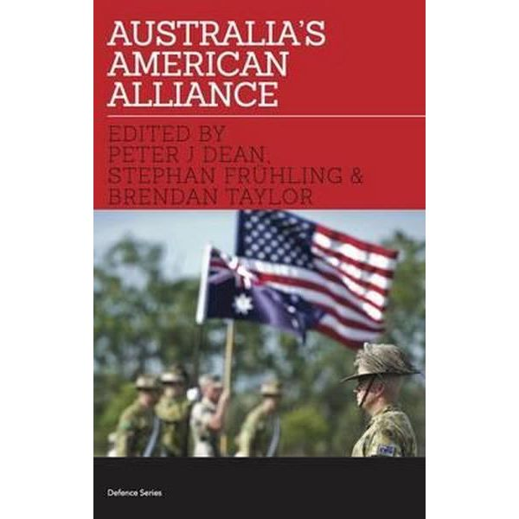
Our relations with the US and planning
We cannot defend ourselves.
Shared values with the US.
Access to intelligence (sat imaging) and technology
Provides a deterrent if nothing else....
Provides stability in the region who like the US being there.
Valuable combat experience for our troops.
Voters like it but only 38% support possible US action in Asia?
No immediate threat in the region.

Slide 35
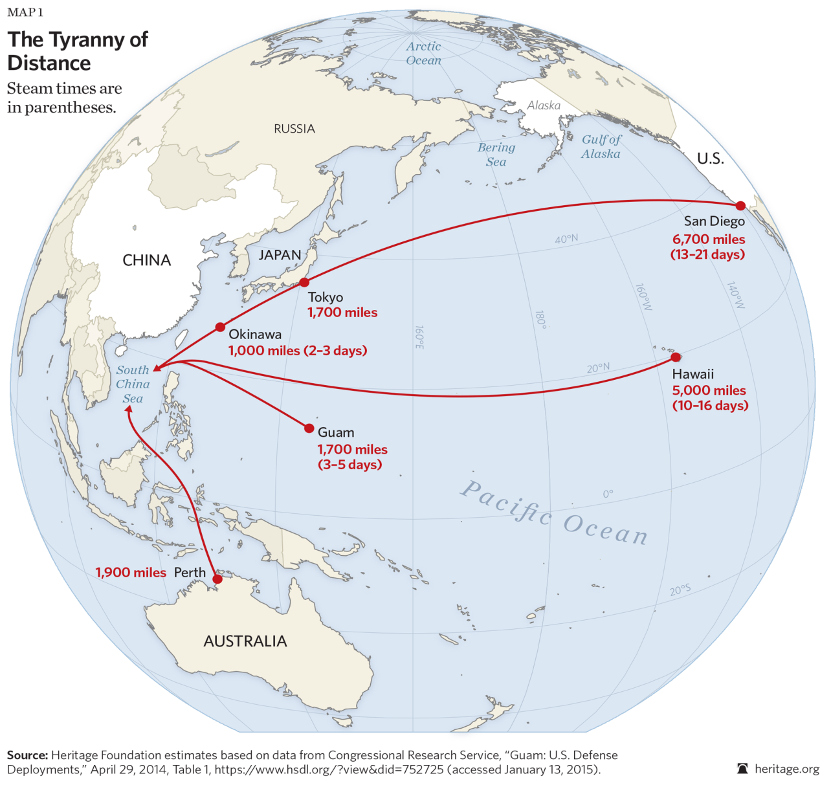
And the tyranny of distance

Slide 36
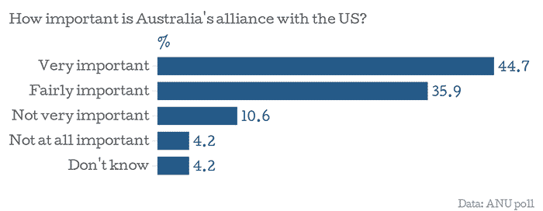
What the voters think

Slide 37
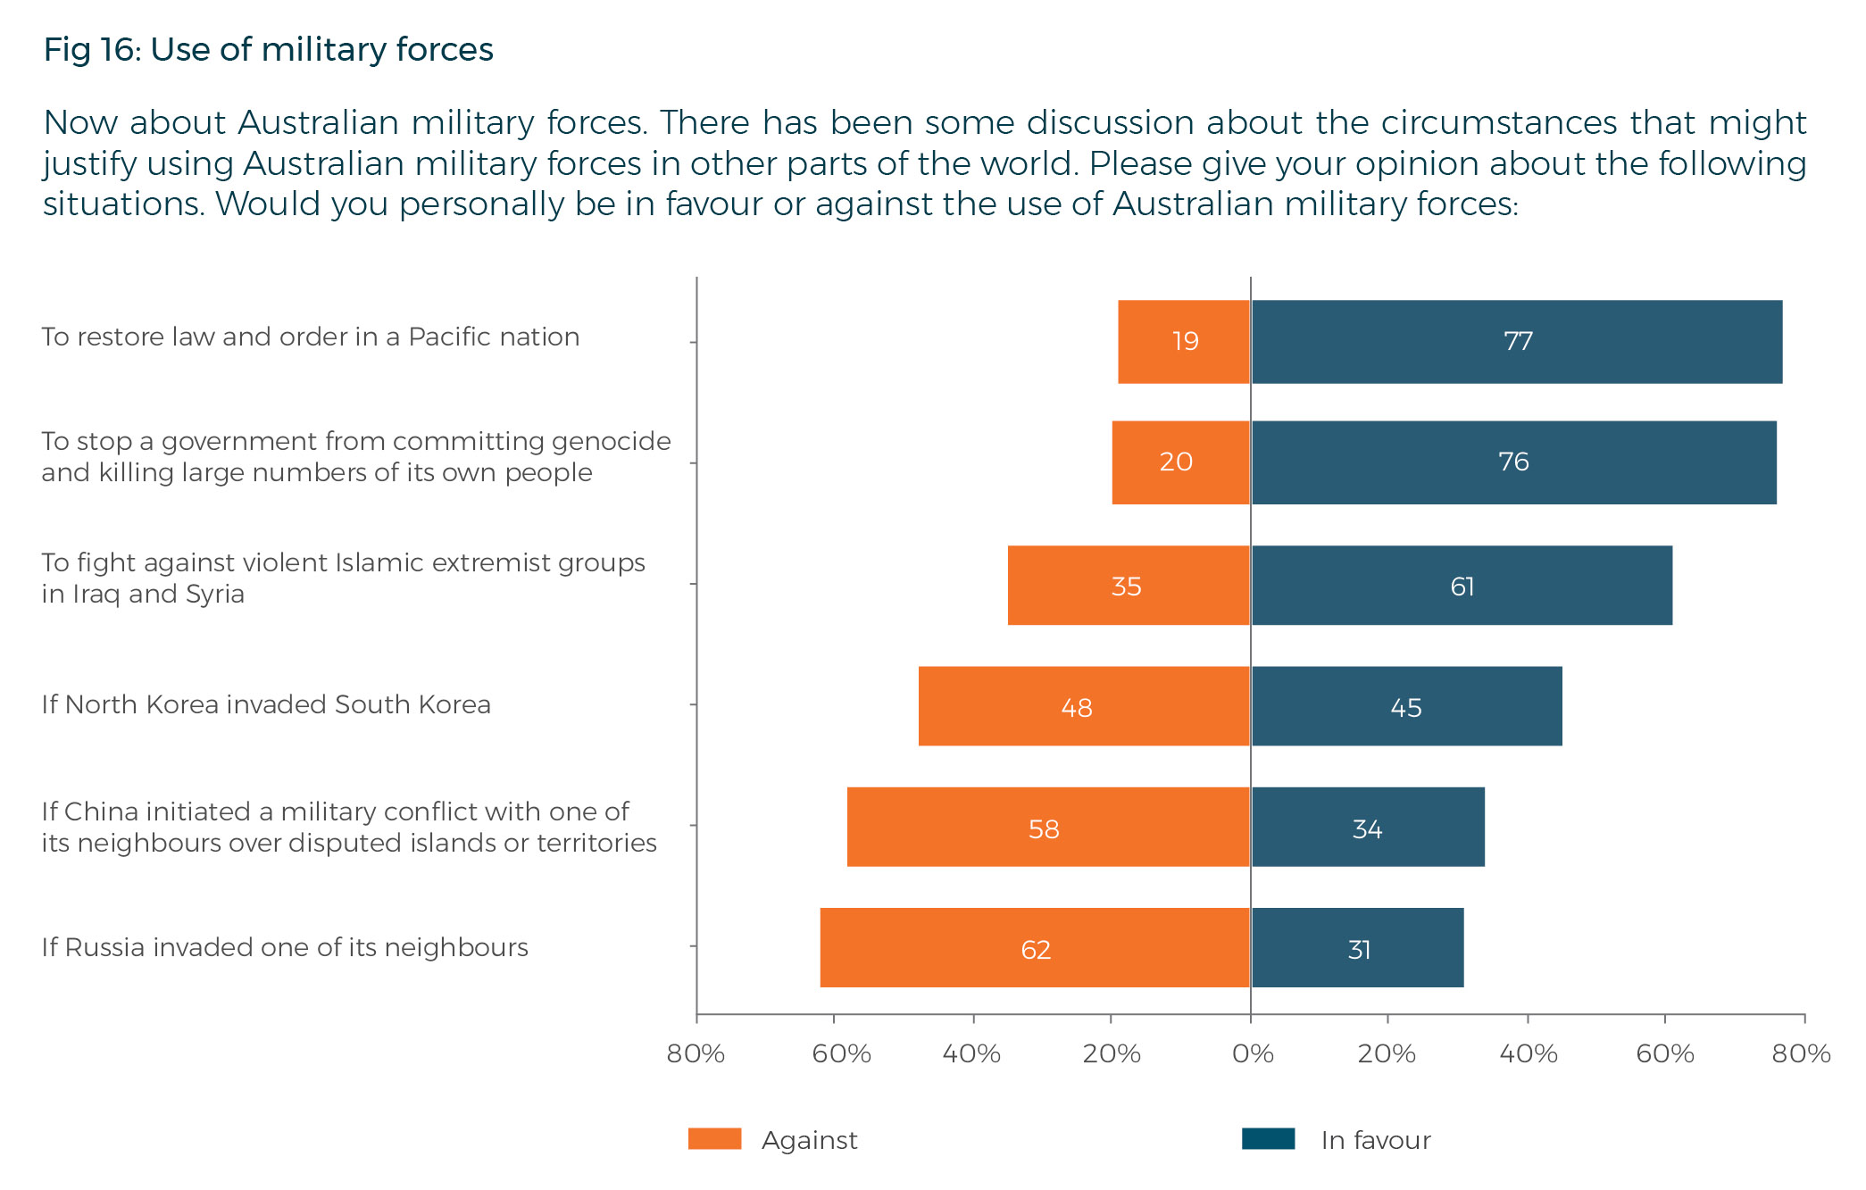
Where and when should we use military force?

Slide 38
Indonesia a threat?
Indonesia has a population of 220 million.
It is a land power – Australia is a sea and air power
Whatever threatens us will come from the North either from Indonesia or a Chinese attack on Cocos – Keeling/ Christmas Island.
Russia built up Indonesia defence forces in the 60s – we got the F111 in reply.
Quieter time after Sukarno was deposed only to flare up again over East Timor in 1998.
Greatest concern is the rise of religious nationalism in Indonesia
Or conflict on the PNG border. It is the only border we share with anyone. Whitlam would not back PNG in conflict with Indonesia but Beazley in 1986 said we would.
Indonesia a focus for the 5 eyes group.
TNI 395,000 strong of which the Army has 300,000 personnel.
Air Force – 110 aircraft (16 SU27 and 24 F16s)
Navy – 2 subs, 2 frigates 2 corvettes and sundry patrol boats.
Indonesian military more into making money – very little sea capability

Slide 39
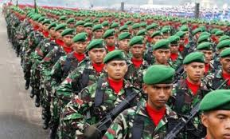
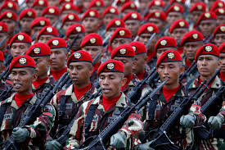
The Indonesian Army

Slide 40
Is China a threat to Australia?
China is creeping southwards and establishing an air power that ASEAN cannot match.
1 limited aircraft carrier. A blue water navy is still a long way off. Limited force projection given that mot of the US’s carrier groups (12 of them) are in the Pacific
In the next 20 years 50% of all the military aircraft and ships will be in the Pacific
Chinese military designed to keep borders secure.
China has been traditionally inwards looking and expansion such as OBOR is essentially trade related and a soft power approach..
China a threat to our sovereignty? Buying influence in politics on both sides, controlling surveillance on Chinese Uni students here, threatening dissidents, controlling Chinese language media here.
while many people are wary of China, they are keeping their eyes on the economic benefits that a relationship with China offers.
Chinese see us a duplicitous. Fear and Greed. Should we counterbalance with closer relations with India?
What if China attacks regional neighbours?
Chinese parents not keen to sacrifice the only child?

Slide 41
The Cyber threat to Australia
Petya Ransom ware attacks of 2017 – directed at the Ukraine and Baltic States?
Stuxnet
NSA hacking tools stolen.
Attacks on Australia. the Australian Signals Directorate responded to 671 cyber attacks in the last financial year.
November 2016 – private defence contractor hacked by the Chinese. Plans for the new defence HQ compromised. The admin password, to enter the company’s web portal, was ‘admin’ and the guest password was ‘guest’.
It included information on the (F-35) Joint Strike Fighter, C130 (Hercules aircraft), the P-8 Poseidon (surveillance aircraft), joint direct attack munitions (JDAM smart bomb kits) and a few naval vessels. ASIO HQ plans stolen by Chinese in 2013.
Democrats Podesta – change your pass word from Gmail fiasco.
Cyber warfare unit set up – 900 staff in 10 years? To counter both business and strategic attacks. Offensive capability as well as defensive. Hard to staff?

Slide 42
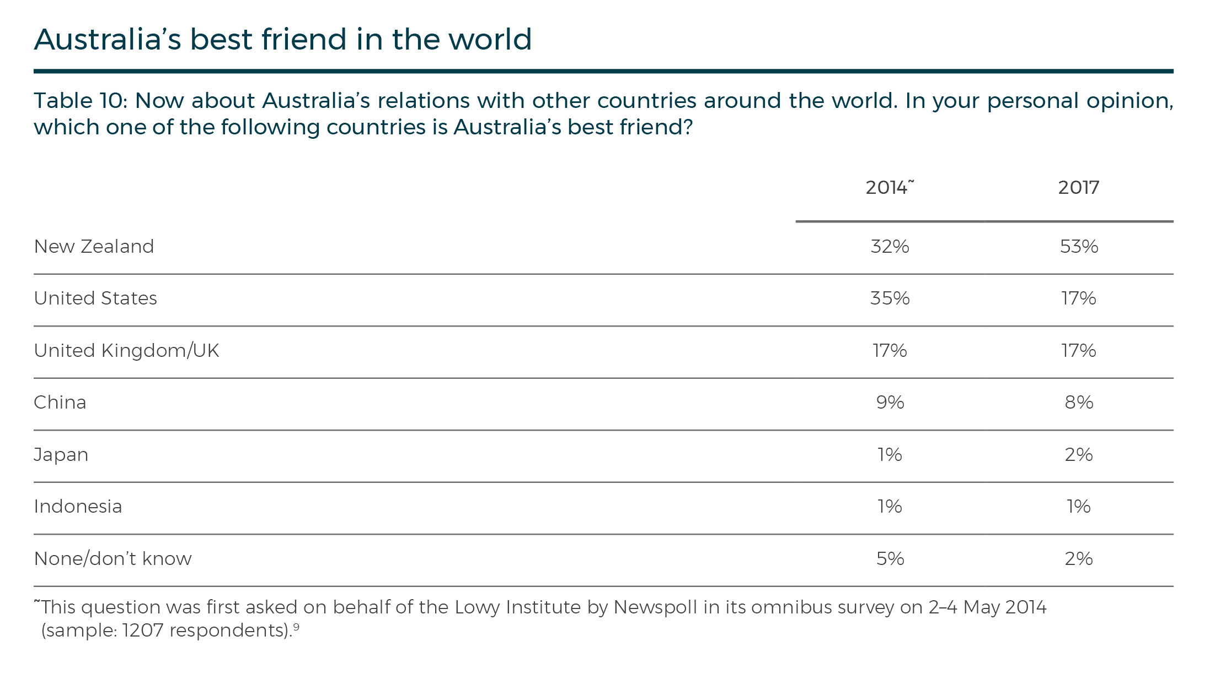
Who can we trust?

Slide 43
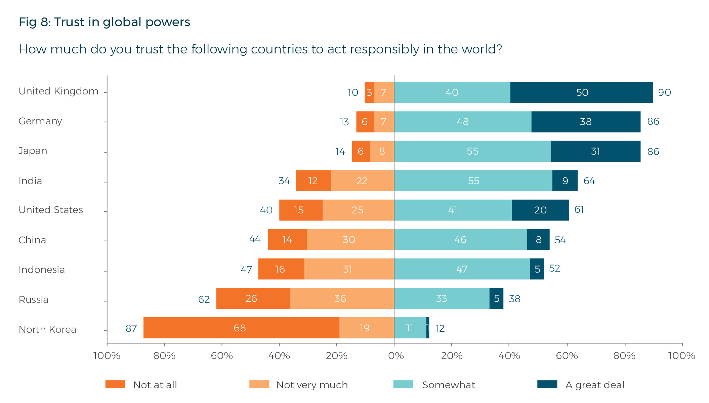
Trust in global Powers

Slide 44
The Spies
ASIO - The Australian Security Intelligence Organisation is the country’s domestic spy agency. It collects intelligence on security threats which could harm Australians at home
ASIS - The Australian Secret Intelligence Service is the overseas spy agency. Like the CIA in the United States, it collects human intelligence — which is jargon for recruiting a network of contacts
ASD - The Australian Signals Directorate (formally the Defence Signals Directorate). The agency that bugged the Indonesian president’s phone, the ASD is akin to the United States NSA. Like ASIS it is a collection agency. It gathers signals intelligence — where ASIS uses personal relationships to find secrets, ASD uses technology
DIO - The Defence Intelligence Organisation is an assessment agency, also under the Department of Defence. It analyses foreign developments and produces intelligence assessments for the Australian government.
DIGO - The Defence Imagery and Geospatial Organisation is a collection agency. It gathers imagery and other “geospatial intelligence”.
The ONA - The ONA is a one-stop-shop for the prime minister and other senior cabinet members. It gathers information from all the other agencies as well as from diplomatic reporting, and open sources such as news reports and then provides advice to the country’s leaders.

Slide 45
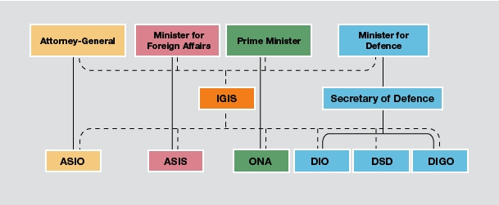
Defence and the spies

Slide 46
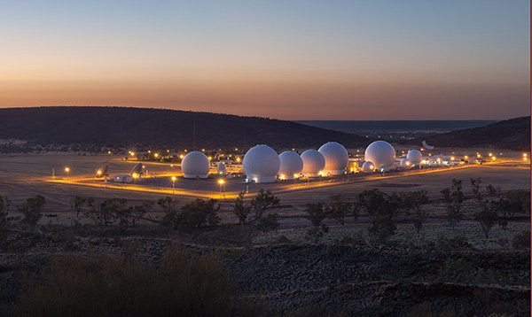
Pine Gap

Slide 47
Can we defend ourselves?
The seas to our north are occupied by friendly powers mostly. A power like China would have to sail through these waters.
No one is going to send 100,000 troops out over the water unless all of our fighter aircraft and subs are accounted for.
5 eyes and JORN gives us plenty of early warning.
The sheers size of Australia and the problem of over extended supply lines. Attacking just Melbourne, Canberra and Sydney would need massive merchant navy resources – note the problem Japan had with this in WW2.
US still has an interest to defend here – Pine Gap. Assets in Darwin.
Geography helps – an attack on Darwin by Indonesia would succeed probably but then imagine the rest of the trip. General winter/ general outback
We do have the technological edge and can project power a fair way out.
But we do need long range strike fighters.
However we probably cannot defend ourselves against a flood of refugees.

Slide 48
Self reliance in defence
At the moment Washington is expected to provide strategic intelligence, space capabilities, a nuclear umbrella and, implicitly, ballistic missile defence. Worse, we expect the US to come to our assistance if we are 'under threat from a major power. Can we afford that?
Australia is independently self-reliant, but only against a force incapable of launching a credible attack on us anyway.
Can we do it like Sweden and Switzerland?
More soldiers needed. Conscription? Defence not always in favour of that.
White paper mentions it and then contradicts but nevertheless an increasing trend to self reliance. ALP supports it.
Greater use of soft power – aid more directed to the region – PNG stability a priority.
Conscription - $3bn pa on wages alone (2000 figure). 30,000 troops now. Had trouble putting 5000 into Timor in 1999.

Slide 49
The Bomb for Australia?
Like the British Navy we could have a nuclear armed sub to wreak havoc on the enemy if Melbourne and Sydney go. The Samson option.
Get our own bomb? It nearly happened in 1971 under Gorton.
Govt was to build a nuclear power station at Jervis bay ostensibly for power generation but really for Uranium enrichment. Dropped when Gorton left office.
It was because the US cut us out of nuclear weapons technology sharing.
We could still do it – we have the expertise, the Uranium and the Lucas Heights reactor. 2 years?
But unlikely as we have signed the NPT and are advocates for it.
It might start off a regional arms race..
Last survey showed 73% of Australians wanted a ban on nuclear weapons.
Would we use it? Against China? How would it affect our signing of the NPT?
Nuclear weapons have not prevented conventional warfare.

Slide 50
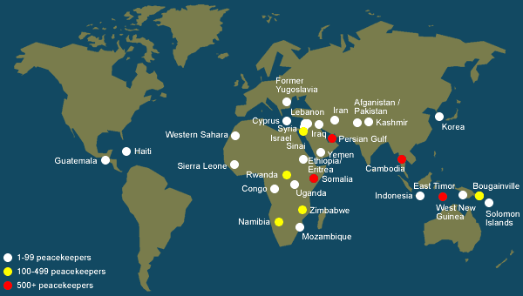
Peace keeping

Slide 51
Australia as an arms exporter
The government plans to create the $3.8bn defence export facility to provide finance to local manufacturers to help them sell more of their defence equipment overseas. It is part of the government’s plan for Australia to become one of the world’s top 10 arms exporters.
Australia currently is ranked 20th in arms exports with a 0.3 percent share of the global market.
The Bushmaster armoured four-wheel drive is one of Australia's best known military products. The vehicles have been purchased by foreign militaries around the world, including Jamaica, Japan, the UK and the Netherlands. Made by Thales.
Australia also exports parts for the new Joint Strike Fighter planes and life rafts for ships.
Priority markets for Australian arms include the US, Canada, the UK, New Zealand, the Middle East and the Indo-Pacific. Labour support – Greens do not.

Slide 52
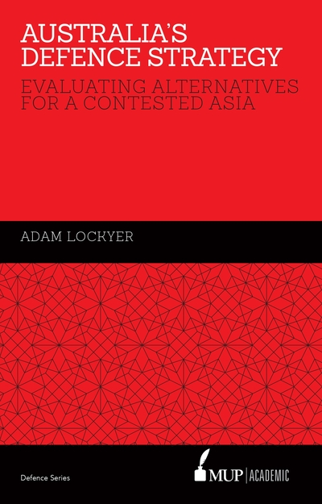

Reading guide

