Slide 1
The rise and fall of Empires
U3A Beechworth – 2017
Ideas from “Hariri’s book, “Sapiens”

Slide 2
What is an Empire?
An Empire must rule over a large group of distinct people with their own culture and territory.
Empires are by nature expansionist – Britain today has clearly defined national borders but 100 years ago anything could have been part of it.
It can be democratic or autocratic – Britain’s Empire was ruled by a democracy.
The size of an Empire’s population is not a defining characteristic.
Size does not matter – the Aztecs were an empire encompassing 371 different tribes but Mexico is not.
Empires were more diverse in the past. Smaller countries, many more of them and with smaller populations – e.g. – where Israel and Jordan now are in Biblical times there were dozens of nations.
The most common form of government off and on for 2,500 years.

Slide 3
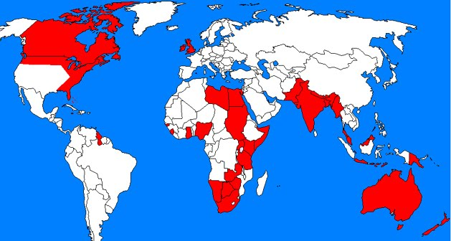
The British Empire

Slide 4
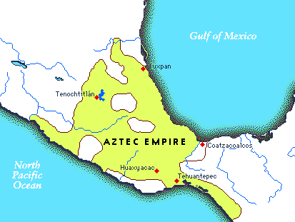
And the Aztec

Slide 5
Nation state vs. Empire
Nation states – inwards looking, homogenous, superior. (we British etc)
Empires – multi ethic, multi cultural, a civilising force, not selfish like nation states? A grand purpose.
history been but one of a revolt against empire in the name of nationality?
In the wake of the First World War, the great continental land empires,– the Russian, the German, the Austro-Hungarian, and the Ottoman empires – all came crashing down, to be replaced by independent nation-states that were widely regarded as their legitimate heirs.
Later came the turn of the oceanic or overseas empires of the French, the Dutch and the British. In a spectacular series of “wars of national liberation” their colonies claimed their independence.
The collapse of the Soviet Union in 1991 seemed to set the seal on the long-drawn-out encounter between nation and empire.
No state called itself an empire any more; only its enemies did so. The US an Empire in denial?

Slide 6
Empires - for good or evil?
Criticisms
1 – they get too big and cannot control so many peoples or they over extend like Portugal.
2 – They should not work because they exploit subjugated peoples and deny then their right to self rules
3 – they reduce diversity and often eliminate the uniqueness of its members.
4 - They ultimately rely on force.
5 - They are exploitative.
6 – Nazism and Communism – a lazy coloniser interested in ideology and power with everything else secondary.
6 – Evil perhaps or perhaps lazy or both like the Belgians in the Congo.

Slide 7
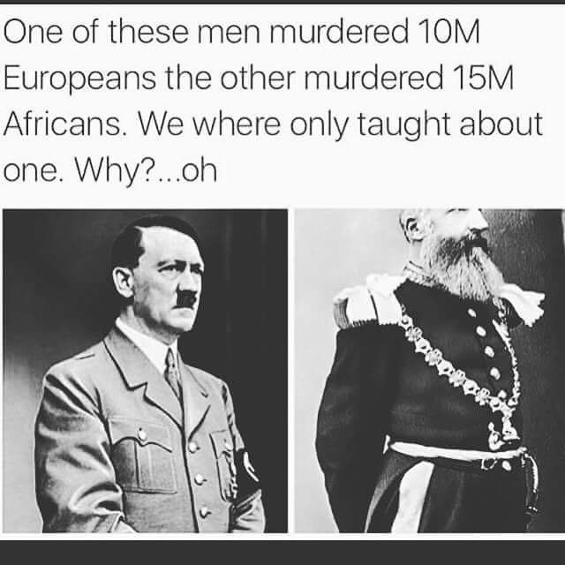
For good or evil?

Slide 8
Belgium in the Congo (1908 – 1960)
In 1884-1885, the Berlin West Africa Conference effectively divided up the African continent amongst the Great Powers of Europe including Belgium, France, Germany and England .
Granted to King Leopold II of Belgium, the Congo was a “personal” concession for the King. The King, not the Belgian government, effectively owned and controlled the Congo. Appalling brutality – whipped, hands cut off – 10 million died at the hands of Leopold’s agents.
Leopold administered the Congo in a notoriously brutal manner, for his own personal wealth. The Congo’s wealth, was brutally extracted using what was basically slave labour. Taken away from him by the Belgian government in 1908. Germany - the same massacres in South West Africa.
Educated Africans who could serve to unify the nation were basically non-existent. This was unfortunate because the Congo was home to many distinct ethnic groups and possessed incredible wealth in its natural resources. Colonial legacy – a dysfunctional place today. Play off one against another often installing a minority to rule through.

Slide 9
The economic drawbacks
Empires make the rules and set the conditions – Russians force Uzbekistan to grow cotton, Kirghizstan to make military equipment.
French rubber plantations in Vietnam, Sugar in Brazil and the Caribbean, tea in India, Spices in Indonesia.
Competition between empires for colonies – one cause for WW1 – Germans back the Boers, start the naval arms race, division over African territories.
The Slave trade – the globalisation of labour from West Africa to the Caribbean and the southern US. Indiana to Fiji etc , Chinese workers on - loan.
Theft - The British and the French in China during the Boxer rebellion and the loot stolen and valued from the summer palace.
Congo bordered by 9 countries all of whom want its wealth.

Slide 10
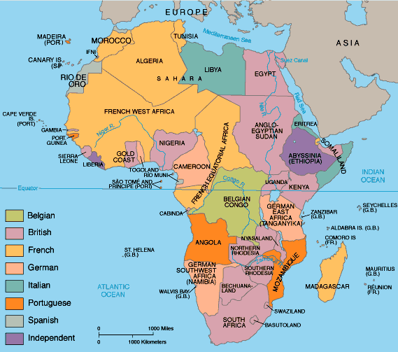
The dismembering of Africa

Slide 11
Other drawbacks
A one sided relationship – the colonies provided the raw materials which were then sent back as processed good to a growing market in the colonies – e.g. textiles in India. Opium used to create a vulnerable China.
Troops then stationed in strategic spots – Suez for the British and French and the Pacific islands for the US. Vital trade routes supported by large naval presence.
Infrastructure then built to facilitate the movement of exports.
Some create empires for livings space – lebensraum in Russia.
Repression of dissent.
Lack of national development – Education – Dutch in Indonesia for example.
An unbalanced economy.
Geography – land locked, unnavigable rivers – few ports.
Destabilised countries to keep them down– Stalin and Tajikistan – everyone has someone else’s people.
Libya always three provinces - Tripolitania, Cyrenaica and Fezzan - one country in 1951 – heading back to three states?

Slide 12
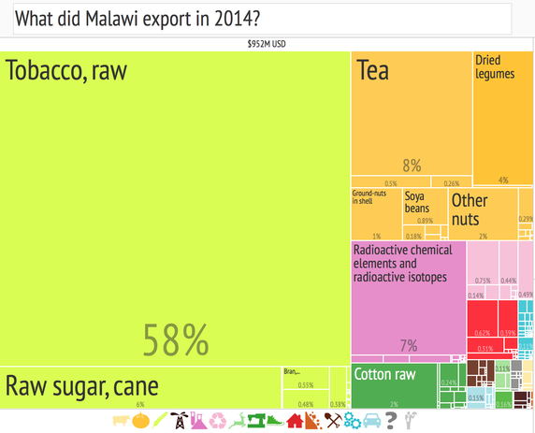
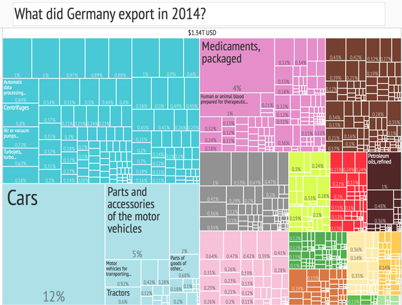
An unbalanced economy vs. a balanced one
Malawi
Germany

Slide 13
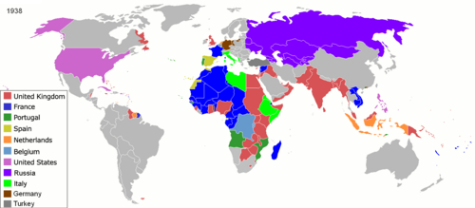
The Age of Empires

Slide 14
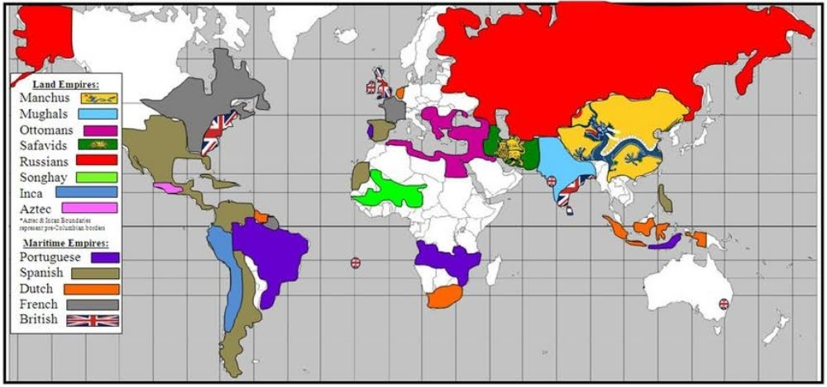
Empires in History

Slide 15
But despite the fact that they have had a bad name
They have stuck around for 2,500 years
They are incredibly stable – out down internal rebellion easily and are really only removed by outside invasion or by splits within elites. As soon as one is gone another one eyes off the vacuum created.
Most subjugated peoples stayed that way. “digested” and cultures fizzled out. The peoples the Romans conquered did not come back after 476 AD. Rare for states to resume independence. Yugoslavia won’t make a comeback.
e.g. The Middle East – passed backwards and forwards between Ottomans, British and the French and when they all finally left, the Phoenicians, Ammonites, Moabites and the Philistines were all gone.
Jews and Armenians the exceptions but even King David would not recognise the Jews today with their Eastern European clothes, their German Dialect (Yiddish) , their synagogues and their Babylonian text (The Talmud). There was no ancient Judea then either.

Slide 16
and by and large they left a legacy
Despite wars, enslavement, deportation and genocide they did provide:
Justice - appeals system
The rule of Law – no silk road without the Mongols to police it
Government – pax Romani
Infrastructure - no Taj Mahal without the Moghuls. Mongols and the Silk Road
written history - Tacitus, Herodotus
Culture – the roman writers
public works aqueducts, baths , piped water etc
Language – French in West Africa, Latin in Europe, English, French, Spanish and Arabic all the languages of Empire.
History and, in short
Civilisation.
Click here for “What have the Romans ever done for us?”

Slide 17
It’s for your own good
The first empire of Sargon the Great (c 2250 BC – Akkadian) started off as King of Kish and grew to take in all of Mesopotamia, like the Romans did in Italy.
Short lived but then followed by the:
  Assyrians
  Babylonians
  Hittites
Assyrians ruled for Assyrians but then along came the Persian King Cyrus – he ruled for everyone including the conquered and exiled Jews. His was the first modern Empire. His was not ethnically exclusive.
The emperor as parent and the subject peoples as children – mutual obligation – one big family.
Cyrus set the example for Alexander, the Romans, the Muslim Caliphs, the Indian dynasties, Mongols, China, the USSR and the US.

Slide 18
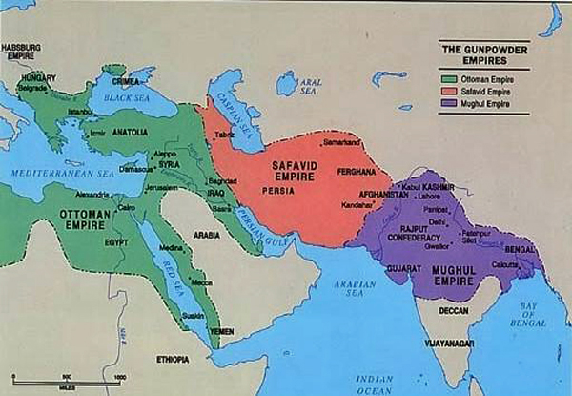
The great Islamic Empires
These empires established themselves out of the remnants of the Mongol Empire.
Ottoman – 1300 – 1922
Safavid – 1501 – 1722
Moghul - 1526 - 1858

Slide 19
A standard culture
Is what they are good at and it makes rule easier for them.
Good at creating one big culture, “They” becomes “us” process.
What they promoted
:
The Chinese way – bringing culture to the “barbarians” – time of Empire are stable and peaceful – a golden age and other times are chaos.
The Romans gave the Gauls and the Germans bath houses and learning.
Muslim Caliphs – spread the word of the Prophet.
Spanish and the Portuguese – souls for God.
British – liberalism and free trade.
Soviets – the advancement of world socialism. Russia greater than the sum of its parts?
Americans – Democracy and human rights. Is that now over with Trump?

Slide 20
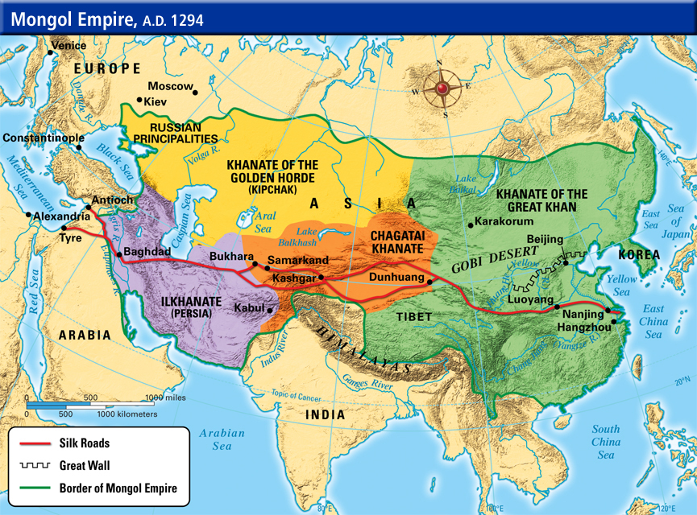
The Mongol Empire (1206 – 1405)

Slide 21
What did the Mongols ever do for us?
Massacred a lot of people and destroyed the great city of Bagdad in 1258. Islam built them and Chingiis Khan destroyed them.
They were tolerant of different faiths.
They valued trade (so they could tax it ).
Kept the Silk Road safe to travel on.
Gunpowder and rice travelled the Silk road among other things that kick started the European Renaissance.
Introduced the Great plague to Europe in 1347.
Treated their own women as equals.
A very efficient mail system.
Rest stations set up every twenty miles on major trading routes.
Collapse of the Silk Road after the Mongols disappeared. Led to Columbus’s search for Cathay in 1492 – the start of the Maritime empires of Europe.

Slide 22
And they absorb others
Romans took from the Greeks, Gods, tutors, drama and Philosophy
Mongols copied from the Chinese.
Arabs borrowed from Greeks and the Persians.
However assimilation the other way around was not always fast or easy. Non Romans in England and roman lifestyle and habits but no promotion. Indians In British India – Gandhi in South Africa.
Nevertheless most did – Claudius upbraids the Senate over Spanish emperors – Trajan, Hadrian, Marcus Aurelius. The Roman Army and outsiders.
People wanted to be Romans even at the end and the language lived on.
In the Middle East the Arabs distrusted non Arabs like Egyptians, Berbers, Syrians but they became Arabs after a fashion anyway over time. A hybrid culture. Absorbed lot of adoptees particularly in Africa.
India absorbed the British. More British than the British?
China spread the Han population throughout China. Absorbed the West?

Slide 23
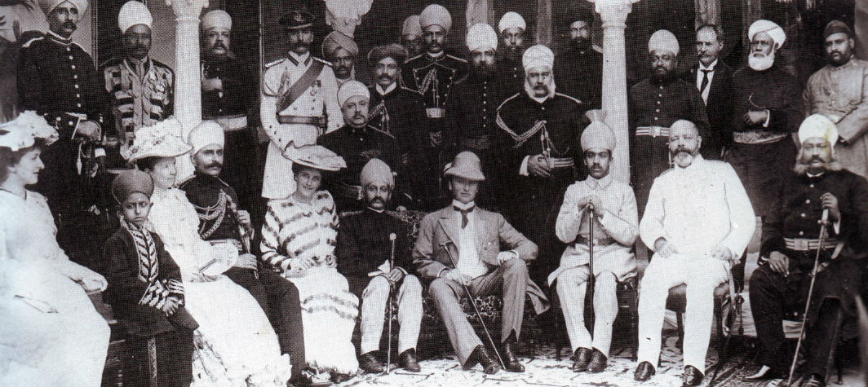
Assimilation

Slide 24
A love/ hate relationship- the civilising link
Indians appallingly treated in British India. However England did unite the country, gave it a judicial system that worked, the railways, democratic government, a lingua franca, cricket and tea (mainly to break the Chinese monopoly.)
And Vice versa – Curry house in England and Indian IT.
Kipling – The white man’s burden? The coloniser's responsibility.
Is Nationalism on the way out?
Nation states are just empires in the making? Spain, France and England in the Middle Ages had all the trappings of Empires. Germany conquers the other Prussian states.
Then “missionary nationalism”. A mission to civilise and enlighten.
e.g. – The Romans – giving roman laws, institutions and culture to the world. Holy Roman Empire picks up the theme. The Spanish spread Catholicism – in turn taken up by the Hapsburgs who see themselves as defending Europe against the infidel Turks. Nazis and Aryan supremacy.

Slide 25
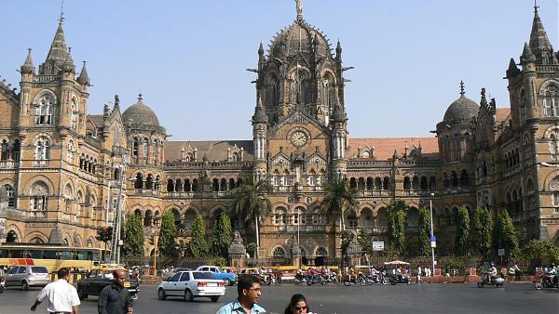
Not everything goes

Slide 26
The other benefits of Empires
Imperial navies made globalisation possible first by the British and then the Americans.
All great recent democracies started off as Empires.
Empires may have been cruel, but they were less cruel and delivered more predictability for the average person than did anything beyond their borders. Athens, Rome, Venice, and Great Britain were the most enlightened regimes of their day.
Hapsburg Austria and Ottoman Turkey were especially protective of Jews.
They delivered more peace and stability than the UN.
Armenians, Albanians and Kurds lived more safely in the Ottoman empire than in its more modern successors.
successful empires were those which created an imperial bureaucracy that governed for the empire as a whole and not just for the metropolis (Rome did this; the French empire did not).

Slide 27
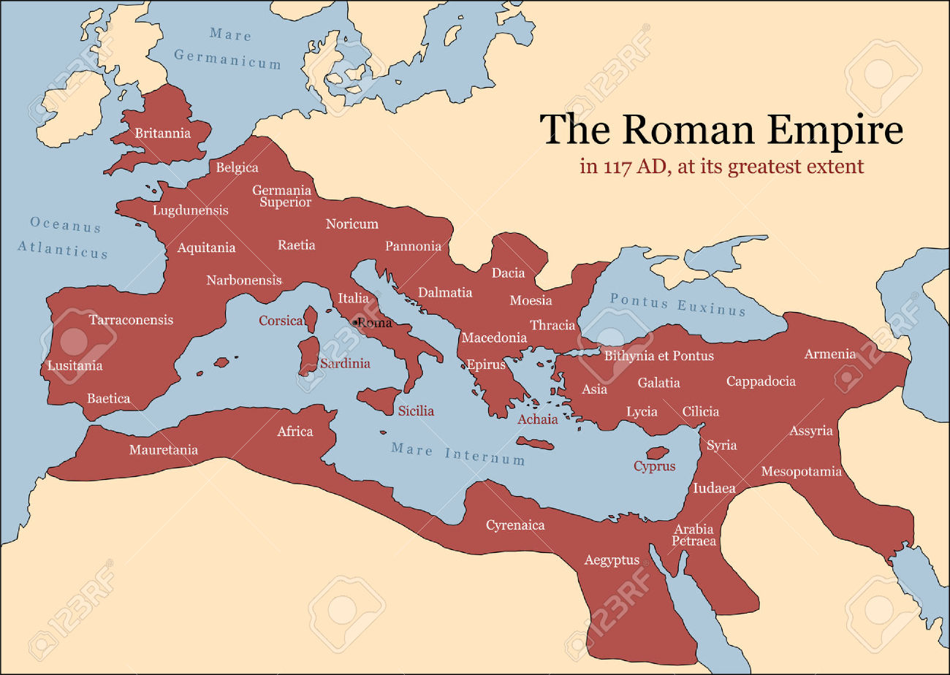
The Roman Empire

Slide 28
Why did the Roman Empire fail?
The Roman Empire failed because :
Of the Goths fleeing the Huns whom the Romans treated very badly. Tax base diminished.
In the end it had a non Roman army. Diocletian hired German mercenaries.
Of the self interest of the generals who used the legions as private armies,
The use of increasing number of slaves destroyed the economy. Huge numbers of slaves were eventually taxed and then let go creating impossible job competition for everyone else. It spent its money on bread and circuses for the unemployed.
Of the rich buying up the land from poor farmers during the Punic Wars and abandoning the cities.
Of a loss of confidence. The locals did not bother defending it. Carthage
Of the need to keep expanding to keep the Treasury full and wages paid
Of the Christians? (Gibbon - the decline and fall of the Roman Empire).

Slide 29
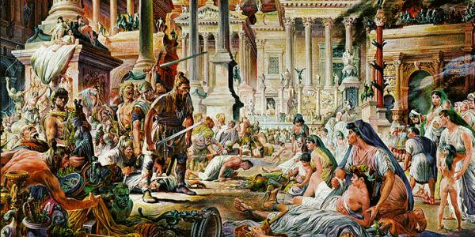
The fall of Rome

Slide 30
But its memory lived on
Rome ransacked in 476 AD by the Goths. Romulus Augustulus – First and last – retired to Naples by the Goths and was not even killed. The Roman Empire imploded.
Paved roads, decent drains and central heating disappeared for a 1000 years. Those in the countryside reverted back to paganism (pagus – countryside – note heathens!
The Dark Ages and the return to barbarism. Learning Latin now waste of time.
Still everyone wanted to be Roman. “every Goth wants to be a Roman but only a poor roman would want to be a Goth” (Theodoric).
Still it survived in the Greek speaking East until 1453AD when it was over run by the Ottomans as the Byzantine Empire based on Constantinople – Constantine its founder in 330AD but originally split by Diocletian.
Succeeded by the Holy Roman Empire – heads of Europe like Charlemagne went to Rome to be crowned (and to steal the pillars)
Coliseum turned into an animal enclosure and robbed for building materials.
Senate and Capitol Hill reminders of Rome in the US.

Slide 31
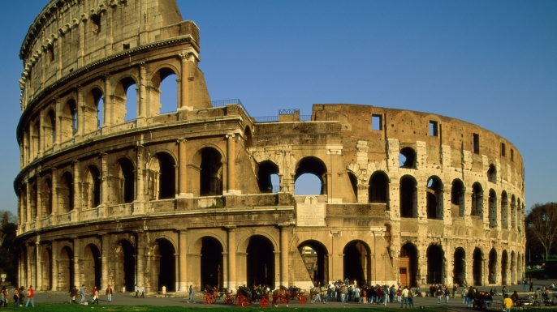
The Coliseum

Slide 32
Why do Empires fail?
Persians conquered an empire and so wanted out of the harsh mountains into the lush lowlands. Cyrus said no “soft lands make soft men”. Defeated by hardy and poor Greeks. For every Persian there is an Athenian waiting.
The Ottoman Empire – 1923 – ethnically diverse – uprisings in the Balkans, The Young Turks, siding with Germany all led to its downfall over a long period of time.
The Hapsburg Empire (Austro – Hungarian) – too much ethnic diversity. 18 nationalities, 5 kingdoms and German speakers one quarter of the total.
The Qing Empire in China (1911) – hated Manchus as foreigners, Opium Wars, unequal treaties by Western powers, Hong Kong lost – lost control.
The British Empire – could no longer afford it. Overseas bases to the US.
The Americans – Trump says it is not sustainable – others have to pay their way. No boots on the ground but what happens if America withdraws? US pessimistic about the Future – The Chinese optimistic – deep roots?

Slide 33
Will America follow Rome?
Despite American fascination with Rome it is unlikely because:
The Romans could be petty and destructive – the destruction of Carthage when it no longer mattered, the 20 year pursuit of Hannibal, using Spain for silver and slaves, roman citizenship for the Romans, foreigners never really belonged.
Rome was a military society with generals fighting for the spoils. Power and wealth were concentrated in the hands of the wealthy.
Germanic tribes treated as slaves rather than allies.
Caesar a populist rebel like Trump? Augustus, Claudius and Domitian – “make Rome Great again”. Trump jet, Mar a Lago – traces of Nero? Caligula bring the family into the fold....etc
Irony – The US likes to quote Gibbon unaware that he blamed the Christians for the fall.
Rome lived off the Greek legacy – incurious. The US is not an Empire.

Slide 34
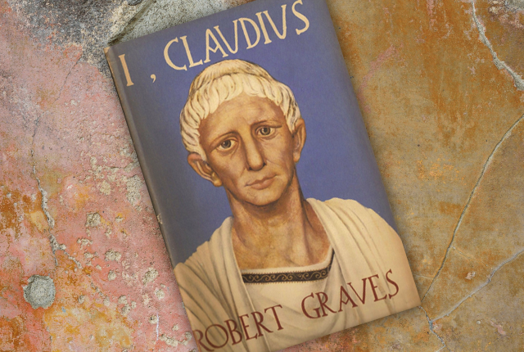
What Rome was really like

Slide 35
Modern Empires - The Americans and the British
America – a stateless Empire. They are not colonisers and were often very anti colonial.
The British were colonisers and this slashed with the US over Suez for example and the French in Vietnam.
The British went overseas – the Americans stayed home. Exported their culture and institutions not their people. For most it was promotion.
The British lived abroad and picked up foreign languages, cultures etc and were interested in them for their own sake,
The American presence overseas was never permanent and focused on fighting alien ideologies at a distance
The British made scale models of themselves – the British Club could get you a gin in Calcutta, Kuala Lumpur or Singapore – home away from home.
British born to rule mentality – Americans born to export capitalism and democracy at the expense of Soviet and Chinese expansion.

Slide 36
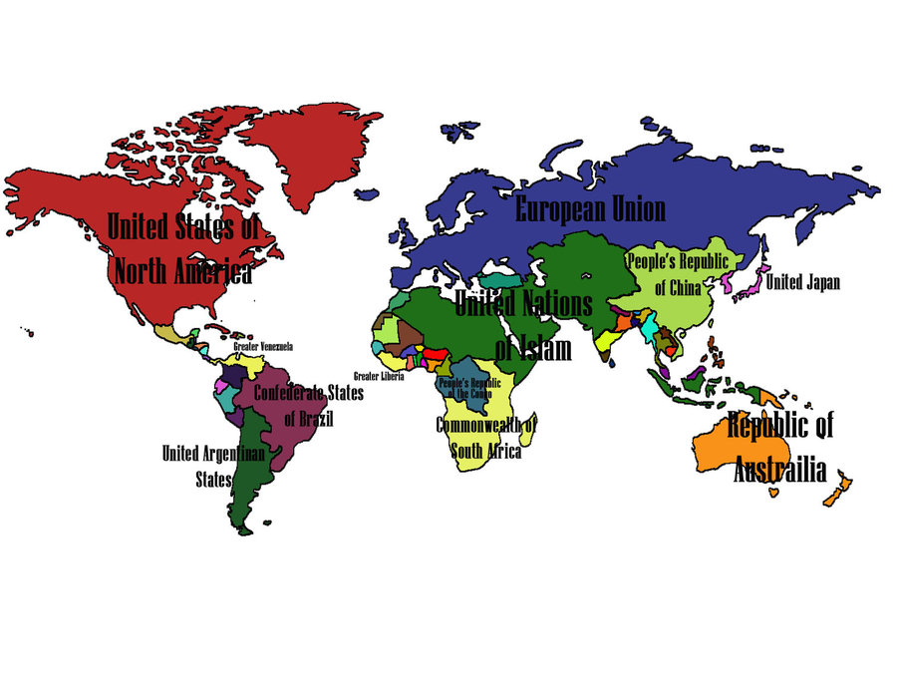
The world in 2100? Future Empires

Slide 37
The decline of the Anglo-American order
Started with Brexit and accelerated under Trump?
America never wanted an empire but got one anyway. Spheres of influence are as much an empire as territoriality. But in the 1850s ports in China and Japan. 1890s annexed Hawaii, the Philippines, Cuba, Guam, Puerto Rico. Samoa from the Germans and in the earl 20th Century the US occupied Nicaragua, the Dominican Republic and parts of Mexico, and Haiti.
All replaced by rivalry with the Soviets during and after World War 2.
But the US no longer willing to be the world’s policemen. Too expensive? However no one else wants to be it either.
Collapse from within? The Roman Empire collapsed due in no small part to the fact that they just did not care anymore.
Bread and circuses and an over extended Empire?
Still the US has the world’s largest military and economy and is the world’s leading technological innovator. There are no immediate rivals.

Slide 38
A fraying empire
After World war 2 with Europe and Japan devastated as a result of the war, American power was unchecked.
It freely engineered regime changes in countries across the globe that opposed US interests, in places like Iran, Guatemala, Chile, Dominican Republic, Brazil, Syria, Indonesia, Congo and Vietnam.
But by the 1970s, with the humiliating loss of the lengthy and brutal wars in Southeast Asia, the capacity of the US to invade countries or topple governments had waned. And the more recent wars in Iraq and Afghanistan in the past 15 years have shown this remains even more true today.
Free trade agreements and globalisation plus the decline of unions saw the working class left behind. In a recent survey people were asked how they would cope with an unexpected $400 emergency. 47% said they either could not or would borrow or sell something.
net worth of the typical household was $87,992 in 2003. By 2013, it had fallen to $54,500 - a drop of 38 per cent. Growing gap between the have and have nots – for the 1% it is working just fine.

Slide 39
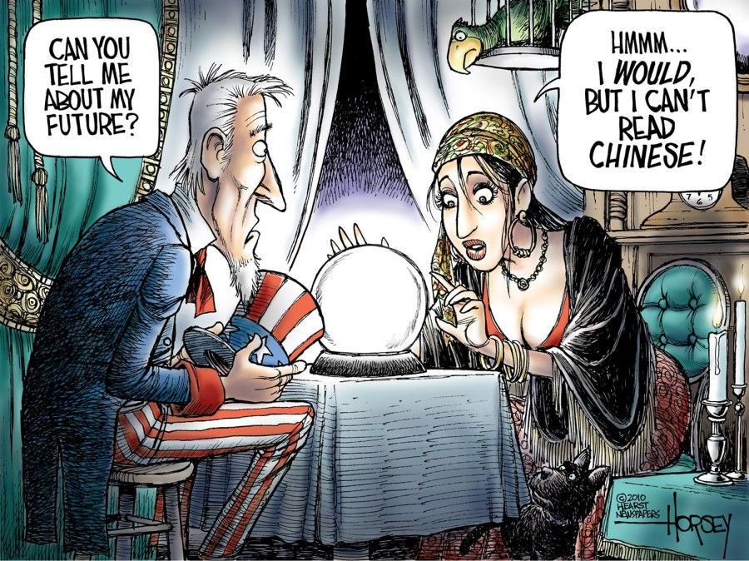
Perhaps?

Slide 40
And Trump
January 2017 - Trump's inauguration follows close on Xi Jinping's Davos speech as the moment the Chinese take economic leadership.
by contrast, Trump has promised to shrink America with his trade policies, his "border tax" and his veneration of a manufacturing-based economy that doesn't really exist anymore.
The US has been an overall force for good, offering a liberal, democratic, outward-looking global leadership since WW2.
Under Trump, we're to have none of that. Trade agreements must favour the US. NATO is out of date. Putin is a mate. Climate change is a Chinese conspiracy. Israel can do whatever it likes.
Just as Britain shrinks through Brexit, America shrinks through its proposed isolationism.
America is still great despite what Trump says – the largest economy, military, wins the most Olympic medals and ”soft power: - everyone copies it.
What America needs most is the investment in people and their education.
The end of the American Century could be made no starker than by an authoritarian communist president being left to claim leadership as America vacates that role.

Slide 41
And the US Economy
Like in Rome it could well be ungovernable for the next 75 years. And that’s because the domestic population is growing restless and angry with their increasingly desperate economic lot.
Meanwhile Standard and Poors have devalued the US as no longer a risk free investment. The agency had agreed with the Obama administration that $4 trillion needed to be saved from the $14.3 trillion debt over ten years.
Unlike the British however, the Americans have not assumed control of large parts of the world from which they must inevitably retreat. Their global commercial enterprise has few strings attached, while withdrawing from both Iraq and Afghanistan within a few years will be a boon.
Military spending has to be curtailed.
The country leads in industries vital to the 21st century and, for all its gloom, remains hard-wired to strive to improve.

Slide 42
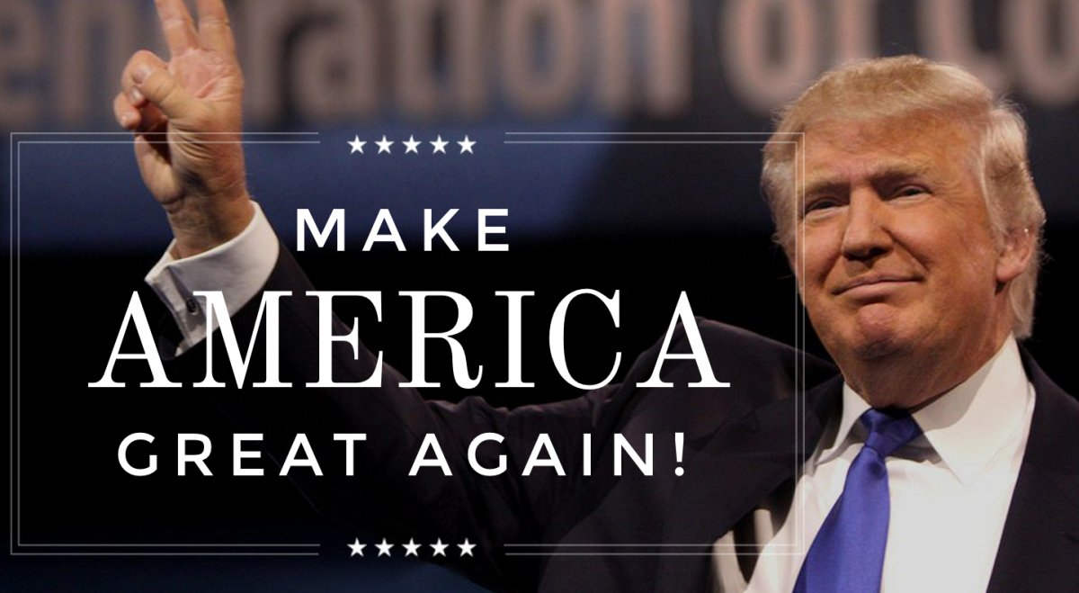
Can he do it?

Slide 43
In Summary
Empire is indeed history. Almost all that we know of history, from Sumeria through Babylon, Egypt, the Assyrian empire, through Persia, Greece, Rome, Byzantium, through the Chinese dynasties, the Carolingian empire, the Holy Roman Empire, the Mongol empire, the Mogul empire, the Habsburg empire, the Spanish, Portuguese, British, French, Dutch, and German empires to the Soviet empire, plus many that we have forgotten, all of this suggests that the history of the world is the history of empire.
The world began the 20th century covered in great empires and ended without a single one.
Decolonisation was a last act of imperialism.
The world of empires which dates back as far as we can remember and which was thriving in 1900 has, 100 years later, become a world of nation states.
All the conditions seem to be there for a new imperialism. There are countries which need an outside force to create stability (recently in Sierra Leone a rally called for the return of British rule). There are metropolitan countries which want stability so that they can trade.

Slide 44
In Summary
However today’s poor generally do not wish to be colonised despite appalling efforts at self government.
Empires however have generally been better than the chaos and barbarism that often followed.
New Empires will have to be different in an era of human rights. It will be the imperialism of globalisation and the imperialism of neighbours. Note IMF strictures on loans – principles of good government – the same as in the old days? Light touch imperialism – making the world safe for investment?
The Imperialism of neighbours. The EU settling the crime ridden, corrupt lawless, volatile Balkans. The EU and the UN run much of it. It is not just soldiers that come from the international community, it is police, judges, prison officers, central bankers and others. A whole team of European officials is creating a Bosnian customs administration. EU aid and soldiers keep Bosnia and Kosovo going. Conditions of entry to EU regulate behaviour.

Slide 45
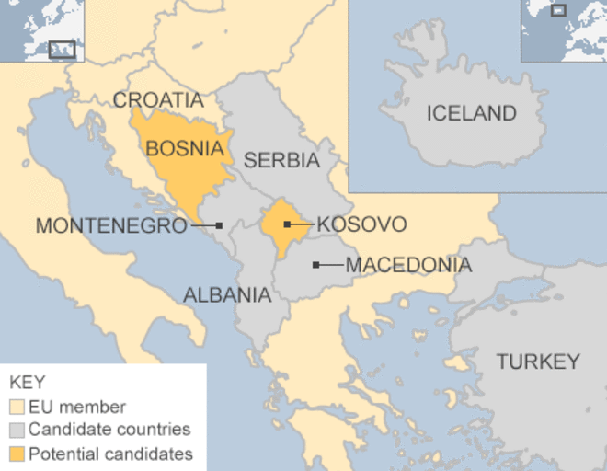
The EU and the Balkans

Slide 46
The future
Nothing lasts forever.
Most empires once gone never come back except for the Russians and the Chinese. The Chinese in Africa – Angola (oil) – the Greek port of Piraeus. The Empire of oil, minerals and markets – an economic Empire?
Will the Internet and globalisation give us the same benefits of Empire in the future? Is the age of Empires over?
Capitalism and technology are both expansionist in their nature, and such expansion always creates dominant cultures.
Nation states seen often as excessively nationalistic? e.g. Yugoslavia and the former Soviet Union. A danger to world peace?
US no longer the world’s policeman – a retreat into isolationism?
“We are at a change point, and face the possibility of a very different world and a very different America..” (Penny Wong)
are we at another 1942 moment?

Slide 47
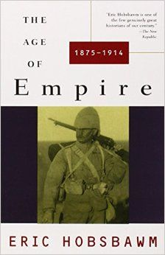
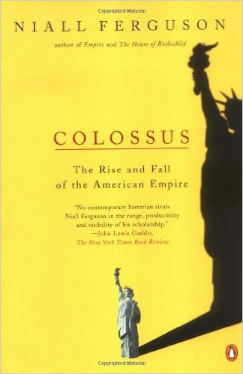
The Age of Empires

Slide 48
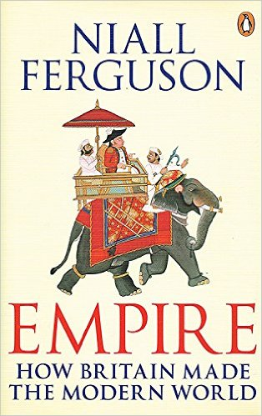
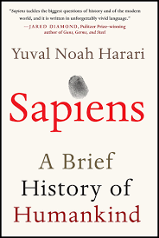
Reading list

