Slide 1
The rise of China
U3A Beechworth 2017

Slide 2
What China invented first
Far too much to fit into one slide but consider:
Paper, paper making, tea, silk, the compass, iron smelting, A mail system, gunpowder, the wheelbarrow, alcohol, umbrellas, the stern post rudder, insurance, stirrups, acupuncture, lacquer, paper money, movable type printing, rockets, seed drills, iron ploughs, horse collar, incense, kites, seed rills, uses of natural gas, pontoon bridge, porcelain, suspension bridge, restaurant menu, tofu, toilet paper, hoverboard, e – cigarette, grain storage, civil service exams, chemistry, playing cards, crossbow, seismograph, abacus, holistic medicine, nail polish etc etc... etc etc etc etc etc etc etc etc etc etc etc etc etc etc etc etc etc etc etc etc etc etc etc etc etc etc etc etc etc etc etc etc etc etc etc etc etc etc etc etc etc etc etc etc etc etc etc etc etc etc etc etc etc etc etc etc etc etc etc etc etc etc etc etc etc etc etc etc etc etc etc etc etc etc etc etc etc etc etc etc etc etc etc etc etc etc etc etc etc etc etc etc etc......................................

Slide 3
Chinese inventions

Slide 4
How did it change?
“By what means are the Europeans thus powerful; or why, since they can so easily visit Asia and Africa for trade or conquest, cannot the Asiaticks and Africans invade their coasts, plant colonies in their ports, and give laws to their natural princes? The same wind that carries them back would bring us thither?“
Europe and North America in 1500 were less rich than the Chinese. But by 1970 the average Briton was 10 times better off than the average Indian and the ratio was 20 times between Americans and Chinese based on purchasing power.
Geographical factors - China was surrounded by natural barriers.
In the north, there was the Gobi Desert. In the south, there were thick forests. In the west, the Himalayas. And in the east, the Pacific Ocean.
In the early 15th century, the Ming Dynasty started shutting the Middle Kingdom out of the rest of the world. This of course continued with the Qing, and the empire remained largely isolated until the 19th century.
China saw itself as not needing anything from the West – Cultural isolationism. The Celestial Empire.
In 1983 China had only 1 per cent of the world’s trade.

Slide 5
Why China fell behind the West – the great divergence
China believed herself superior and not in need of anything from the West.
The fact that Western Europeans travelled to China because they wanted Chinese goods (i.e., porcelain, silk, tea, spices) encouraged this belief in superiority.
A Confucian based bureaucracy – the maintenance of order at home. Inward looking – no desire to colonise.
Trade at home was enough with the size of their domestic market. Outside trade only to enrich themselves.
Contact with barbarians as corrupting morality and potentially destroying Confucian values.
China's sudden withdrawal of its navy from the Indian Ocean in 1500 - show the flag - not exploratory.
More important to secure the state against the threat from the Mongols to the north.
Closure of the Silk Road after 1453.

Slide 6
The Needham question
“Why did modern science take its meteoric rise only in the West at the time of Galileo [but] had not developed in Chinese civilisation (or Indian or Islamic)?”
Part of the reason was that China was self sufficient. They had a favourable balance of trade.
Europeans shifted that balance by the sale of opium. Britain sold opium to China because it had not enough silver to pay the Chinese for their goods.
Which led to the Opium Wars of 1839 -1842 against the British and the treaty of Nanjing. Westerners not subject to Chinese Law and China loses control over the West. Treaty Ports established to facilitate British trade, compensation paid by the Chinese for the Opium already confiscated and the ceding of Hong Kong. Other nations followed. Missionaries arrive.
After the Opium Wars the Manchus start to modernise. Army is overhauled and try to develop an Industrial base. Manchus fell in 1911 /12 ending 2000 years of imperial rule.

Slide 7
Europeans and others in China

Slide 8
Opium

Slide 9
The Six “killer” apps
Niall Ferguson identifies the 'killer apps' of the West's success – competition, science, the property owning democracy, modern medicine, the consumer society and the Protestant work ethic – the real explanation of how, for five centuries, a clear minority of mankind managed to secure the majority of the earth's resources.
Competition
In 1420 when Ming China had a credible claim to be the most advanced civilization in the world: 'All Under Heaven'. England on the eve of the War of the Roses would have seemed quite primitive by contrast. Yet the lead that China had established in technology was not to be translated into sustained economic growth. In China a monolithic empire stifled colonial expansion and economic innovation. In Europe political division bred competition.
2. Science
In 1683 the Ottoman Army laid siege to Vienna, the capital of Europe's most powerful empire. Domination of West by East was an alarmingly plausible scenario. But the Ottomans were defeated: not so much by firepower but because they did not have a scientific revolution. Ballistics and artillery.

Slide 10
The six killer apps
3. Property
Why did North America succeed while Latin America for so many centuries lagged behind. In North America you could own land and develop it. In South America land was held by a tiny elite descended from the Conquistadores. By 1900 most rural north Americans owned some land- few did in South America.
4. Medicine
Modern medicine in the late 19th century began to make major breakthroughs against the infectious diseases that killed a lot of people. Life expectancy doubled. Even the colonies particularly in Africa benefited – French yes German no.

Slide 11
The killer apps
5. Consumerism
Originating in UK but flourishing most spectacularly in United States, the advent of mass consumption has changed the way the world worked. Consumerism is the point of capitalism and drives it. Led by the Japanese, one non-Western society after another has adopted the same model, embracing the Western way of manufacturing and consuming. Only the Muslim World has resisted.
Work
The sixth element that enabled the West to dominate the rest was the work ethic. Max Weber famously linked it to Protestantism but the reality is that any culture, regardless of religion, is capable of embracing the spirit of capitalism by working hard, saving, and accumulating capital.

Slide 12
But does it or will it still hold true?
Are we losing the competitive edge to Asia?
Can we maintain the lead in science when interest in science as a discipline in the West is waning along with educational attainment in the subject?
how long can the burkha hold out against Levis?
is China in the process of building a new African empire?
The work ethic – the average Korean worker works 1000 hours a year more than the average German. Look at PISA scores to see who puts in the work at school.
Perhaps, ironically, the biggest threat to Western civilization could turn out to be this westernisation of the world, if the consequence of Asian economic growth is to change the global climate for the worse.

Slide 13
The Civil War – 1920 - 1949
In 1949, Chinese Communist leader Mao Zedong declared the creation of the People’s Republic of China (PRC).
That ended the costly full-scale civil war between the Chinese Communist Party and the Nationalist Party, or Kuomintang (KMT), which broke out immediately following World War II and had been preceded by on and off conflict between the two sides since the 1920’s.
The creation of the PRC also completed the long process of governmental upheaval in China begun by the Chinese Revolution in 1911.

Slide 14
Mao Tse Tung and Deng Xiaoping
Leader from 1949 - 1976
Leader from 1978 - 1989

Slide 15
China under Mao
China impoverished in 1949. Famine, industry wiped out, high unemployment, currency valueless. Wars since 1920 and against the Japanese from 1937 – 1945.
Land handed over to the peasants. Land owners exiled or killed.
Western influence disappears. Cars give way to bicycles.
Anti corruption drives.
The Korean War – Chinese involvement from 1951.
1953 – private industry nationalised.
1956 – Hundred flowers campaign begins.
1958 – Failure of the 5 year Plan.
1960 - Sino – Soviet split .
1966 – The Cultural revolution. “Better Red than dead”.
1972 – Nixon to China and detente with the US.
1976 – Mao Dies.

Slide 16
China changes tack – Deng Xiaoping
Deng Xiaoping – fired twice – after the Cultural Revolution and after the death of Mao. Came back at the age of 74.
''It doesn't matter whether a cat is black or white, as long as it catches mice.''
Most Chinese who watched a television or used a washing machine or dialled a telephone did so only since Mr. Deng came to power.
The focus was solely on economic development after the ideologically bound years of Mao.
No cult of personality – China regains colour under Deng.
Because he had seen what modernization had done for the West, Mr. Deng's strategic vision was broader than Mao's.
Deng started cautiously, creating special economic zones in China's coastal provinces of Guangdong and Fujian, where tax subsidies attracted Hong Kong's manufacturing tycoons. The economic zones ignited an export explosion that continues today.
Also responsible for Tien An mien massacre.

Slide 17
How China changed
In 1978 China was poor with a GDP per capita of Zambia. China experienced an average GDP growth of close to 10% per year until 2014, raising per capita GDP almost 49-fold, from 155 current US Dollars (1978) to 7,590 US Dollars in 2014, lifting 800 million people out of poverty. 2016 6.7%
How? In 1978, three quarters of the country’s industrial production was accounted for by centrally controlled, state-owned enterprises, following centrally planned output targets. Collectivized agriculture was the norm.
Prices and banking liberalised under Deng Xiao Ping – banking modernised and trade opened up. Private sector now 90% of her exports.
China the assembler and exporter – the innovator? The need to grow the domestic market. Urban household now spend 40% of budget on services (education, health, travel etc)
Foreign exchange reserves of $3.21 trillion dollars.
Heavily into overseas investments.
Still below world average and the East Coast grows but the poorer west does not. A rapidly growing middle class spoiling single children.

Slide 18
Share of World GDP 1700 - 2030

Slide 19
Chinese consumers

Slide 20
Chinese consumers

Slide 21
What the Chinese consumer wants

Slide 22
Economic power does not equal military power
The US is still far ahead technologically, better and more experienced at managing large industrial/defence projects.
The US has a string of bases and alliances – unless they walk away from them.
It will take long time for China to catch up with Nuclear Subs, Satellites and transport vehicles.
Intellectual property payments are 1991 times larger in the US.
China can wait – it knows it is still a long way behind but wants its sphere of influence.
The US spends 711 Billion on defence – China $143 billion – 8,400 attack helicopters in the world – the US has 6,400 of them.
China roundly defeated by the Vietnamese in 1979.
Using “soft power” instead.

Slide 23
Where they invest

Slide 24
The Chinese Middle Class
Hardly any in 1990 – now there are 225 million earning average of $40,000
China transformed. Paddyfields have given way to skyscrapers, bicycles to traffic jams. An inward-looking nation has grown more cosmopolitan: last year Chinese people took 120m trips abroad, a fourfold rise in a decade. A vast Chinese chattering class has sprung up on social media.
But they don’t seem to want democracy – seen as chaos – Arab Spring etc
Concerned about their savings. Angry with Corruption ( so Xi is very popular). Property rights dodgy. Very concerned about urban pollution.
More likely to protest in the open about government high handedness.
The party must accommodate the Middle Class desire for change and stability or suffer the consequences.
When growth was rapid things were stable but as it slows there may be unrest.
An ageing workforce will want to be treated properly in retirement.

Slide 25
Chinese priorities

Slide 26
But China does have plans of its own
850 million of Chinese have Net access that the government cannot always block. Population is getting older. Chinese now less tolerant of pollution (only 1% of China’s cities meet WHO guidelines for air and water quality)
Anti corruption drive claims huge number of victims – govt trying to restore faith with Chinese Middle Class?
Just launched Asian Infrastructure Bank – 57 countries joined – purpose is to fund infrastructure and as a rival to IMF and the World Bank.
integration of south-east Asia into the Chinese rail network through Chinese-built railways in Vietnam, Cambodia, Thailand, and Laos.
All roads lead to Beijing?
New Silk Road project. China’s New Silk Road will include high-speed rail lines, modern highways, fibre optic cables, energy pipelines, seaports, and airports. It will link the Atlantic shores of Europe with the Pacific shores of Asia. It’s history’s biggest infrastructure project. $1 trillion, 65 countries and growing interdependence of those countries and the Chinese economy. Great jobs growth for the Chinese.
That project is already underway.

Slide 27
The Old Silk Road

Slide 28
A brief history of the Old Silk Road
For hundreds of years, tea, silk and ceramics were the staples on the old Silk Road – an ancient network of trade routes from China to the Middle East and Europe.
Silk went westward, and wools, gold, and silver went east. China also received Nestorian Christianity and Buddhism (from India) via the Silk Road.
No one ever travelled the whole road.
With the gradual loss of Roman territory in Asia and the rise of Arabian power in the Levant, the Silk Road became increasingly unsafe and untraveled.
In the 13th and 14th centuries the route was revived under the Mongols and at that time the Venetian Marco Polo used it to travel to Cathay (China).
It is now widely thought that the route was one of the main ways that plague bacteria responsible for the Black Death pandemic in Europe in the mid-14th century moved westward from Asia.
From 1453 it was not safe for Christians to travel or trade on the Silk Road – explored maritime options instead to cut out the middle men. China became preoccupied with internal dissension and pulled back from the West. The Persians develop sericulture.

Slide 29
The new silk road project

Slide 30
In 2016, 1702 freight trains to Europe from China – 3 tracks east 3 tracks west.

Slide 31
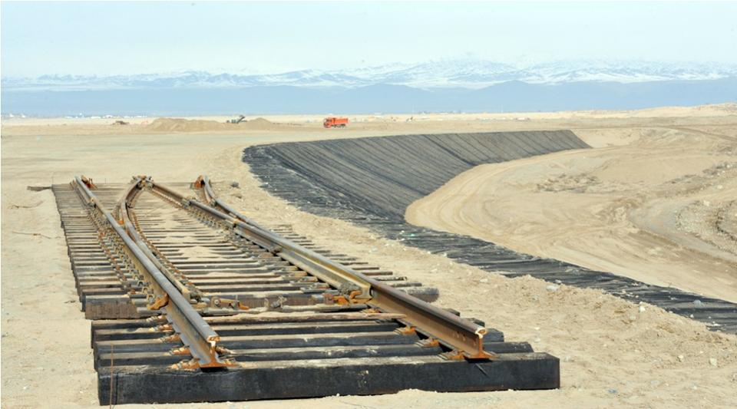
Khorgoz (Kazakhstan) the hub – three rail tracks east and three west. HP warehousing – a logistical hub.

Slide 32
Trade along the new route
Englishman Nigel Cropp is buying fidget spinners in Yiwu. “I buy them for 60 or 70 cents and sell them on for a fiver (£5). At one point I heard they were retailing at $15 (£12). The customers are really fighting for them. I can sell 100,000 a day, maybe 10 million by the end of the year.”
The fidget spinner is this year’s must-have item for schoolchildren in Europe and North America.
$1500 to ship a container across the globe. Imagine what you could fill it with!
Rail takes only 18 days to get to Europe, compared to 35 by sea but at twice the cost.
China is counting on the Silk Road to become a magnet for the domestic travel industry.
India and Japan see a plan to embed Chinese money and muscle across three continents, to take control of strategic ports and amass geopolitical influence.

Slide 33
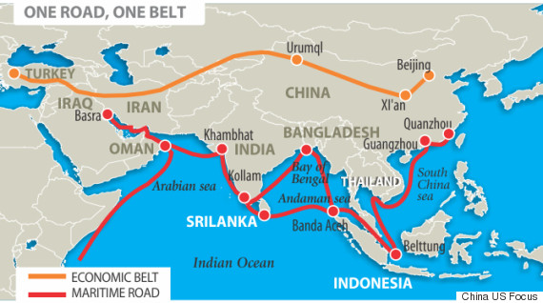
The sea route for the silk road

Slide 34
And in Africa
Djibouti to Addis Ababa railway 466 km – electric $4bn – all done by Chinese engineers and financed by Chinese banks. 12 hours by rail instead of what was 3 to 4 days by truck. Hefty repayments but Djibouti growing at 6.7%
Half Sub Saharan African roads are not paved.
China is taking its resources and expertise global. $5bn high speed rail in Indonesia, railway cars for Boston and Chicago and 2400 km Pan Asia railway from China, Laos, Thailand and Singapore.
Not counting the $1 trillion New Silk road. Rail freight London to Beijing.
$13bn rail link in Kenya from Nairobi to Mombasa.
Urban Transit system for Lagos.
US not in the picture.
Trump expressed severe scepticism re foreign aid and development projects.

Slide 35
ASEAN

Slide 36
China and East Asia – soft power
ASEAN does not have unified voice – no united foreign policy so –
Duterte in the Philippines – angry at US interference in their affairs (human rights) makes overtures to China.
Duterte has to rely on Chinese who control business in the Philippines and who have strong ties with China.
Malaysia – Mahathir a lot of anti US rhetoric. Najib upset over IMDB revelations coming out of the US. Bought 4 Chinese naval vessels this year.
Laos looking to Chinese infrastructure over the Silk road to Europe.
Cambodia – 2 major loans from China and supported China over South China Sea crisis.
Thailand run by the military – US not impressed so greater Thai ties with China over arms and trade.
Myanmar – Aung Sang Sui Kyi first visit was to Beijing
Exceptions – South Korea and THAAD and very much so - Vietnam

Slide 37
China and its neighbours (the SCS). Divide or buy off.
ASEAN does not have unified voice – no united foreign policy so –
Duterte in the Philippines – angry at US interference in their affairs (human rights) makes overtures to China.
Duterte has to rely on Chinese who control business in the Philippines and who have strong ties with China.
Malaysia – Mahathir a lot of anti US rhetoric. Najib upset over IMDB revelations coming out of the US. Bought 4 Chinese naval vessels this year.
Laos looking to Chinese infrastructure over the Silk road to Europe.
Cambodia – 2 major loans from China and supported China over South China Sea crisis.
Thailand run by the military – US not impressed so greater Thai ties with China over arms and trade.
Myanmar – Aung Sang Sui Kyi first visit was to Beijing.
Exceptions – South Korea and THAAD.

Slide 38
What the world thinks

Slide 39
Should we be concerned?
we are very dependent on the Chinese market from mining to education.
China backs some despotic regimes over seas from Burma, to Sudan to Syria.
Chinese demand for oil and minerals is driving up world prices
The Planet cannot afford a middle class China.
A Chinese economic slowdown could have serious impact on the rest of the world and China itself.
China grabs overseas infrastructure companies as investments like Greek ports, Portuguese power companies, Australian real estate etc.– Africa a future colony?
South China Sea – China trying to reclaim what the US sees as its lake and China sees as a repeat of past humiliations (Taiwan). . But politically Trump now accepts a “One China” policy vis a vis Taiwan.
A partner in world affairs taken seriously as a major player and one who is not lectured at would benefit everyone.
Chinese ambassador kisses Julie Bishop – says we can be friends with both the US and China – no cold war rhetoric – quite a change.

Slide 40
Trump and China – things coming to a head?
Trump appoints Sinophobe Peter Navarro to the National Trade Council who has written such alarmist publications as:
The Coming China Wars, Death by China: Confronting the Dragon, and Crouching Tiger: What China's Militarism Means for the World.
He believes that the US should strangle China with economic war and a Pacific Arms race. A superpower showdown.
The Trump transition team has mooted an import tariff of 10% across the board
However China is shifting from export-led growth to a consumer economy driven by internal demand.
Chinese wages have been soaring at double-digit rates. The Yuan is no longer over-valued.
A Harvard study of 16 such hegemonic rivalries over the last 500 years found that three-quarters ended in war, with the clinching example said to be the Anglo-German battle for global mastery before 1914.

Slide 41
Trump’s obsession with China?

Slide 42
And who is advising Trump?
Tillerson says it is like Russia taking the Crimea.
South China Sea - access to the Islands will not be allowed. But a blockade is seriously impossible.
Strongly involved with Vietnam’s petro-chemical industry.
US not in a good position as it is not in UNCLOS either.
US set to increase FONOPS within the 12 mile limit.
Steve Bannon sees a US-China war as inevitable “within 5 to 10 years”. Navarro, an advisor to Trump has written “Death by China” and “The coming China War” amongst other anti Chinese essays.
Trump – rally around the flag? Generate a crisis to save himself from impeachment? Note George Bush after 9/11 (Afghanistan etc) and Kennedy after the Cuban Missile Crisis.
China to pursue its own economic programme rather than a military one? Building a network of client states tied to the Chinese economy.
North Korea is another issue.

Slide 43
A Trade War?
The fastest growing markets for the best items China produces, like laptop computers and cell phones, are in developing regions such as India, Latin America, and Africa. In contrast, China itself is a market that the U.S. can hardly ignore. By the end of 2015, Chinese consumers bought 131 million iPhones.
Trump’s tariffs would automatically trigger penalties against the U.S. in the World Trade Organization
China’s foreign currency reserves now stand at more than $3 Trillion. In contrast, the U.S. has foreign exchange reserves that hover at around $120 billion.
Chinese holding of US debt at 15% not considered a problem as others would buy the debt.
The Davos speech by Xi Jinping. January 2017.
Trump tears up TPP. China is advocating for a 16-nation pact called the Regional Comprehensive Economic Partnership that excludes the United States. US to lose $5bm trade exports to Japan? Asia and Latin America now look to China for economic treaties and leadership.

Slide 44
Tariffs – an explanation
Tariffs are generally used to protect domestic manufacturers from overseas competition offering cheaper goods. It is a tax on imported goods.
The higher prices of imported goods due to tariffs often causes foreign producers to elect to withdraw from the domestic market, reducing competition.
This lack of competition removes the incentive from domestic producers to find ways to lower the prices of their goods, resulting in higher overall prices for consumers, as well as a lack of innovation that competition often causes.
Tariffs also have a negative impact on the trade balance with countries against which they are used.
Foreign nations often impose their own tariffs in response to domestic tariffs, raising the prices of exported goods, which causes less demand for those goods overseas.
This, in turn, results in a loss of profits for domestic producers who export goods, as well as a loss of possible jobs on the domestic front because producers must lower production or withdraw from the export market altogether.

Slide 45
US Trade with China

Slide 46
Why a trade war with China would be a bad idea
Starbucks Boeing and Apple, to name a few, have placed huge bets on China. All three companies say the country of 1.3 billion will soon be their single largest market, if it's not already. Boeing Vs. Airbus?
Huge tariffs on Chinese goods will make them way too costly or drive them out of the U.S. market altogether increasing prices in the US. There is no substitute for Chinese cheap goods.
Many US manufacturers rely on cheap Chinese electronics.
China is the top holder of U.S. government bonds with $1.3 trillion on their books.
Tariffs won't change that equation. Tariffs will make it worse.
Labelling China a currency manipulator is fighting the last war, as China recently has been intervening to keep its currency high, not low,
China, however, is now well positioned to draw its neighbours into a closer embrace. A trade war could help. China left out of the defunct TPP now counters with one of its own leaving out the US. Fewer environmental, worker safeguards than the TPP.

Slide 47
China’s future
Unlikely to become a territorial power. China will get what it wants by buying what it wants – the New Silk Road and Central Asia for example.
Its engagement in Africa for example is transactional rather than imperial.
When it perceives it could have a problem with its image, it responds pragmatically: building hospitals, paying for malaria-prevention programmes, laying down railways.
“Sweep the snow in front of your own house - don’t worry about the frost on your neighbour’s roof” - China faces problems on a global scale within its own borders: it has more poor people than any other country save India.
A lack of engagement is not unusual in a rising power. It took a world war to draw America irrevocably onto the world stage. And the absence of an articulated agenda does not stop China wanting more standing.
China’s leaders are convinced that America is determined to prevent their country from increasing its strategic and military influence in Asia—that it is trying to contain China.

Slide 48
A quick look at important data

Slide 49
China’s future
But the American “pivot to Asia” has shown few results so far.
what China wants in East Asia : a decrease in the influence of external powers that would allow it untroubled regional dominance.
the question of Taiwan’s sovereignty will come to a head; it is in effect protecting its flanks in case of a future clash with America on the matter.
China’s armed forces are much less advanced than America’s. But China enjoys the advantage of playing at home. It sees a war-weary America as unlikely to spend blood and treasure defending uninhabited rocks of no direct strategic importance.
Both the aspirations of the enriched and the resentments of the oppressed are in play. In western regions, Muslim and Tibetan areas are constantly rocked by unrest. In the more prosperous east of the country, the post-Tiananmen deal—stay out of politics and you can do anything you want—is fraying, and public outrage at corruption, pollution and other problems grows louder.

Slide 50
China and Soft Power – the limits
soft power is the power to attract, to co-opt . But also to seduce – we want to be like them and so on. A charm offensive. Money is part of the answer but only part of the answer.
China increases its “cultural footprint overseas – greater media presence, Confucian institutes etc.
To attract but China still has a long way to go – will not have the same respect as the West until the Chinese buy infant formula at home, would rather go to a Chinese Uni than an Australian one, until Beijing is as nice a place to live as New York... etc.
Can you really win hearts and minds when you block Google, Facebook and twitter?
Chinese propaganda can still be a very blunt instrument in promoting itself overseas.
Lots of Chinese abroad to further the cause.

Slide 51
Soft power

Slide 52
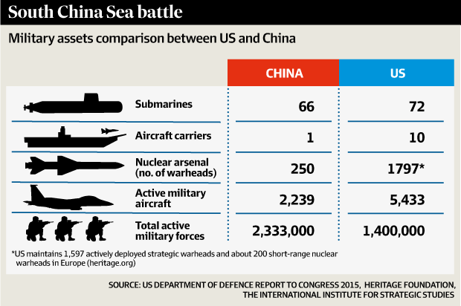
The military balance

Slide 53
The US and its options
One suggestion is that a U.S.-led coalition would use “three layers, surrounding the target islands with private civilian boats in the inner circle, followed by law enforcement vessels in the outer circle, all protected by warships over the horizon.
The US should not count on its allies to help in the case of a blockade.
Economic sanctions by the themselves would not deter China in the SCS
Nationalists in Beijing government would not let China back down?
Legal protests not likely to get anywhere as the US is not a signatory of UNCLOS.
Militarily the US is a decade ahead of China but China has been building up its supplies of anti ship missiles.
China has focused on “Raising the cost” for any encounter even if it is behind.
Two US aircraft carriers now there the equivalent of Australia’s entire navy and air force.
No one is really sure how capable China’s submarines are.

Slide 54
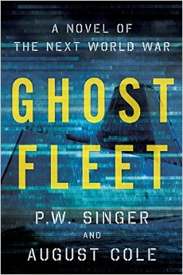
Don’t Panic
Everyone is much better at conflict resolution since the Cuban Missile Crisis
Most serious cold war conflicts have been avoided.
However – a word of caution - A Harvard study of 16 such hegemonic rivalries over the last 500 years found that three-quarters ended in war, with the clinching example said to be the Anglo-German battle for global mastery before 1914.
and just in case, read this...

