Slide 1
Just for starters

Slide 2
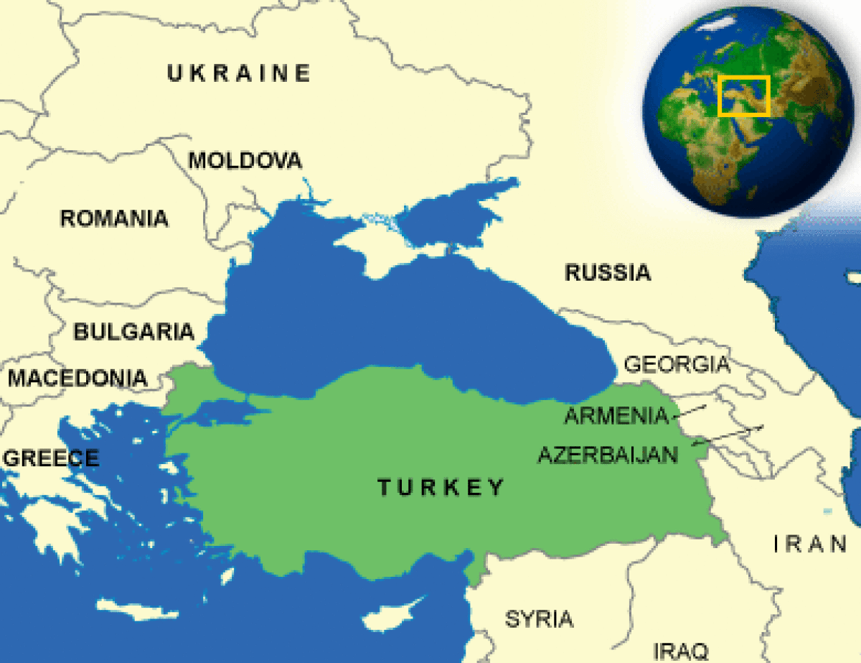
Turkey – neither East nor West
Taken over by Alexander the Great who Hellenised it – followed by the Romans who did the same.
Populated by 11th Century Seljuks. Ruled until 1243 when the Mongols took over.
The centre of the Ottoman Empire started mid 14th Century

Slide 4
The beginning- The Ottoman Empire
1453 AD – End of the Roman Empire in the East. Sultan Mehmed II the Magnificent captures Constantinople, ending Byzantine Empire and consolidating Ottoman Empire in Asia Minor and Balkans.
15th-16th centuries - Expansion into Asia and Africa.
1683 - Ottoman advance into Europe halted at Battle of Vienna. Long decline begins.
19th century - Efforts at political and economic modernisation of Empire largely founder.
1908 - Young Turk Revolution establishes constitutional rule and rules the Empire from 1913-18 (rule of the three pashas) but degenerates into military dictatorship during First World War, where Ottoman Empire fights in alliance with Germany and Austria-Hungary.

Slide 5
Before and during World War 1
1912-13 Ottomans lose first Balkan War to Serbia, Greece, Bulgaria. Lost to the Christians. Campaign in Persia also fails.
1914 – The Ottomans remove Greek orthodox community of some 150,000 from the Aegean coast and replaces them with Muslims from the Balkans.
1914 – Russia made the protector of the Armenian Christians.
1915 - “Remove the tumours” – ethnic relocation/massacre of Armenians at the same time as Gallipoli. Success at Gallipoli emboldened the Turks to move against the Armenians. Armenian Christians seen as a fifth column. Armenian massacre still denied. 1 million died.
1918 - End of WW1 Greeks, Brits and French divide up the Ottoman Empire after Ottomans back Germany and Austria- Hungary. Under punitive agreement they lose colonies and the West gives Armenia and Kurdistan their independence.
Syria and, Lebanon and Iraq lost thanks to Sykes – Picot agreement.
Turkey gets what is left - Anatolia

Slide 6
The rise of Mustafa Kemal – Ataturk
Mustafa Kemal. A revolutionary, army officer born in Greece.
Ataturk the hero of Gallipoli – sets him up for power.
Ataturk sets Turkey on to the path of modernism and away from its Islamist past.
1923 - Grand National Assembly declares Turkey a republic and Kemal Ataturk president.

Slide 7
Ataturk’s reforms
Mustafa Kemal throws out British, Greeks and French during Turkey’s war of independence 1919-23.
Swaps Greeks from Smyrna for Muslims in Greece.
Turns Turkey into a secular state not multi ethnic like the Ottoman Empire but a nation with a single national identity. Turkey for the Turks so to speak.
The Republic of Turkey created in 1923 with Mustafa Kemal as President.
Often autocratic.
Bans Islamic head gear, makes education secular,
Promotes equal rights for women. Women given the vote
Arabic replaced by Latin letters and the Turkish language,
Islam removed from the constitution, Islamic courts and judges shut down.
Western dress encouraged.
Ottoman caliphate in Istanbul left merely as a figure head .

Slide 8
The Military as the protectors of Ataturk's legacy
1960 – Islamist PM elected overthrown by the Army
1971 another coup
1980 – military coup. Martial law
1997 – Military coup
2016 – a failed coup?
Why do armies always get involved in developing countries?
The military are determined to see that Turkey does not become an Islamist state
Now effectively undermined as a political force by Erdogan?

Slide 9
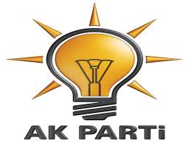
The rise of Islam
2001 June - Constitutional Court bans opposition pro-Islamic Virtue Party, saying it had become focus of anti-secular activities.
2001 – AKP founded by joining a group of conservative parties together.
2002 January - Turkish men are no longer regarded in law as head of the family. The move gives women full legal equality with men, 66 years after women's rights were put on the statute books.
2002 August - Parliament approves reforms aimed at securing EU membership. Death sentence to be abolished and bans on Kurdish education, broadcasting to be lifted.
2002 - Islamist-based Justice and Development Party (AK) wins landslide election victory. Party promises to stick to secular principles of constitution

Slide 10
Islamist party victorious
2002 - Constitutional changes allow head of ruling AK Party, Recep Tayyip Erdogan, to run for parliament, and so to become prime minister. He had been barred from public office because of previous criminal conviction. (10 months for inciting religious hatred in a poem). AK has won every election since 2002.
2003 - AK Party leader Recep Tayyip Erdogan wins seat in parliament. Within days Abdullah Gul resigns as prime minister and Erdogan takes over.
2003 - Eyeing future EU membership, parliament passes laws easing restrictions on freedom of speech, Kurdish language rights, and on reducing political role of military.
2007 Justice and Development party (AKP) jails secularists and replaces them AKP members.
Erdogan – head scarves OK – Turkey is a Muslim Country with no place for secularism in the constitution.

Slide 11
Tensions in Modern Turkey
Military vs. democracy
Secularism vs. Tradition
For Assad or against?
For its neighbours or against – Egypt, Syria, Russia, Israel
Tensions between the Alevis (Shia) allied to Syria’s Alawites who make up a quarter of the population and Sunnis.
Turkey vs. Kurds vs. USA. Support for Saudis against 9/11 provisions.
A secular government with Islamist leanings and the conditions of EU membership.
His clampdown after the failed coup and his efforts to muffle the media have been seen as a step back for the kind of civil liberties that would be a prerequisite to joining the EU.
Turkey sees itself targeted by three groups of "terrorists": IS, Kurdish militants and coup-plotters.

Slide 12
The military and the Kurds
1984 - Turkey recognises "Turkish Republic of Northern Cyprus.“ Cyprus divided after 1974 when Turks invaded – Cyprus Turkish northern third and Greek 2/3rds
Kurdistan Workers' Party launches separatist guerrilla war in southeast.
1987 - Turkey applies for full EEC membership.
1990 - Turkey allows US-led coalition against Iraq to launch air strikes from Turkish bases.
1992 - 20,000 Turkish troops enter Kurdish safe havens in Iraq in anti-PKK operation.
1995 - Major military offensive launched against the Kurds in northern Iraq, involving some 35,000 Turkish troops.
Kurds - The world’s largest minority without a state of their own approx 35 million people.
Kurds had long battled the spread of IS militants in Syria without any help from Turkey.

Slide 13
Who is fighting whom?

Slide 14
Peshmerga – YPG and PKK

Slide 15
Turkey, the YPG and PKK
Turkey has been shelling both Kurdish fighters of the Popular Protection Units (YPG) and so-called Islamic State inside northern Syria.
The YPG are widely regarded as one of the most effective forces in the fight against IS and attacks on them have prompted calls from the UN, US and EU for Turkey to show restraint.
While Turkey is fighting against the PKK on its soil, neighbouring Syrian Kurds continue carving out a self-declared autonomous region known as Rojava, and the YPG has gained the trust of Turkey 's international allies in the fight against Islamic State.
Turkey likes the Iraqi Kurds because they are an ally against Shia government in Bagdad.
Needs Iraqi oil from Kurdish controlled area.
Kurdistan in Iraq is Turkey’s second biggest export market.
Kurdistan a semi autonomous state Turkey can do business with.

Slide 16
Where the Kurds are

Slide 17
Irbil – the capital of Kurdistan

Slide 18
Turkey and Europe
Turkey’s relations with Europe have been antagonistic at various points in history. The armies of Suleiman the Magnificent laid siege to Vienna in 1529. The Ottomans did so again in 1683, and occupied much of the Balkans until the end of World War I.
Turkey has been part of NATO since 1952 and an associate member of the EU since the 1960s. Efforts to become a full EU member have floundered since negotiations started in 2005.

Slide 19
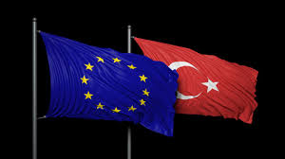
And the EU
2004 - EU leaders agree to open talks in 2005 on Turkey's EU accession.
2005 - Multi-billion-dollar Blue Stream pipeline carrying Russian gas under the Black Sea to Turkey opens in the port of Samsun.
2006 - Gunman opens fire in Turkey's highest court, killing a prominent judge and wounding four others. Thousands protest against what they perceive as an Islamic fundamentalist attack.
2006 - Parliament passes new anti-terror law which worries the EU and which rights groups criticise as an invitation to torture. Civil rights a serious issue for the EU
2006 - Kurdish separatist group, the PKK, declares a unilateral ceasefire in operations against the military.

Slide 20
Turkey and Europe
Turkey makes an enemy of Holland and Germany for banning “Yes” referendum rallies.
No freedom of speech in Europe says Erdogan – hypocritical.
Pick a fight with Europe appeals to the conservatives, nationalist sentiment and his right wing. Same tactic as the campaign against the Kurds in 2015.
Germany and Holland called Nazis. Germany still blames Turkey for the Armenian genocide.
Erdogan inflames the situation – have a baby boom in Germany – have five children. Outbreed the Europeans?
Merkel – Lady Hitler and pictures of Dutch police dogs attacking Turkish protestors in Rotterdam.
End of the EU application – the refugee deal?

Slide 21
Turkey and the EU migrant deal

Slide 22
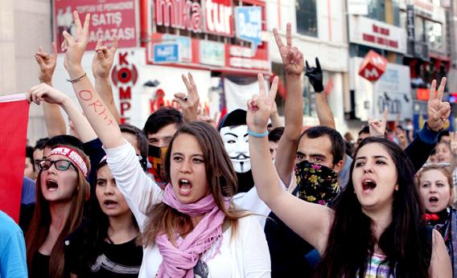
Secularist protest
2007 April - Tens of thousands rally in Ankara, aiming to pressure Prime Minister Erdogan not to run because of his Islamist background.
2007 - AK Party wins parliamentary elections. Abdullah Gul elected president
2007 October - Voters in a referendum back plans to have future presidents elected by the people instead of by parliament.
2008 February - Thousands protest at plans to allow women to wear the Islamic headscarf to university.

Slide 23
Conflict at home and abroad
2010 - Relations with Israel come under severe strain after nine Turkish activists are killed in an Israeli commando raid on an aid flotilla attempting to reach Gaza.
2010 - The whistle-blowing website Wikileaks publishes confidential cables revealing that France and Austria have been deliberately blocking Turkey's EU membership negotiations.
2011 -Thousands of refugees fleeing unrest in Syria stream into Turkey. Ankara demands reform in Syria.
2011- PKK rebels kill 24 Turkish troops near the Iraqi border, the deadliest attack against the military since the 1990s.
2012 - Tension rises with Damascus. After Syrian mortar fire on a Turkish border town kills five civilians, parliament authorises military action inside Syria, and the armed forces respond with artillery fire into Syria.
2013 – Gezi park protests – 5 million nationally take part. Penguins. A chance to get back over the environment, the war in Syria and restrictions on freedom.

Slide 24
Erdogan and wife Emine – the new Ataturk?
Mayor of Istanbul from 1994 – 1998. Founded AKP in 2001 and led it to three election wins in 2002, 2007 and 2011. Prime minister from 2003 to 2014. President since 2014.

Slide 25
Erdogan presidency
2014 - Prime Minister Erdogan wins the first direct popular election for president.
2015 - a court clears 236 military officers accused of involvement in an alleged conspiracy to remove former Prime Minister Erdogan from power in 2003.
2015 - Turkey announces air strikes against Islamic State militant group after suspected IS suicide bomber kills 32 young activists at rally in Suruc, on the Syrian border.
2015 - Ceasefire with the Kurdish rebel PKK finally crumbles under the weight of tensions aggravated by the Syrian civil war and the role of both Turkey and the Kurds in the war. Kurdish insurgency erupts once more.
2015 - Turkey accuses Islamic State of twin suicide bomb attacks on Ankara peace rally by Kurds that kills 100 people.
2016/17 - 100,000 military, Judges, academics detained or purged. Schools still not open. A new authoritarian regime? 34,000 prisoners released to make room.

Slide 26
Erdogan’s double game and the cult of personality
Terrorist as far as Erdogan is concerned are the Kurdistan Workers Party (PKK) not ISIS.
PKK more a threat than ISIS.
Allowed free passage of ISIS into Syria from Turkey.
Got into fights with Russia, Egypt and Israel.
Europe needs him (refugees) US needs him (militarily).
Personality cult grows at the expense of freedom.
100 room palace on the Bosporus declared illegal by the courts.
Resurrecting the Ottoman Empire?
Islamist – supported Muslin Brotherhood.

Slide 27
2015 election results
AK Party needs 330 to govern in its own right

Slide 28
Erdogan for and against
For
13 years of stability
Built hospitals and schools.
Economy grew at 5% annually since 2006
A flood of investment from abroad.
A favourite of the Turkish poor.
A symbol of moderate Islamic Government
Against
Autocratic rule
Polarised the nation
Makes too many enemies?
Undemocratic and actively removing any opposition in the south east.
It is all about Erdogan.
Led to increased terrorism at home.

Slide 29
Terrorist attacks 2016.

Slide 30
Erdogan - background
In 2013, Erdogan lifted curbs on religious expression, such as the wearing of headscarves, put in place when the army was Turkey’s dominant political force. By giving a voice to an underclass of Islamic conservatives, Erdogan meant to roll back Ataturk’s secular legacy in favour of what he called a “pious generation.”
Later that same year, Erdogan battled to defend his inner circle from corruption allegations.
He has accused opponents -- including those behind the July coup attempt -- of being followers of Fethullah Gulen, an Islamic cleric and government critic in self-imposed exile in the U.S.
After a purge of the police and the judiciary in 2014, dozens of journalists were detained. In March a court replaced the management of the nation’s biggest newspaper.
The government has widened oversight of the Internet and blocked access to Twitter and YouTube at times, drawing criticism from the U.S. and the EU.

Slide 31
Turkey under Erdogan
Catalyst for conflict with the EU is the lack of democracy in Turkey and the possible reinstatement of the death penalty.
Referendum next year over Turkey’s bid to enter the EU.
Most likely will fail given Government’s control over the media.
Refugee deal with the EU then at risk? No more visa free travel within the EU and money at risk?
What about foreign fighters leaving Syria back through Turkey?
Erdogan talks about joining the Shanghai Five group instead with Russia, China and the “stans” etc.
Erdogan starts a massive mosque building programme..
Turkey has its eyes on Mosul and under Erdogan perhaps a Greater Ottoman style Turkey?

Slide 32
The 15 July 2016 attempted coup

Slide 33
The attempted coup - 2016
Pro-coup soldiers take military leadership hostage, briefly seizing control over parts of the Turkish armed forces. Called the Peace at home Council The Council cited an erosion of secularism, elimination of democratic rule, disregard for human rights, and Turkey's loss of credibility in the international arena as reasons for the coup.
Turkish parliament and Presidential palace bombed
Shootouts between police officers and pro-coup soldiers occupying Ankara and Istanbul streets
Turkish Air Force declares no fly zone over Ankara downing unauthorized military aircraft presumed rogue
Three-month state of emergency announced by President Erdogan,[later extended and still in place.
300 killed.
Was it a plot by Erdogan?

Slide 34
Erdogan continued
$4bn moved from Gulenist businesses to the state. Gulen blamed for everything. He is a CIA man, a cardinal, a carrier of the $1 note. Gulenists arrested those close to Erdogan in 2013 for corruption, bribery and tender rigging.
Paranoia – US has an earthquake machine it wants to use on Istanbul.
People out on the streets for a month.
July 15 now a national holiday and all speeding fines removed.
Bosporus crossings renamed for those who died.
Purges spread to mayors with Kurdish sympathies
Turks who had nothing to do with the attempted coup being punished, particularly journalists.
A divided society and an undemocratic one with Erdogan as seemingly President for life.

Slide 35
Fethullah Gulen – 4 million followers of Democratic Islam

Slide 36
Gulen and the Gulenist movement
The Turkish government blames the failed coup attempt on Fethullah Gulen, a Turkish preacher and businessman who has lived in self-imposed exile in the United States since 1999.
Gulen is the leader of a widespread and influential religious movement known as "Hizmet" (Service), which owns foundations, associations, media organisations and schools in Turkey and abroad. Gulen is cultural Islam and not political Islam.
Gulen was once a strong ally of Erdogan, and during the Justice and Development Party (AKP) struggle to end the military's influence in Turkish politics in the late 2000s, his organisation had its golden years. Many people in the bureaucracy were removed without due process and replaced with Gulenists.
Gulenist police officers arrest business people and bureaucrats who are close to the AKP on corruption charges and the split begins. Erdogan closes Gulen schools that prepare students for University exams. Gulen organisation declared a terrorist group and banned.

Slide 37
Since the coup
160,000 people purged from their jobs (by April 29)
45,000 people suspected of Gulenist links arrested.
150 media groups closed
1500 civil society organisations shut down.
Republican Party calls election a fraud – electoral commission refuses to annul the election results.
just one day after the coup was foiled, 2,745 judges were dismissed and detained.

Slide 38
How can Turkey function after the purges?
Watchdogs say that around 1,200 schools, 50 hospitals and 15 universities have been closed. Affected schoolchildren have usually been able to find places in local state schools — but their purged parents have mostly been frozen out of the job market.
Those parents are living off their savings.
gaps have been largely plugged by members of other Islamic orders, or loyalists from the president’s Justice and Development Party, known as the AKP.
School and University class sizes tripled in size.
Gulenists still the biggest faction in the Army.
Turkey an open air prison with people denouncing each other. A toxc atmosphere?

Slide 39
Spill over of the Syrian Conflict
.
Turkey shoots down a Russian military jet on Syria bombing mission. Russia, Turkey's second-largest trading partner, imposes economic sanctions.
European Union strikes a deal whereby Turkey restricts flow of migrants into Europe, in return for €3bn ($3.17bn) and concessions on stalled EU accession talks. President Erdogan says that deal on restriction of flow of migrants into Europe - could collapse if Turks are not granted visa-free access to the EU.
2016 March - Authorities put Turkey's biggest newspaper, Zaman - closely linked to Erdogan rival Fethullah Gulen - under state control.
2016 June - Turkey recalls its ambassador to Berlin after German parliament adopts resolution declaring as genocide the killing of Armenians by Ottoman Turkish forces during WW1.
3 Million Syrian refugees in Turkey and 78% of them say they do not want to go back. Positive for economic growth but negative for employment.
Turkish firms cannot hire ore than 10% of their employees as refugees. Refugees often exploited.

Slide 40
Turkey invades Northern Syria

Slide 41
The Syrian conflict 2
2016 - The authorities detain thousands of soldiers and judges on suspicion of involvement in a coup attempt that President Erdogan says was inspired by his exiled opponent Fethullah Gulen. Lists already made up so military pre empts move by Erdogan?
The government also shuts down dozens of media outlets - including 16 TV channels - during a continuing crackdown in the wake of the failed coup attempt.
State of Emergency extended by 3 months this week.
2016 August - President Erdogan visits St Petersburg for talks with Russian President Vladimir Putin.
2016 - Turkey enters Syria with US backing with tanks and artillery to root out ISIS on the border. US very supportive and not critical of Erdogan.
Turkey buying Iranian black market oil.
Keeping Syrian Kurds away from the border so they don’t encourage Turkish Kurds
Turkey wants Kurds to move East of the Euphrates

Slide 42
Where do they want them to go – east of the Euphrates

Slide 43
Turkey and the US
US needs Turkey in a volatile part of the world
US concerned about rounding of Gulen supporters a chance to kill off opposition? Gulen extradition still being translated.
US does not want relations with Turkey to deteriorate further. Needs Incirlik and nuke storage?
US supports YPG in Syria – US accused of being behind the coup.
US would never hand over Gulen?
Swap Predator drones for peace talks with the Kurds?
Trump arms the Kurds against wishes of Erdogan

Slide 44
Turkey and the US – part two
Trump has made defeating IS the top priority. Raqqa is the last stronghold and the Kurds are the best ones to do it. Turkey wants the Syrian rebels to do it.
Turks say the Kurdish rebels YPG are linked to the outlawed PKK.
YPG has done most of the fighting. The US military supports them but does Trump?
The US does not want to lose Turkey particularly as it is making up with Russia.

Slide 45
And just to make it a bit more complicated

Slide 46
Turkey and the region
Egypt hoped the military coup would succeed.
Iran , Qatar and Israel backed Erdogan against the failed coup.
2016 – “the year of more friends and fewer enemies”.
Turkey has enormous ability to influence events in the region.
Membership of NATO means it can do what it likes internally as long as it serves US/NATO externally. It gives NATO a non Christian face in the Middle East.
Will hold on to NATO but not EU membership which it sees as interfering in domestic policy. EU objections seen as racist as well.
If Turkey collapses it would encourage ISIS and Russia to act more aggressively in the region.
Turkey to maintain $3bn migration deal with the EU?

Slide 47
The changes to the constitution – April 2017
The president will have a five-year tenure, for a maximum of two terms.
The president will be able to directly appoint top public officials, including ministers and one or several vice-presidents.
The job of prime minister will be scrapped.
The president will have power to intervene in the judiciary, which Mr Erdogan has accused of being influenced by Fethullah Gulen, the Pennsylvania-based preacher he blames for the failed coup in July.
The president will decide whether or not impose a state of emergency. Recently extended by another three months.
Turn out was 85%.
Ankara, Istanbul and Izmir voted against.
Outlying rural areas voted heavily for – final result yes – 51.4%

Slide 48
Turks in Germany
About 3m people of Turkish descent live in Germany. Half of them retain Turkish citizenship, making Germany in effect Turkey’s fourth-largest electoral district.
Of the roughly 570,000 German Turks who voted in 2015, 60% chose Mr Erdogan’s party, giving him a higher share in Germany than at home.
Some 2,000 of the country’s 3,000 mosques are Turkish, and 900 of those are financed by DITIB, an arm of the Turkish government, which sends the imams from Turkey.

Slide 49
How Turks overseas voted (for)
The Netherlands (70.94%)
Austria (73.23%)
Belgium (74.98%)
France (64.85%)
Germany (63.40%)
Switzerland (61.92%) against

Slide 50
What the referendum result means
the “Yes” vote was a reaction to years of turmoil that included the resumption of a violent Kurdish insurgency, a wave of Islamic State terror attacks and last year's failed coup attempt.
Erdogan gains unlimited power. No more checks and balances. It granted him authority to control the parliament and judiciary and the power to rule Turkey by decree. The post of prime minister will be eliminated.
Narrow victory contested at home and by international observers. Unstamped ballots counted. in 961 ballot boxes, 100% of the ballots were “yes”. And in a third of these 961 boxes, 100% of eligible voters had cast votes.
Allocated TV for speeches – Erdogan and AKP – 136 hours. The opposition – 31 hours.
Return of the death penalty as the final nail in the coffin of EU membership?
The close result does not give him legitimacy? Wings clipped for 2019 election? Or is a win a win for Erdogan?

Slide 51
Since the referendum
Since the referendum another 4000 officials have been removed from office. They include more than 1,000 justice ministry workers, a similar number of army staff and more than 100 air force pilots.
The latest sackings follow the suspension of more than 9000 police offices and another 1000 on Wednesday on suspicion of having links to the US-based cleric Fethullah Gulen.
Access to Wikipedia cut and TV dating shows banned.
Unlike European leaders Trump congratulates Erdogan on his win. A split between US and Europe.
A State of emergency extended by 3 months.
Turkey more polarised than he is willing to admit – might he have to strike a deal with the Kurds?

Slide 52
TV and the national mood
Over three seasons so far, “Dirilis: Ertugrul” (Resurrection: Ertugrul) has described medieval campaigns waged by Turks against Christians.
Focusing on the life of Ertugrul Bey, father of Osman Bey, the 13th century founder of the Ottoman Empire, the series leads television ratings in Turkey every week.
The first season featured a Turkish campaign against Crusaders in Anatolia, the second season battles against the Mongols, the third season war with the Christian Byzantines.
94% of Turks say that watching TV is their favourite activity. There is a huge export market for Turkish TV in the Middle East.

Slide 53
Turkey – not Ottomans just a little big bigger

Slide 54
Reading guide

