Slide 1

Update session – Europe and North Korea
Beechworth U3A - 2017

Slide 2
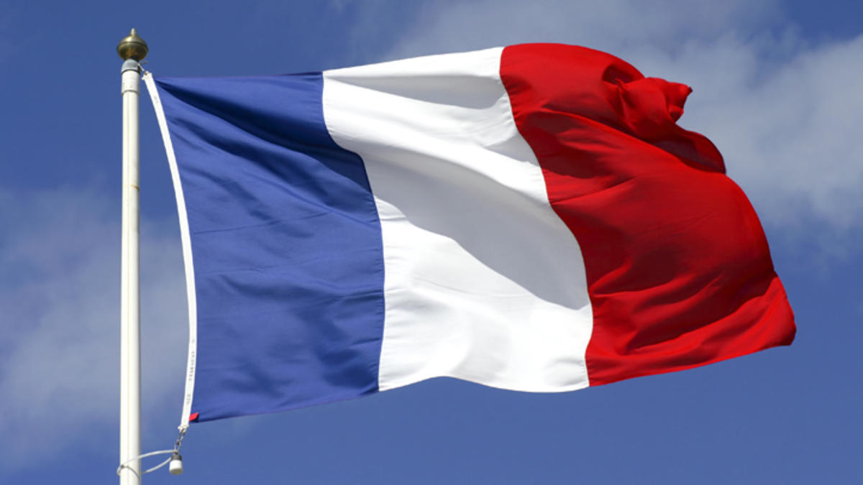
The French Elections
Beechworth U3A - 2017

Slide 3
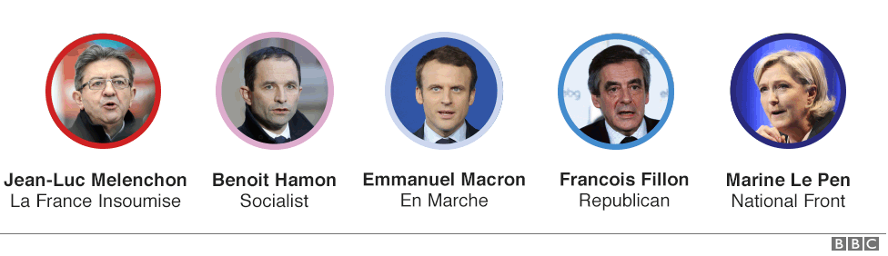
The candidates

Slide 4
What they stand (stood) for!
Fillon – (republicains) A Thatcherite. Took the axe to France’s bloated civil service. Catholic base but badly tarnished by scandal over paying his wife 1000s of Euros for a fictitious job. Was well fancied before that.
Le Pen – (Front national) right wing, anti immigration and anti EU. Took over part from her father in 2011. Tried to remove charges that the party was racist and a holocaust denier. Seeing how far the populist Trump effect can go? Through to round two with Macron. Champions “forgotten France”.
Macron – (en marche – literally “on the move”). Inexperienced and an outsider although did work for Hollande the previous President whose popularity plummeted to 4%. A centrist – married to a wife 20 years older. Pro Europe and pro open markets, pro immigration. Through to round two on May 7. A young Kennedy?
Hamon – Socialist party – a Jeremy Corbyn? Universal basic income – tax robots 32 hour week down from 35.
Melenchon – anti capitalist. Raise minimum wage, ;eave NATO, tax the rich 32 hr week and 350 point manifesto.

Slide 5
The process
The President is elected for five years and may serve only two terms.
The President is head of the military, head of state and the Executive ( chairs Cabinet meetings).
The President also appoints the Prime minister – who then forms government. President and the PM may be from totally opposite political parties. President forced to choose PM from majority party in Parliament.
Round one may be the only round if one candidate gets a majority but this rarely happens.
Round Two then is between the two highest vote getters in real terms.
Remaining candidates must then try to soak up the votes of the others. Usually major rallies are held at this point.
Voting with the heart in the first round and the head in the second?
Winner installed in a lavish ceremony at the Elysee Palace.

Slide 6
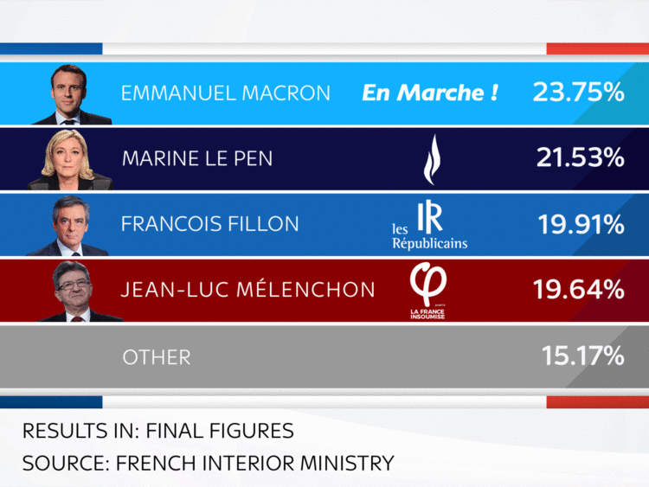
The results of round one

Slide 7
Why is this election important?
France is the second largest economy in the Eurozone and 7th largest in the world.
French people are increasingly concerned on security matters, after several terrorist attacks across the country, and disenchanted with high levels of unemployment and poor economic performance.
Macron the favourite because he is new and interesting? Vague on details. A reformist, anglophone, technocratic and liberal but if Le Pen wins it will mean the most right wing leader since Franco 40 years ago and France turning inward and protectionist.
Le Pen – end of the Euro and the free movement of peoples. 53/37% of French voters think the Euro is good for them. Frexit or reform?
A referendum on the EU if she gets in? Unlikely as the FN needs to win 289 out of 577 parliamentary seats in June for a majority, up from two at the moment. The party only has two seats in the 348-seat Senate.
Waiting for the next round?

Slide 8
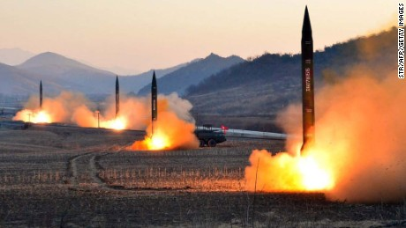
North Korea

Slide 9
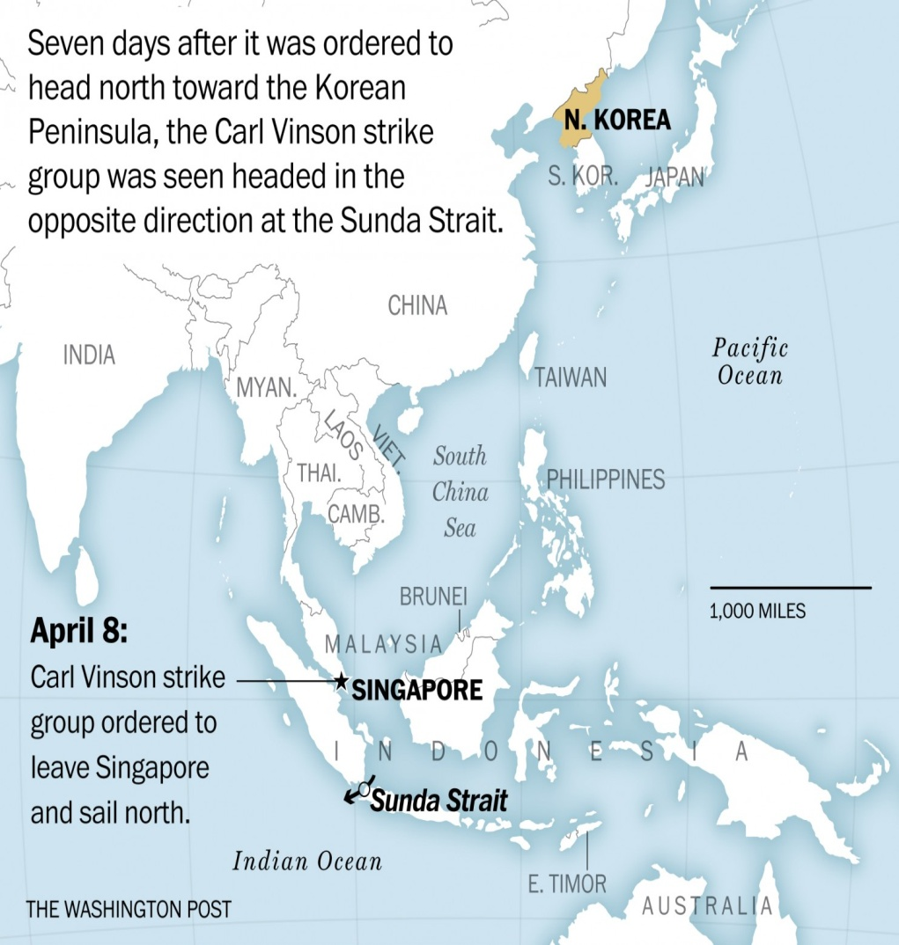
The US position on North Korea
No negotiation.
If China won’t fix it we will.
NK must give up its nuclear weapons.
Pre-emptive strike option still on the table.
North Korea 25 million – highly urbanised. South Korea - 49 million of whom 45 million are on line.
South Korean TV soaps are popular across the region, including in China
There are 29,000 US troops in the country.
PM Turnbull won’t rule out Australian involvement if North Korea crisis leads to war during Pence visit. NK threatens Aust with nukes.

Slide 10
North Korea – why there are no options
During the Cold War both at similar stage of development. 1990s SK booms – NK prepares for war.
NK – permanent state of war to stave off challenges to regime internally.
1991 – Soviet support disappears leaving it vulnerable to the US.
Threats against neighbours means it cannot back down.
Aim to make SK a nuclear hostage against US strike
React first because the US can wipe it out.
Sanctions won't work as it did in Iran – 1990s -10% of population died during the famine.
Cyber attacks only slows down the process.
Seoul as a near target 25 million people – an acceptable risk?
US to leave SK as the only deal the North would accept – neigbours (e.g. Japan) would not.

Slide 11
How does North Korea survive?
China has cut off coal imports – 80% of their revenue in NK.
Chinese flights to NK suspended or reduced.
China conducts military exercises on the border with NK.
No observer sent to NK national celebrations.
However – NK sources of revenue have diversified and food distribution better organised.
Also generates cash from:
Bank hacks – SWIFT system attacked – Bangladeshi bank
Drugs in diplomatic bags etc
Counterfeit money - $US 100 notes
Arms sales to Syria and Iran through 3rd parties.
Selling labour overseas ( slave labour) with 90% remittances back to the regime.

Slide 12
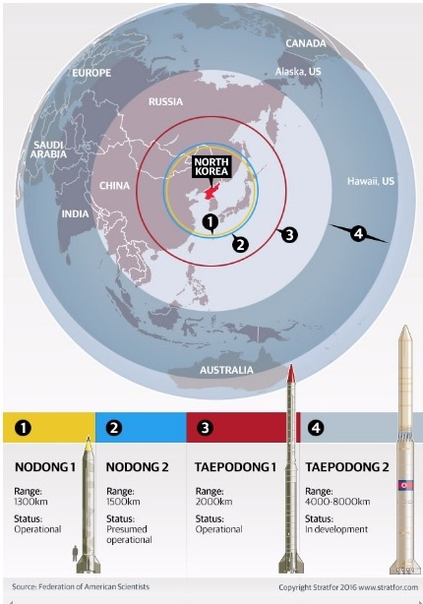
North Korea’s missiles

Slide 13
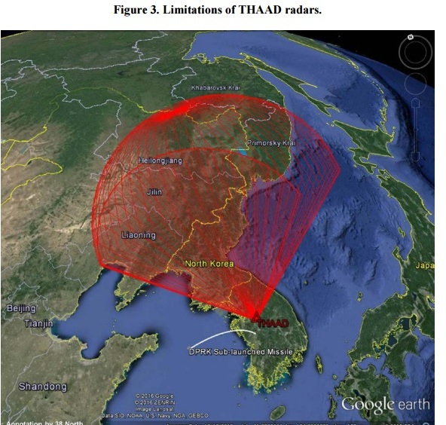
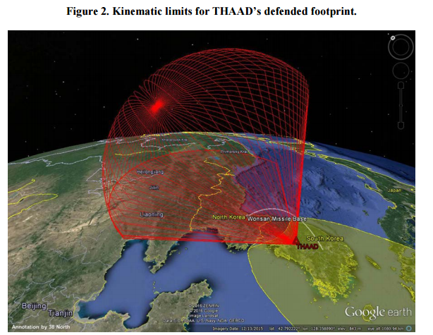
The THAAD system
Note system is kinetic and China worried it can spy on their arsenal
The US wants SK to pay for it?

Slide 14
China and North Korea
China sick and tired of defending her unruly neighbour.
Could cut off oil – a major crippling blow.
China moves 150,000 troops to the North Korean border. Russia does the same.
China is now onside with the US – no longer talk of a trade war. China votes against NK in the UN.
China still miffed over death of Kim Jong Nam who was under their protection.
China worried that a nuclear NK would also encourage Japan to go Nuclear.
Carl Vinson – provocative? Wrong direction – a loss of face for the US in South Korea? North sees all US actions as a bluff?
South Korea – a new president in May – possibly leftist and more conciliatory to NK?
Trump - “Korea is historically part of China” and on talks with President Xi of China at Mar a Lago – “after listening for 10 minutes, I realised it is not so easy”.

Slide 15
Australia, The US and North Korea
Caught between two “unpredictables”?
Pence visit – and the refugee deal – what have we promised?
North Korea threatens Australia. With nuclear strike. Actually Darwin!
Our involvement in Iraq ( Howard) made us more of a terrorist target?
Options for Australia
Press for diplomacy over the NK issue – Trump now going for sanctions.
Quadruple defence spending?
Armed Neutrality?
Nuclear weapons for Australia?
Sit Trump out and wait for 2020?

Slide 16
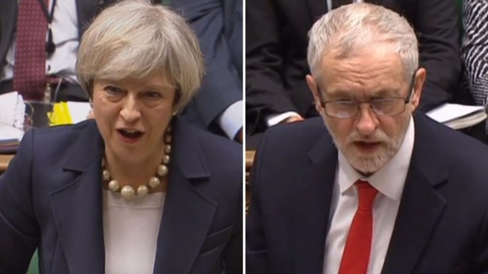
Brexit – Theresa May Vs Jeremy Corbyn

Slide 17
Press reaction in the UK to article 50
Are Britain and the European Union ready to live apart?
The Observer and The Guardian are not too happy about the developments:
The UK will throw into jeopardy the achievements of 60 years of unparalleled European peace, security and prosperity from which it has greatly benefited. — The Observer, March 25
Leaving the European Union will weaken the remaining 27 members, and it is likely to set this country on a decade or more of instability. — The Guardian, March 28
The Telegraph suspects Europe is elated.

Slide 18
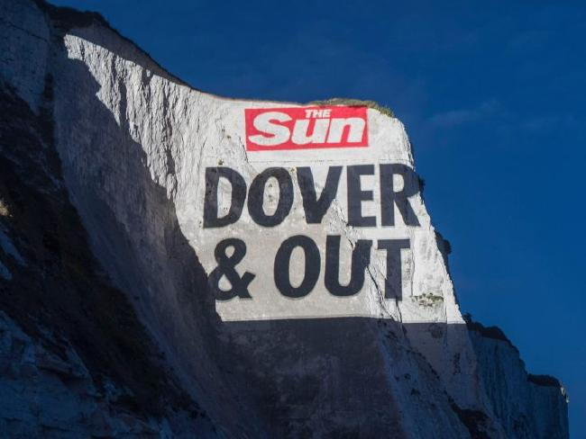
As “The Sun” newspaper in England sees it

Slide 19
Brexit – update
PM May calls for snap election on June 8. Was scheduled for 2020. To strengthen her hand in negotiations with the EU and while Jeremy Corbyn is 21 points behind in the polls. EU officials supportive. Good timing? Letting the shock subside?
Scotland’s Nicola Sturgeon calls for second referendum on independence 2 years from now. Mrs May not happy.
Last referendum in 2014 went from 27% to 45% during the campaign. During Brexit referendum Scots voted 62% to remain.
Scottish National Party membership quadrupled since Brexit.
Holding a legally binding referendum in Scotland would require the approval of London. Few expect the authorities there to reject the request. Northern Ireland and Wales also thinking about it.
Scots revenue from oil and gas diminished – getting more back from England than it pays in taxes? What currency would they use – what about the bases in Scotland?

Slide 20
Brexit – the key issues
Trade – Britain exports mainly good and services. Trade could be reduced by 22 – 30%. New deals with the US and Canada? EU not keen on new arrangements.
Immigration and labour mobility – important for business that operate internationally. Agriculture and food delivery rely heavily on EU workers. EU workers in the UK invaluable in the areas of hospitality, construction and health care. A new VISA system similar to those for non EU migrants?
Security – will there still be access to the EU terrorism database, Interpol etc?
Defence – treaties with France to remain operational but what about Scotland Submarine base and the Clyde shipbuilding areas?
Health – 4 our of 10 doctors considering leaving – 2 out of 10 not sure? Doctors considering leaving are/were trained in Europe.
EU determined to make UK pay a heavy price for leaving to deter others. $50 billion figure mooted.

Slide 21
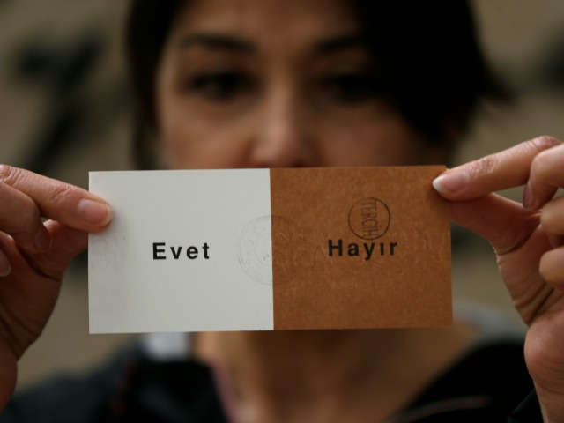
The Turkish referendum – Erdogan in power till 2029?

Slide 22
The changes to the constitution – April 2017
Turn out was 85%.
Ankara, Istanbul and Izmir voted against.
Outlying rural areas voted heavily for – final result yes – 51.4%
The president will have a five-year tenure, for a maximum of two terms.
The president will be able to directly appoint top public officials, including ministers and one or several vice-presidents.
The job of prime minister will be scrapped.
The president will have power to intervene in the judiciary, which Mr Erdogan has accused of being influenced by Fethullah Gulen, the preacher he blames for the failed coup in July.
The president will decide whether or not impose a state of emergency.
Since then another 1000 mainly police have been arrested. The Party itself next? Turkey closes down Wikipedia.

Slide 23
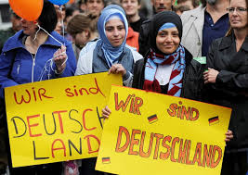
Turks in Germany
About 3m people of Turkish descent live in Germany. Half of them retain Turkish citizenship, making Germany in effect Turkey’s fourth-largest electoral district.
Of the roughly 570,000 German Turks who voted in 2015, 60% chose Mr Erdogan’s party, giving him a higher share in Germany than at home.
Some 2,000 of the country’s 3,000 mosques are Turkish, and 900 of those are financed by DITIB, an arm of the Turkish government, which sends the imams from Turkey.

Slide 24
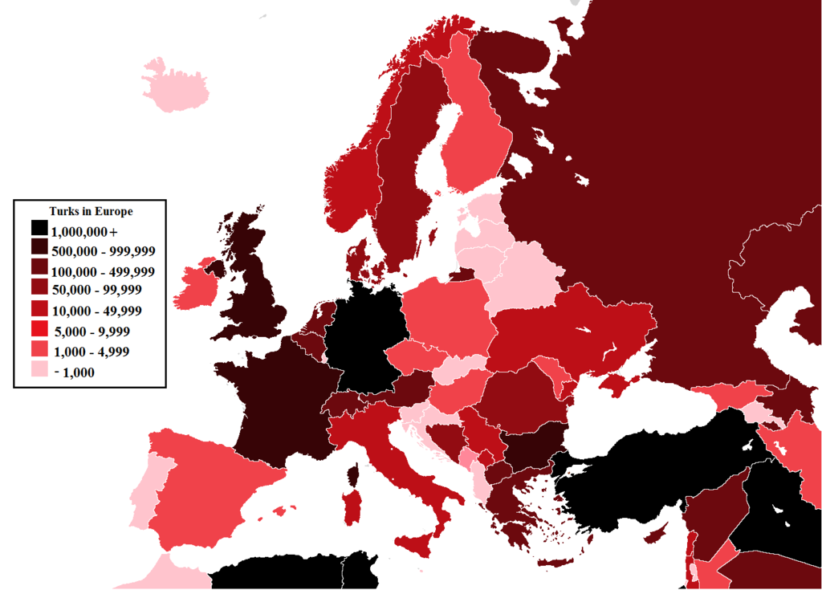
How Turks overseas voted (for)
The Netherlands (70.94%)
Austria (73.23%)
Belgium (74.98%)
France (64.85%)
Germany (63.40%)
Switzerland (61.92%) against

Slide 25
What the referendum result means
the “Yes” vote was a reaction to years of turmoil that included the resumption of a violent Kurdish insurgency, a wave of Islamic State terror attacks and last year's failed coup attempt.
Erdogan gains unlimited power. No more checks and balances. It granted him authority to control the parliament and judiciary and the power to rule Turkey by decree. The post of prime minister will be eliminated.
Narrow victory contested at home and by international observers. Unstamped ballots counted. in 961 ballot boxes, 100% of the ballots were “yes”. And in a third of these 961 boxes, 100% of eligible voters had cast votes.
Allocated TV for speeches – Erdogan and AKP – 136 hours. The opposition – 31 hours.
Return of the death penalty as the final nail in the coffin of EU membership?
The close result does not give him legitimacy? Wings clipped for 2019 election? Or is a win a win for Erdogan?

Slide 26
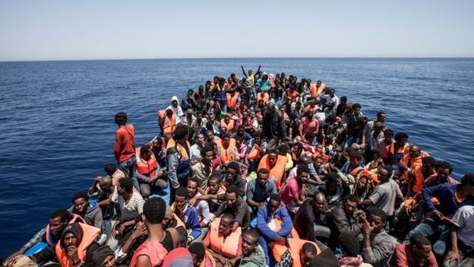
Europe and the Migrants – 3 charts

Slide 27
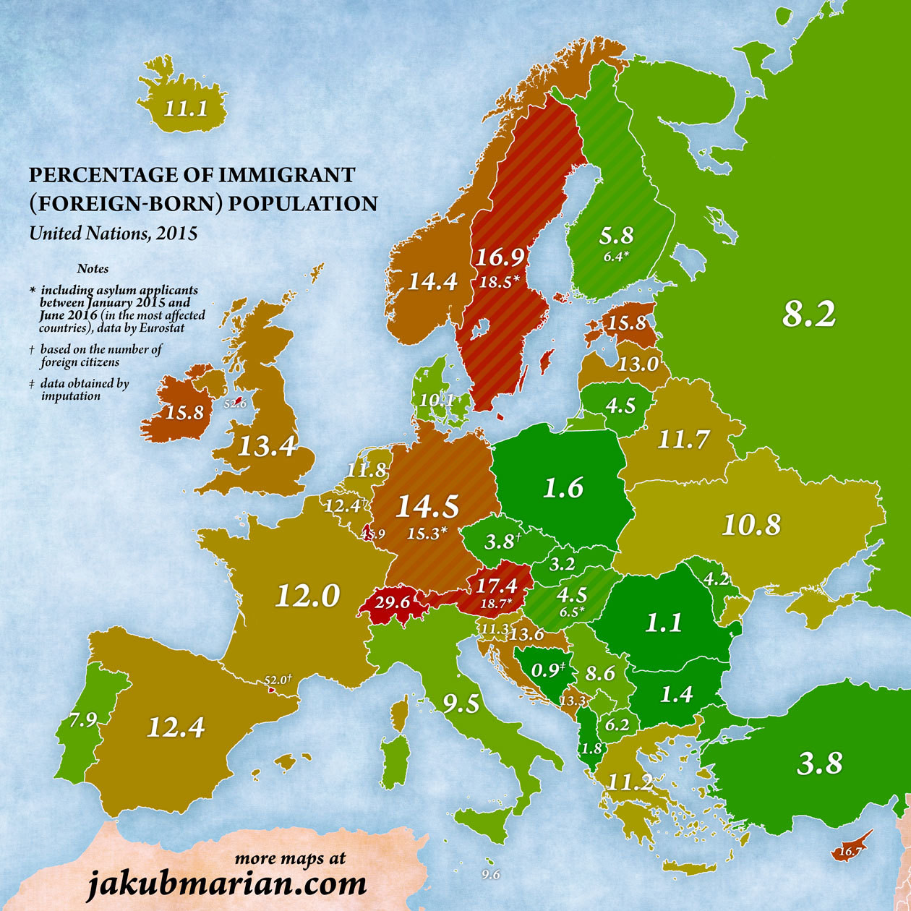
Europe – percentage foreign born

Slide 28
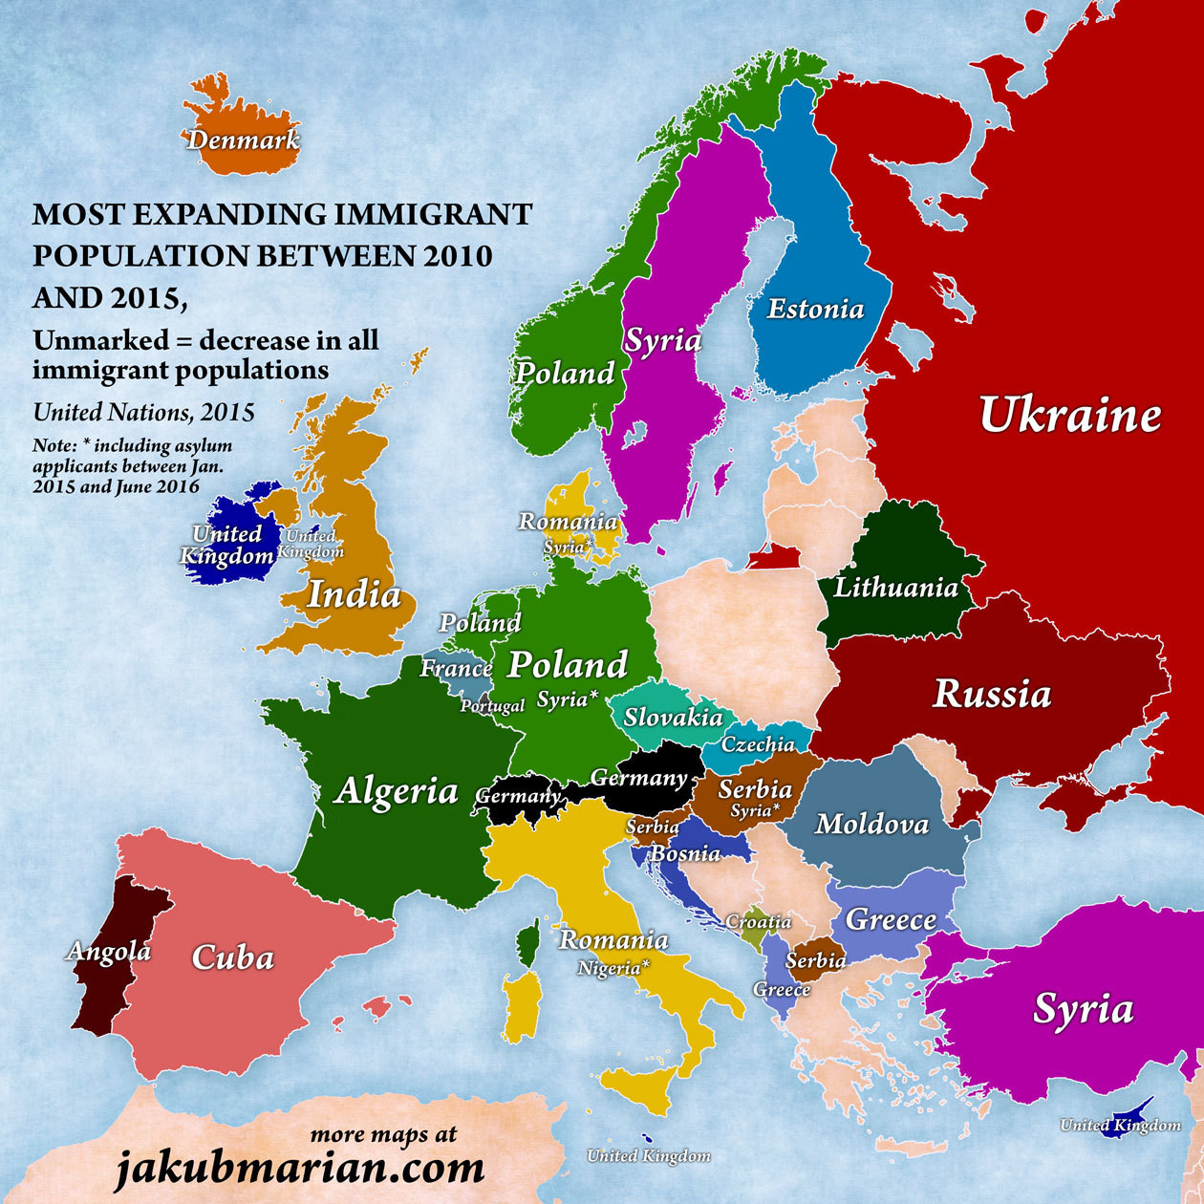
Most expanding immigrant populations

Slide 29
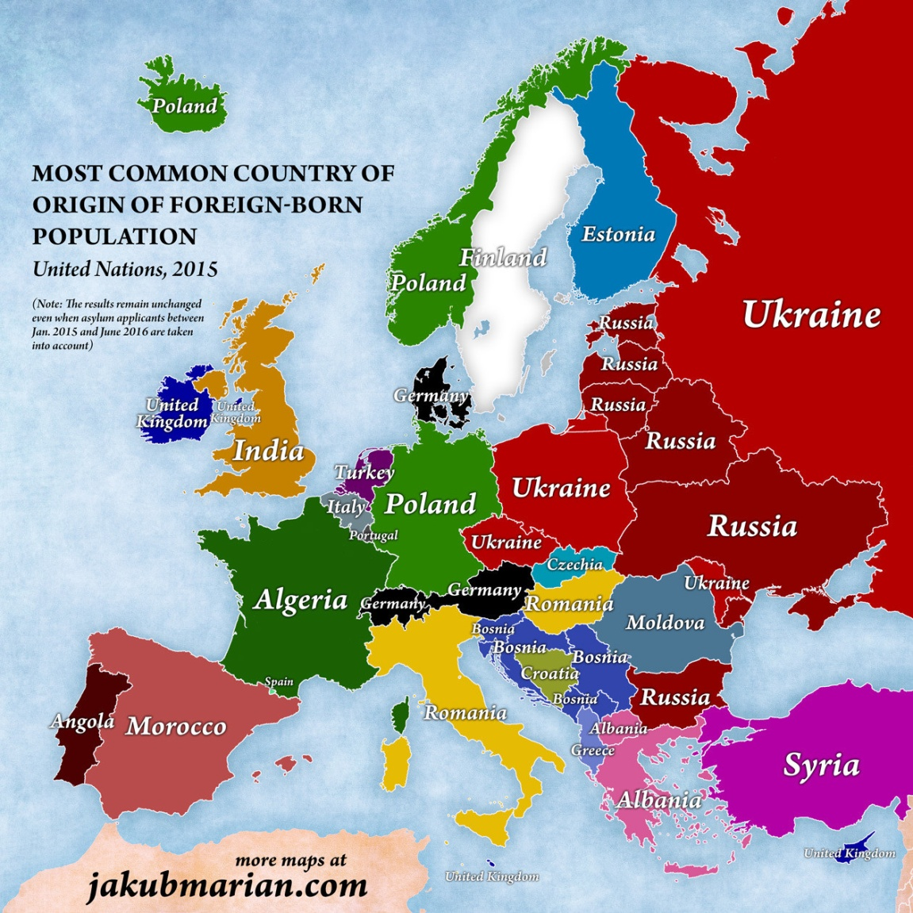
Most common country of origin

Slide 30
Immigration in Europe – following Trump?
US has 3.2 Million Muslims and since 1990 takes in 1 million migrants every year.
Europe a net exporter of migrants between 1820 and 1914. 50 million migrated from Europe going to the US, Canada and South America.
An importer after its colonies are lost. Guest workers since 1970 for those who did not have colonies.
Migration from the Middle East to Europe down 80% (up 20% from North Africa) thanks to closure of the West Balkan route and the deal with Turkey.
Germany took in 890,000 in 2015 and 280,000 in 2016.
Germany – 2016 – 55,000 refugees return voluntarily back to Balkans, 25,000 deported.
Sweden and Norway – tougher controls – immigration well down – 90% in Norway.
Hostility to Muslims not helped by Erdogan comments. However Europe exports more terrorists than it imports.
Nearly all European polls overestimate the number of Muslims living there (France by a factor of 4).
Europe needs migration to compensate for demographic decline.

Slide 31
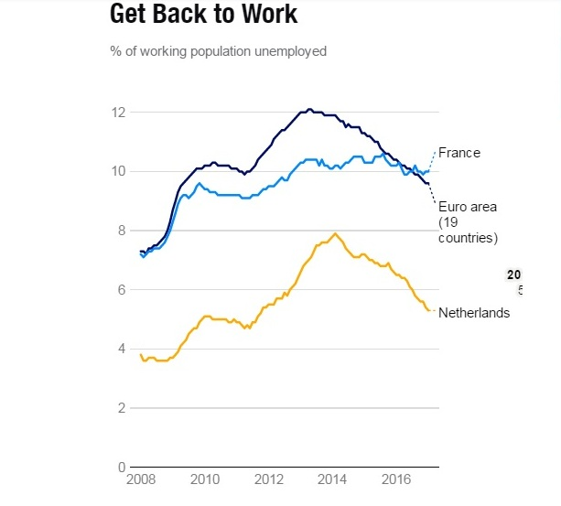
Other elections in Europe
Holland - Dutch election where far right, anti immigrant party of Geert WIlders runs a distant second a return to normal for Europe? Dutch parliament fragmented but united against Wilders.
Populism in decline as unemployment drops across the Eurozone?
The candidate for Germany's Social Democrats to challenge Angela Merkel, Martin Schulz, has vowed to fight populism if his party wins the elections due in September.
Trump turning them off? Fewer than 1 in 4 voters in Germany, France and the Netherlands want closer E.U.-U.S. ties

Slide 32
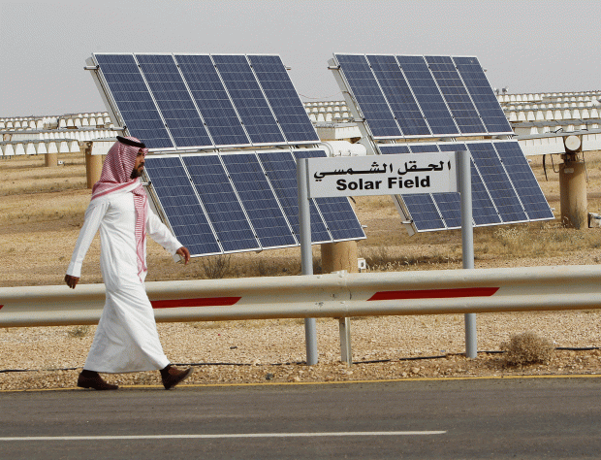
Saudi Arabia update

Slide 33
And the Saudi Vision 2030
King Salman concluded a six week Asian tour spanning China, Japan, Indonesia, Brunei, and Malaysia, while his son, Deputy Crown Prince Mohammed bin Salman met with President Donald Trump. Both trips aimed to drum up investment for the Kingdom’s, Vision 2030.
China and Japan, the world’s second and third largest economies, are in the top five export markets for Saudi Arabia, and the Saudis are the largest supplier of petroleum imports for both countries.
In China, $65 billion worth of joint ventures between Chinese and Saudi firms in sectors ranging from energy to renewables to space.
Ventures with Indonesia and Malaysia.
the Saudis cast a wide net to capture as much foreign investment and diversified revenue as possible.
Saudis spend $24 billion (AUD) on shopping and travel overseas every year.
Saudi leaders have to lead by example. Bureaucracies can they cope?
This is a country where people have always lived with cheap petrol, without taxes, and free water and electricity.

Slide 34
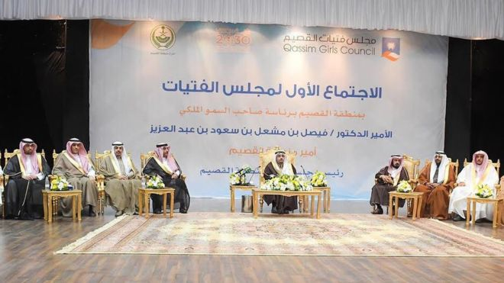
But they still have a long way to go

Slide 35
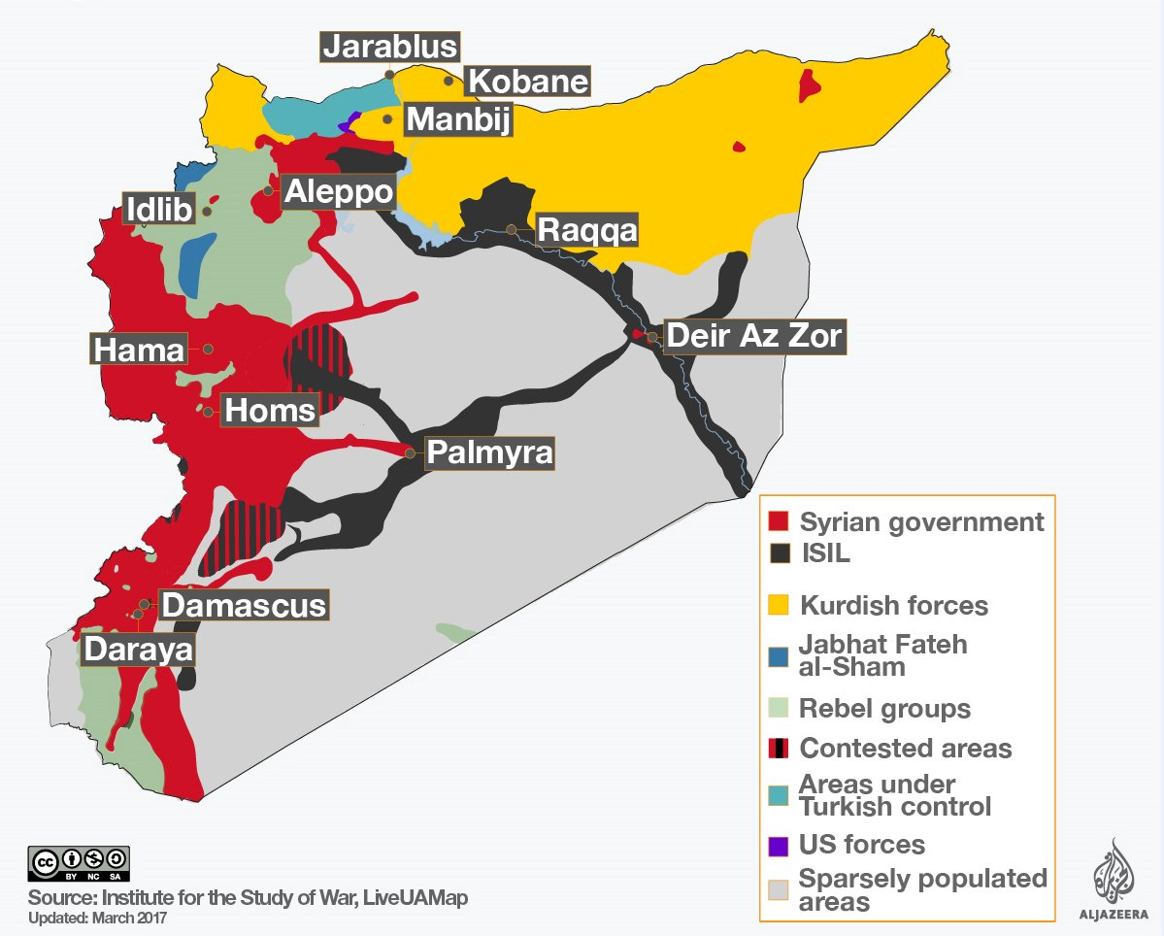
Syria – how it spread (from the NYT)

Slide 36
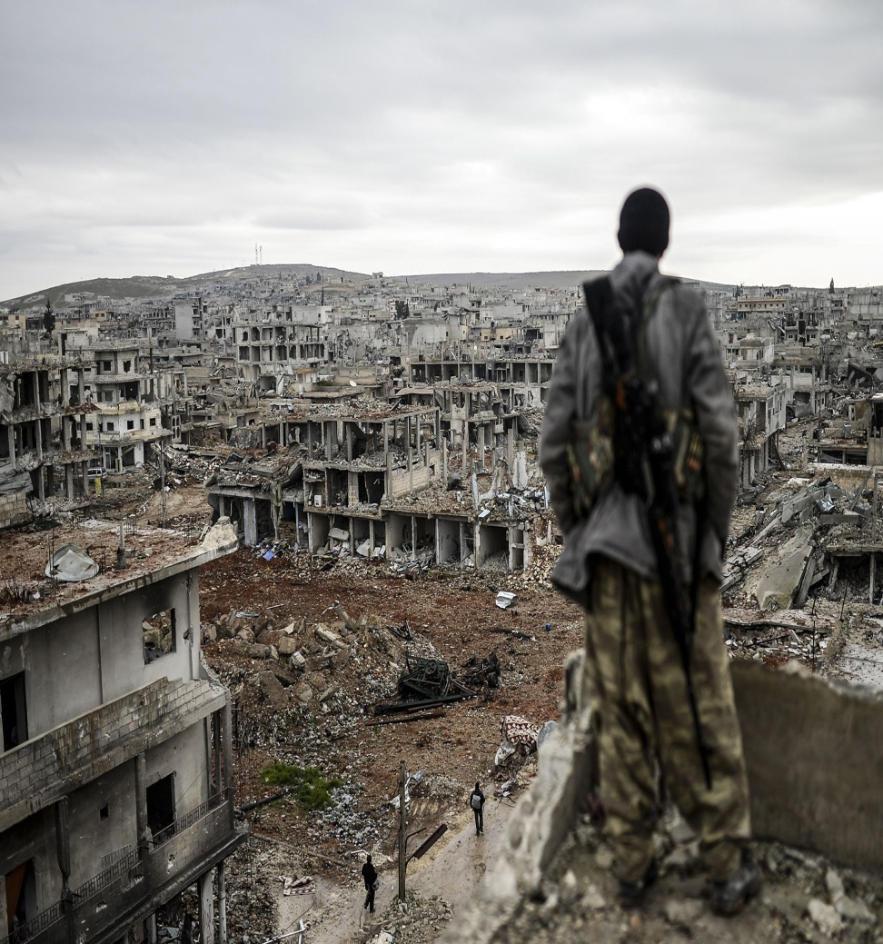
The Syrian conflict
In its 7th year. Started in 2011 with crackdown against pro Arab spring supporters.
Led to sieges, barrel bombs, starvation, bombing of civilian areas, attacks on hospitals, doctors etc.
465,000 killed. Over 6 – 12 million internally displaced.
Many left in besieged towns without access to help.
5 million have fled to neighbouring countries and some on to Europe.
External input - Israel bombs Hezbollah ammo dump?

Slide 37
Syria – the consequences
Conflict spreads – no longer Muslim killing Muslim left to burn out by itself.
For Europe it has meant ;
the growth of the right ( Le Pen supports Assad)
Threatened cohesion of the EU (Brexit a partial result)
Loss of faith in core EU values –borderless movement and pluralism.
Anxiety over identity and cultural values.
Conflict with Turkey (or at least Erdogan)
For Russia
A Sunni backlash? Growing unpopularity at home – Uzbek and St Petersburg incident. If Syria collapses will it become a haven for Islamic State?
The World – Global division, paralysis of the Security Council because the US and Russia back opposing sides. Lack of consensus or any plan. Is Trump interested in solving this? The end of “the responsibility to protect” started in Kosovo.

Slide 38
If you have the time - watch this summary
http://www.aljazeera.com/news/2016/05/syria-civil-war-explained-160505084119966.html

Slide 39
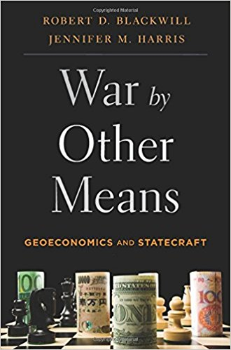
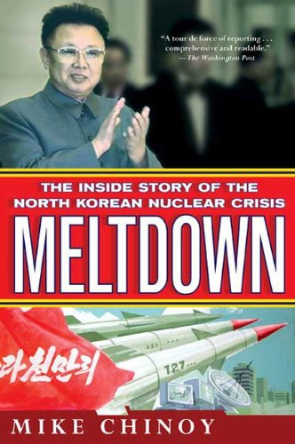
New books

